Slide 1


AI Industry Hub Scale up easy
Accenture Data & AI Intelligent Consulting Hub
Generated by Midjourney

Slide 2













































Drive Gen AI and OWN the client's agenda around datA
AI Industry Hub | Part of ICH
Jean-Marc Ollangier
KEY SCALING ENABLERS
Intelligent Consulting Hub 2000+ functional and industy experts
+25% expected HC increase in FY24
ICH
100+
Industry-relevant proofs-of-work
600+ AI Consultants in nearshore /offshore locations
10 000+
Hours delivered monthly
5+
Languages spoken
DATA & AI
KEY CLIENTS GEN AI implementations
100+ experts in eliciting insights from data.
AI Industry Hub
Key tools & skills
Gen AI technologies
Function
Industry
PaLM2

Slide 3
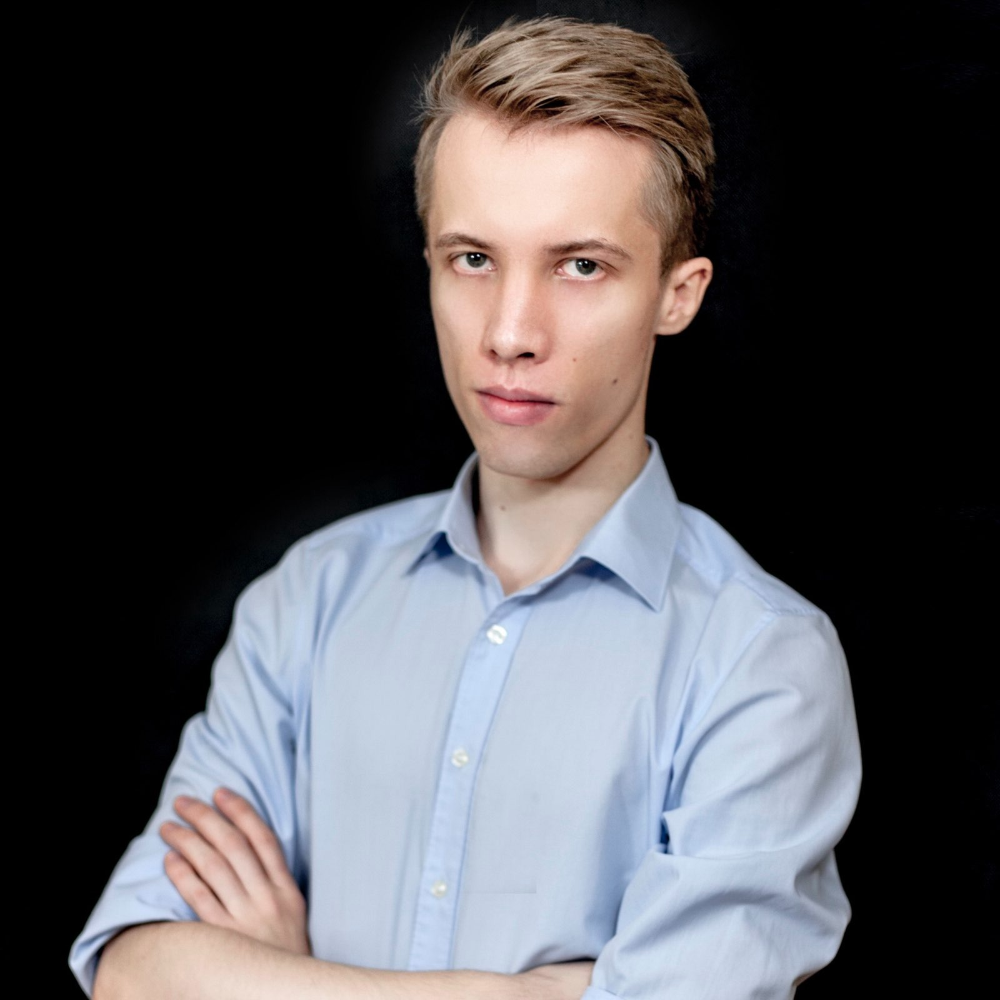
Michał Antczak
Consultant, Data Science
Major Financial Institution – Data Science Consultant
Overseeing process for regular creation of production data for fraud detection. Conducting testing and validation of production code after migration (Python, SQL). Gathering requirements for a design of an automated dashboard design for data analytics.
Major Telecommunication Company - Data Science / Data Engineering Senior Specialist
Constructing segmentation models for marketing campaigns – from creating data pipelines combining data from different infrastructures (SQL and Hadoop/Hive) to creation of final models, for the purpose of aiding marketing decisions.
Major Finance Institution - Data Science Specialist
R&D of a new big data infrastructure: exploring and benchmarking a variety of ML tools, frameworks, methods and algorithms to evaluate their usability and business potential. Development of the new infrastructure – transformation from the previous single-server based infrastructure, to the big data infrastructure; Participating in big data infrastructure procurement process and decisions as a technology specialist; Building risk management models, mostly focused on credit risk assessment with ML methods (R, Python, SAS); Gathering requirements and then creating monitoring tools to evaluate model performance in time (PowerBI, Shiny); Conducting performance optimization tasks for existing toolkits; Handling PoC projects (examples: h2o.ai, MicrosoftML); creating comparative analyses between new potential algorithms and already existing ones; Supervising production of critical level databases for the organization.
International Business Consulting Company – Collection/Vendor Query Specialist
Handling of the corporate collection process for multiple regions across Europe and Central Asia; Leading conference calls and meetings with regional sales managers;
SGH Warsaw School of Economics, Master’s in Data Analysis - Big Data
University of Lodz, Bachelor’s in Finance and Accounting
Michał is a Data Scientist/ Data Engineer with professional experience within finance and telecom industries, with focus on the big picture and being the communicator between the technology and business.
Languages: Python, R, SQL, SAS
Databases: MSSQL, OracleSQL, Hive/Hadoop
Big data and cloud frameworks/ platforms: Spark, AWS (EC2, RDS, S3)
Other: PowerBI Docker
Telecom
Banking
English Polish German
Notes:
michal.antczak

Slide 4
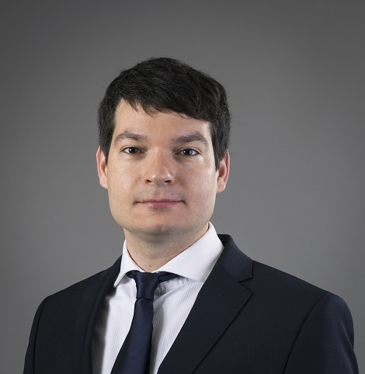
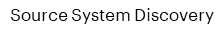
Peter Benak
Senior Manager, Data Analytics & Visualization
CEE Automotive company – Products manager (program level)
As a Program level member – having responsibility for 4 analytical products processing data, reporting, recommendation engine & web personalization.
Responsible for analysis of Epics coming from Portfolio level together with Epic owner, its split into impacted products & creating feature backlog for them.
Facilitating PI planning ceremonies (features prioritization, commitments, creation of objective, dependencies identification & resolution, etc…)
Responsible for Program performance measurement – measuring business impact of each Product increment cycle and reporting to head of departments.
CEE Automotive company - Lead-2-Sales project
Project aimed to measure Lead to sales funnel across markets and propose improvements in the funnel.
As a Technical member of a team, responsible for defining data request to get data from market CRMs, design dashboard & KPIs to visualize it.
CEE Automotive company - Data driven Aftersales use cases - Business and Functional Design
Client aimed to monetize Car & Customer data in Aftersales area.
Project's scope was to create business & functional design including business case for prioritized data driven use cases, including – identifying business potential,
In the role of delivery lead Peter lead team of 5 people to:
identify business potential across Skoda and daughter companies in abovementioned UC
define business and functional requirements
created residual value/ buy back calculation using car telematics & service data history
calculated business case for each use case
Banking sector – CEE, French, Italian & UK banks - Project/ program manager
Various Project manager / stream lead roles for French, Italian and UK banking groups
IT project manager role responsible for project preparation & execution of evolution of core banking system.
Data business migration lead in Core banking system migration program
Program management of Customer experience related projects enhancing B2C Customer journey
Comenius university in Bratislava, Slovakia – Faculty of mathematics, physics & informatics – specialization Economical & managerial mathematics.
Experienced management consulting professional having over 13 years of experience at Accenture in business & technology consulting.
8+ year experience in Delivery lead roles with focus on Data IT delivery, Data monetization projects covering E2E lifecycle.
Experienced in both waterfall & Agile methodologies
Lean Six Sigma Green belt certified
Leading SAFe & Agile fundamentals certified
Business ideation & use case design, business case build
Knowledge of data analytical tools & solutions:
BI reporting tools
Big data solutions (Google, Teradata, Azure based, AWS)
Automotive
Banking
Telco
Energy
English, Slovak, Czech, French
Notes:
Peter.benak

Slide 5
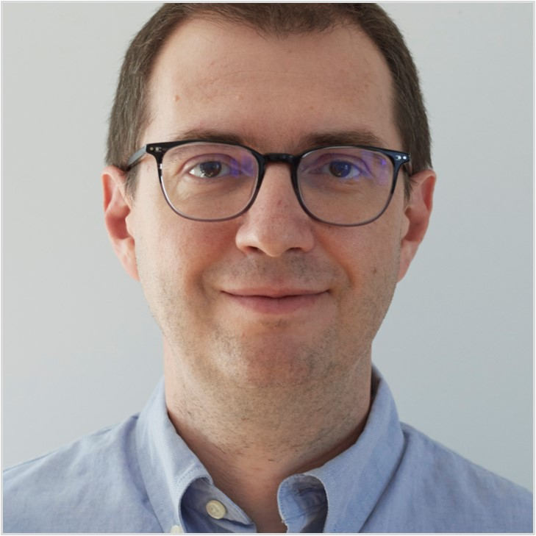
Jerzy Błaszczyński, Ph.D.
Consultant, Data Science
Global FMCG company
Development of internal MLOps Python libraries (multi-cloud AI accellerators). Technologies used: multiple cloud environments (Azure, GCP, AWS) and Databricks platform as well as CI/CD (GitHub Actions, Docker, PyTest, Great Expectations), and ML-related tools (e.g., MLflow, Kubeflow).
Germany-based international Retailer
Development of ML project focused on demand forecasting for products in stores around Christmas on Databricks platform. Enhancement of the logic and consideration of feedback from end users (store planners). Review of forecasting methods (Python, FB Prophet, MLflow) aimed at optimization of calculations. Delivery of many data analyses (e.g., outlier analysis, comparing forecasts coming from different experiments). Daily cooperation with data scientists in the stream. Development of the logic for handling multiple opening scenarios using forecasts from one model per region.
Global technology company that powers travel industry - Machine Learning Engineer
Development of predictive models for demand forecasting and recommendations on GCP.
Global health information technology and clinical research provider - Senior Data Scientist
Development of machine learning models and econometric models for projects executed by Data Science and Advanced Analytics team. Leading supercomputing and networking center - Machine Learning Engineer
Applications of ML techniques related to detection of anomalies, predictive maintenance, preference learning, recommender systems, as well as image segmentation and classification. Predicting and preventing incidents and potential failures with anomaly detection techniques. Supporting human workers in planning services and repairs. Detection of anomalous behaviour and prediction of energy consumption and heat generation in data center; electric energy consumption in buildings. / Technologies used: Python, scikit-learn, TensorFlow, Keras, MLflow, Apache Spark. Construction of ranking (ordinal classification) of security alerts used by computer security incident response team’s (CSIRT). Ordinal classification by models implemented in ruleLearn library (co-authored). / Technologies used: Java, spring, GitHub, Gradle, JitPack, Docker, Liquibase. Detection of network traffic anomalies and DDoS in the center’s network using various machine learning approaches including deep learning with adversarial examples. / Technologies used: Python, scikit-learn, TensorFlow, Keras, Apache Spark, Docker.
Polish technical research institute – Research Assistant / Assistant Professor
Research within the Laboratory of Intelligent Decision Support Systems: Preference Learning and Multicriteria Decision Analysis, Machine Learning, Artificial Intelligence in Medicine, Granular and Soft Computing, Decision Support, Data Mining and Knowledge Discovery. Teaching activities: Decision Support Systems, Data Analysis and Statistics.
IT Company - Software Developer
PHP and SQL programming, GUI design, database design, requirements engineering.
Ph.D. in Computer Science – Artificial Intelligence (with honours) – Poznan University of Technology, Poland
M.Sc. in Computer Science – Poznan University of Technology, Poland / Universite Paris Dauphine, France
Jerzy is a researcher with over 15 years of experience in data analysis, construction and application of predictive models in wide set of domains including medicine, chemistry, economics, security, and networks. He is also an engineer with expertise in design and implementation of various parts of software projects using different frameworks. He has a thorough understanding of methods of data analysis from both theoretical point of view, as well as effective application. He tends to prefer interpretable models. He has strong skills in technical analysis and design of software.
machine learning, anomaly detection, learning from imbalanced data, preference learning, ensemble models
data analysis & support, multicriteria decision analysis,
scikit-learn, TensorFlow, Keras, VertexAI, Apache Spark
Python, Java, SQL, R, MLflow, Docker, PostgreSQL, Liquibase, Spring, Gradle, git, JitPack
Cloud, GCP / MLOps (Git, Github, Mlflow, Kubeflow, Docker)
Life Science
Pharma
Medicine
Chemistry
Security
English Polish French
Notes:
jerzy.blaszczynski

Slide 6
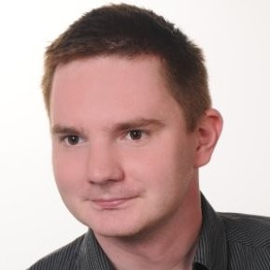
Marek Błażewicz, Ph.D.
Associate Manager, Data Science
Multinational Healthcare Company –
R developer/Senior Data Scientist
Project NEST, part of Insight Engineering: tools for statistical analysis in clinical research: development and maintenance; development of R packages, analysis of sales and promotional data, development of modelling pipelines (R/Python), mostly Bayesian framework, time series analysis; managing small team of Data Scientists.
American advertising company – Senior Data Scientist
Development of methodology and statistical software (R/Python), particularly in the field of Market Mix Modelling (MMM); campaign outcome forecast and budget allocation; market insight and segmentation, Multi-Touch Attribution; applying Bayesian methodology (MCMC); methodological and technical support, ad-hoc MMM for different clients
Global Marketing Agency - Data Scientist
Methodology development: marketing data analysis (TV, online); lookalike modelling and segmentation, machine learning and deep learning methods, working with GCP.
International Market Research Company – Data Scientist
Modelling based on internet traffic data; working with survey and panel data; development of machine learning solutions based on media and demographic data; support for other branches and teams abroad.
Interdisciplinary Centre for Mathematical and Computational Modelling, Top Polish University
Preparing the quantitative part of the project (survey among entrepreneurs); job market analysis; analysis of own and existing data; preparing reports and publications, data visualizations and graphics; preparing materials for online courses; speeches during seminars.
Real Estate Research Institute
Real estate market analytics
Ph.D. in Social Psychology – Institute for Social Studies – University of Warsaw, Poland
M.Sc. in Psychology, specialized it psychometrics – University of Warsaw, Poland
B. Sc. In Mathematics – Cardinal Stefa Wyszyński University in Warsaw, Poland
Marek is a Data Scientist with 10 years of professional experience across projects in various industries. He has experience in marketing mix modelling, segmentation, sales and promotion data analytics and market research.
Marketing Mix Modelling, sales & promotion data analytics
Data science, statistics & data analytics, machine learning, Bayesian data analysis
R, tidyverse, caret, rshiny, rmarkdown, rstan
Python, pandas, numpy, sklearn, pystan, Prophet
SQL, Snowflake, various database systems
Github, Gitlab, Jira
Google Cloud Platform, AWS
Real estate
Job market
Healthcare
Market Research
Marketing
English Polish
Notes:
marek.blazewicz

Slide 7
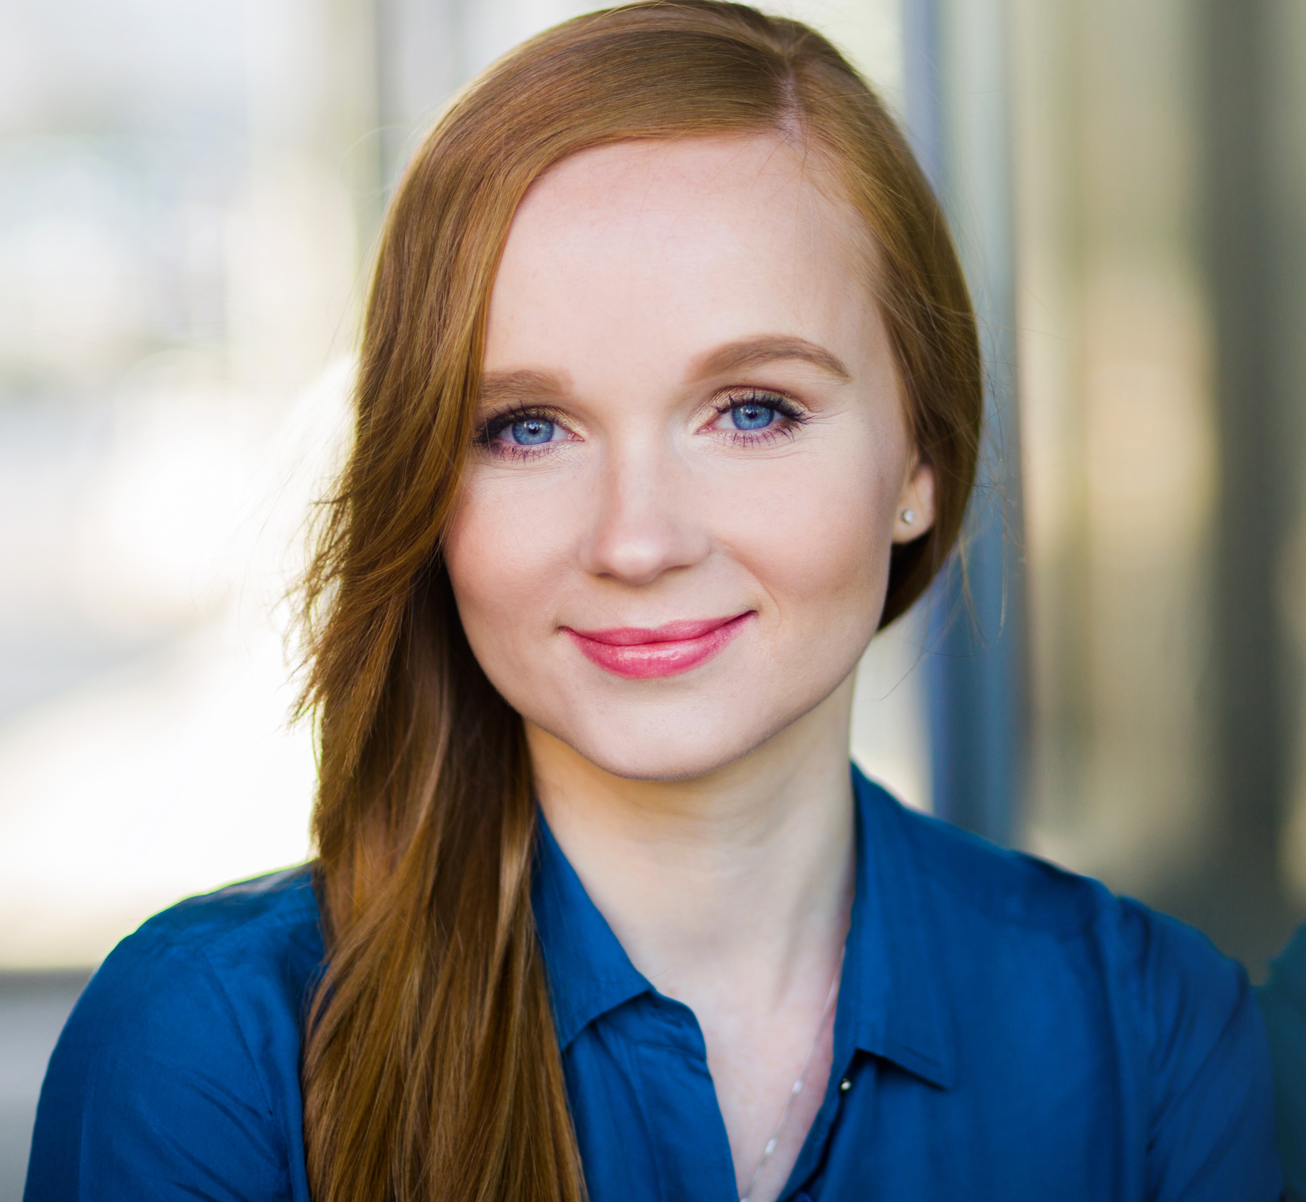
Joanna Biolik
Senior Manager, Data Science
International Retailer – Senior Data Scientist & Team Lead
Leading data science Accenture team cooperating closely with the Client on various analytical and modelling topics, among others: pricing optimization, supply chain analytics, international testing guidelines, fraud detection, market basket analysis, assortment optimization. Driving an initiative of implementing a data science architecture allowing for machine learning solutions industrialization. Technologies: Azure, Databricks, Python, PySpark, R, SQL.
International Cruise Line – Project Lead
Leading analytical team designing solution for casino offers assignments using SAS Viya and SAS Intelligent Decisioning. The solution involved casino and brand reservation data analytics in order to apply optimal decisioning.
Global Digital Media Agency – Client Performance Director
Managing team of around 20 consultants and project managers servicing the company's biggest clients in digital advertising area (mainly performance marketing) Building relationship with key clients and supporting the team in formulating and solving clients' business problems.
Top Tier UK Bank – Lead Data Analyst
Leading team of analysts implementing a new Anti-Money Laundering strategic solution. Customer and transaction data analytics.
Leading European Bank – Lead Business Analyst
Leading team of business analysts delivering a regulatory reporting program. Development of big data analytics and reporting approach towards unique undertaking in the investment banking industry – a central trades repository. Trade data analytics, business reporting and visualization.
Major Polish Bank – Customer Analyst
Customer insights generation and visualization. Mass-market customer micro-segmentation and profiling. Propensity modeling - customer scoring for cash loan campaign design, monitoring and evaluation.
Global Market Research Company – Research Manager
Managing various research projects for the biggest brands of FMCG, Banking, Automotive, Telco and Pharmaceutical markets. Client service, building relations with clients, delivering results presentations, preparing offers and deal negotiations. Quantitative research design and analytics in usage & attitude and pricing areas.
Warsaw School of Economics, MA in Quantitative Methods in Economics and Information Systems
Joanna is a business-oriented data science senior manager focused on developing retail analytics practice in Poland. Over the past 10 years she has worked with clients across many industries and managed various analytical teams, including international ones.
Retail Analytics
Data Modeling, Statistical Analysis
Data reporting and visualization
Digital Marketing Analytics
Azure (AZ-900 Certification), Databricks, Python, PySpark, SAS, SQL
Teams, projects and stakeholders’ management
Retail
FMCG
Banking
Automotive
Teleco
Pharma
E-commerce
Polish English Spanish German
Notes:
joanna.biolik

Slide 8
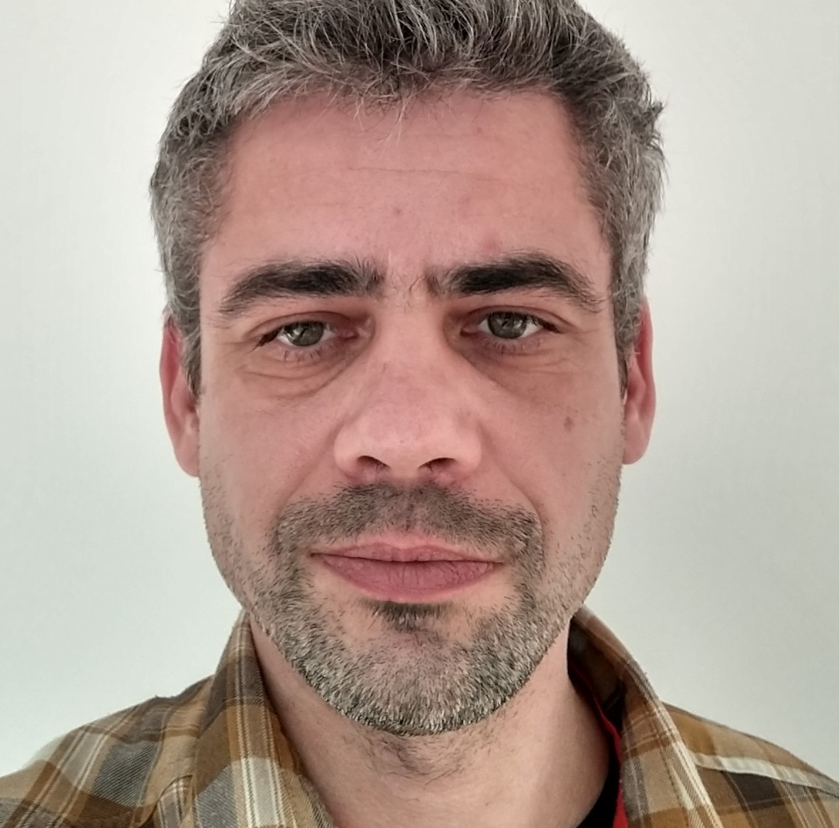
Tomasz Boguszewski, Ph.D.
Consultant, Data Science
Consulting – Data Scientist
Developing and operationalization of models for support information system based on NLP.
FMCG – Watson developer
Developing Intelligent Email Assistant in IBM Watson based on Natural Language Understanding module.
International Marketing Company - Data Science Team Leader
Leading data science and data engineering team. Support customer service in web analytics and marketing campaign.
Collecting customer requirements, providing proposal solution, implementing analysis and deliver insights.
Major Global AGD and RTV Company - Data Scientist Project Leader
Leading analytics team dedicated for supporting launch of voice assistant (Bixby) in Europe. Support of European teams in custom data analysis, coordinating project, gathering requests from stakeholders. Reporting demanded system analysis and recommendation to local developer teams in Europe and Korean Headquarters. Presenting results during multinational meetings across Europe.
Anomaly detection, churn, usage and system performance analysis.
Working in Agile methodology based on Jira and Confluence tools.
Major Aviation Company - Data Scientist
Working as part of gas turbine Life Cycle Management team. Data analysis for condition-based maintenance of gas turbine and locomotive. Proposing maintenance optimization based on various source of data and according to requirements. Performing process optimization according to Six Sigma approach.
Analysis of gas turbines parts failure based on whether data.
Providing failure root cause analysis based on operation data, anomaly detection, predictive and risk modeling for gas turbine. Process automation for data collecting and measurement results for gas turbine blades.
Academic Experience
Numerical modeling for Wendelstein 7-X stellarator project. Design structure and heat transfer analysis of composite materials.
University of Warsaw, Post-grad in economic
Warsaw University of Technology, PhD in composite material engineering
Warsaw University of Technology, M.Sc. in aeronautical engineering
Tomasz is a Data Scientist with 10 years of professional experience in data preparation, analysis and team management. He find easily common language with both business and technical partners. He also has PhD degree in material science.
Data analysis: visualization, supervised / unsupervised learning, anomaly detection, predictive analysis, survival analysis, text mining, attribution, churn, DOE
Technical: Jira, Confluence, Python, Jupyter, R, SQL, GCP, Fortran, JMP
Certificate: Google Cloud Certified - Associate Cloud Engineer, Azure AI Fundamentals
Engineering
Marketing
AGD/RTV
Energy
Polish English
Notes:
tomasz.boguszewski

Slide 9

Karol Chrzastek
Consultant, Data Engineer
Major banking group in UK – Data Engineer
Worked remotely in an Agile framework with a team located entirely in the United Kingdom. Maintained, modified and implemented multiple business processes in SQL and Python. Used AWS Athena, Hadoop and Snowflake to analyse and modify data, run scripts. Interacted with stakeholders to understand requirements and develop ETL processes.
American tabaco company – Data Engineer
Implemented custom business logic in Python including backups, restore processes. Deployed as shell jobs in AWS Glue. Configured stack resources, policies and security roles using YAML for AWS CloudFormation to facilitate deployment. Implemented integration tests for multiple components of the system. Contributed various functionality to a common library. Monitored logs of processes using SQL queries on AWS Athena and Snowflake. Interacted with clients to provision resources and fix problems with the platform. Onboarded an external team designated to provide monitoring over a certain part of the system.
Major banking holding in UK – Data Engineer
Analysed various financial data of corporations to identify predictive indicators of bankruptcy. Participated in meetings with teams located in Hong Kong and New York to receive guidance and feedback on the project.
SGH Warsaw School of Economics, Master degree, Finance
UJ Jagiellonian University, Bachelor degree, Mathematics and Computer Science
Karol is an experienced Data Engineer with over 3 years of professional experience in data management projects in fields such as banking and FMCG.
His main area of focus is designing and implementing modern data pipelines for data transformation and cloud scaling analytical solutions.
Python, SQL, Java, C/C++, Spark
AWS – Lambda, Glue, CodePipeline, Athena, S3, CloudFormation, SQS, IAM, Redshift
Snowflake, PostgreSQL, MongoDB, Oracle, Microsoft SQL Server
Apache - Hadoop, Airflow, Hive
Pandas, NumPy, React, Node.js
IntelliJ, Git, Visual Studio
Banking
FMCG
Polish English
Notes:
karol.chrzastek

Slide 10
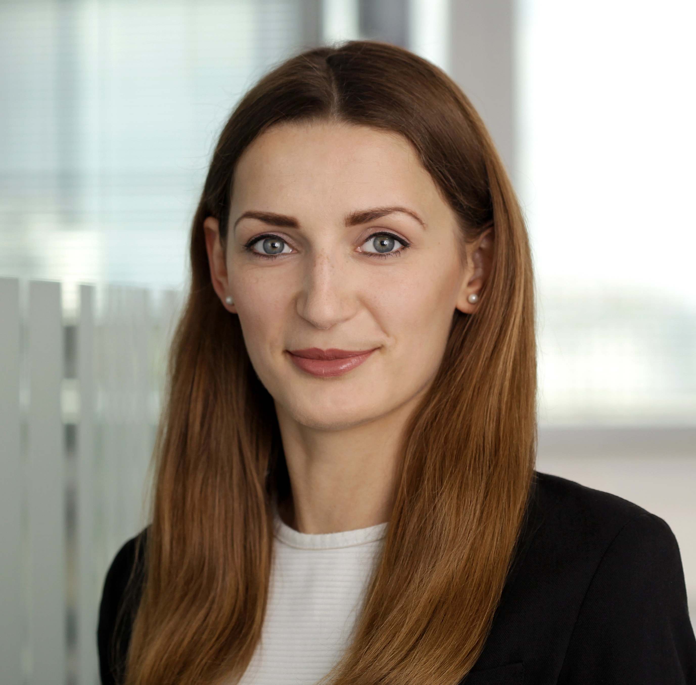
Kaja Cieślukowska
Manager, Customer Analytics
German Insurance Company
Design and implement new Marketing Campaigns Environment - Designing campaign data model, configure environment and on-Premise - Cloud connection. Integration with contact channels. Customer Journeys implementation (SAS CI360, SAS 4GL). Support and enabling Client to work on the environment.
Polish Petrol Retailer
Design and implement new Marketing Campaigns Environment - Designing campaign data model and integration with contact channels (SAS 4GL, Java, REST API). Contact channel integration and content personalization implementation (SAS CI, Oracle). Implementation of marketing campaigns, contact rules logic and control groups selection.
Large Polish Bank
Improvement of Marketing Campaigns Environment – Support in designing new Contact Policy approach. Designing and optimization of Real-Time Campaigns environment architecture with Complex Event Processing integration. Developing and testing Real-Time Campaigns (SAS CI – RTDM, MA).
Major Polish Communications Company
Next Best Action - Managing customer profile data - preparation of business requirements, development and analytical support during building Data Mart which contains detailed information about clients (Teradata and Oracle SQL). Design and development of precalculated Next Best Offer recommendations for entire client base in multiple contact channels (SAS CI – Marketing Automation). Event Based Campaigns - Development of solution that enables client to response quickly and automatically to different kinds of customer’s behavior through different communication channels (Oracle SQL, SAS EG, SAS CI). Creating custom nodes which enable personalized integration with various contact channels (4GL). Creating scripts that monitor the quality of data. Analysing and developing new events in Complex Event Processing environment. Marketing Automation - Migration of entire B2C and B2B campaign system to SAS CI - gathering requirements for campaign briefs, verifying data completeness, arranging necessary expansion of data mart, environmental optimization and final implementation of campaigns. Conducting trainings for future SAS CI users at the client site. Team leading – managing and coordinating work of the team (planning and delegating tasks, monitoring work progress, identifying risks, helping with troublesome tasks) in B2B part of migration. VoiceBot - Business requirements analysis, project's cost estimating, preparing data for an AI Voicebot (Oracle SQL, SAS EG).
University of Warsaw, Computer Science and Econometrics, MA
University of Warsaw, Mathematics, BSc
Kaja has over 7 years of experience in Customer Analytics, mostly in communications industry. She went through different roles on a complex NBA project and combines data mining knowledge with business skills. She has experience in data processing, data analysis and marketing automation.
SAS CI360
Customer Intelligence, Campaign Management, Marketing Automation, Real-Time Decision Manager
Complex Event Processing
Data analytics, statistical modelling, data mining, econometrics
Statistical programming tools: SAS (4GL, EM, MC), R, STATA
Oracle SQL, Teradata SQL
Insurance
Banking
Telecommuni-cations
Polish English
Notes:
kaja.cieslukowska

Slide 11
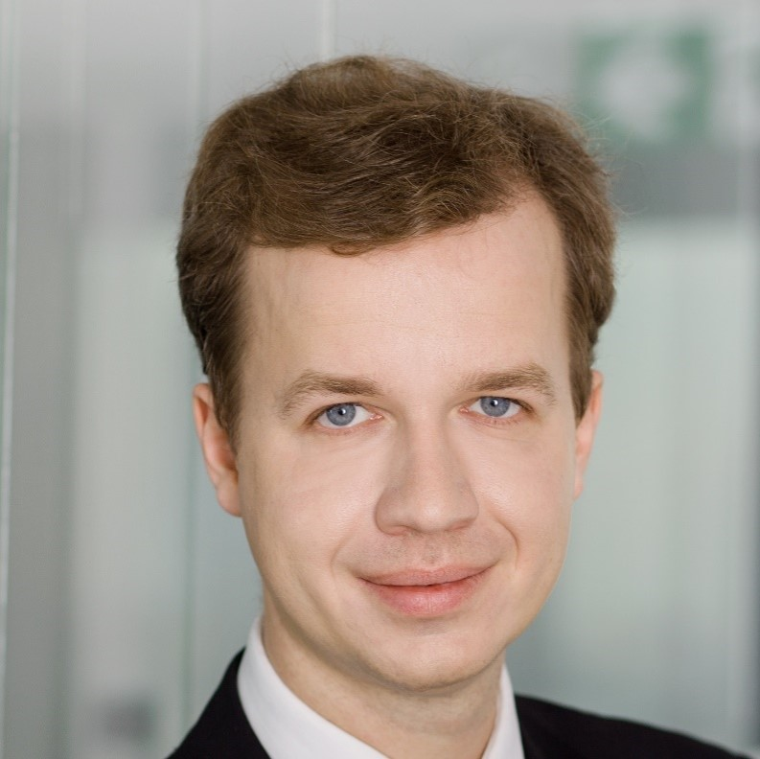
Piotr Czetwertyński
Data & AI Value Strategy Senior Manager
Leading German Insurance Company - SAS Campaign management architect
Designing and overseeing new installation for full SAS Campaign Management stack (cloud and on-prem).
Leading Polish Bank - SAS Campaign management architect
Analysing existing system implementation and designing and delivering improvements.
Leading Brazilian Telecom - Analytics strategy manager
Advisory project planning analytics and campaign management organization transformation (with SAS)
International Home Appliances - Analytics portfolio manager
Responsible for overseeing of multiple analytics use cases developed by joint Accenture-client team
Leading Polish Telecommunication Company - Big data architect
Responsible for design of Customer Data Hub data model and architecture on Hortonworks cluster.
Polish Telecommunication Company - Real-time campaign business processes stream lead
Responsible for delivery of recommendations of campaign process modifications for SAS Campaign tools.
International Tobacco Company - BI project architect and lead
Design of BI solution in service desk area.
International Automotive Parts Company - Analytics strategy manager & delivery lead on Analytics Strategy project
Responsible for overall project delivery, including as-is assessment, design of target state and roadmap creation.
International Pharma Company - Analytics delivery lead on Customer Analytics POC project
Responsible for development of NBA algorithm in SAS technology, look alike model design and implementation. Behavioural patterns recognition algorithm and Customer Analytical Record design & implementation
International Oil Company - Analytics strategy manager on Analytics Strategy project
Main responsibility was to review current state of analytics and BI in the company and best available market Solutions
Polish Telecommunication Company - Segment Manager
Responsible for campaign management (budgeting, roadmaps, processes, scripts), Purchasing client databases from market, targeting and base generation (SAS and SQL), analyses of campaign results, management of churn prediction model, Value At Risk and Next Product to Buy models.
University of Warsaw: Master Degree in Sociology
University of Warsaw: Bachelor Degree in Computer Science
Piotr has over 12 years experience in campaign management, designing and applying analytical solutions, for large clients on Polish and international market.
He is feeling extremely well in roles where he can apply his business and analytics capabilities at the same time.
Campaign Management
System & data architecture
Customer Analytics
Data manipulation
Analytics Strategy/Advisory
Big data
Segmentations
NBA
Project & team management
Insurance
Telecommu-nication
Oil & gas
Pharmaceuti-cals
Polish English Swedish German
Notes:
piotr.czetwertynski

Slide 12
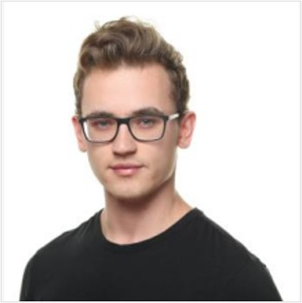
Rafał Daniszewski
Consultant, Data Science
Insurance Company – Data Analyst
He took part in designing and creating new reporting environment in PowerBI for british insurance company. During this project he worked on ensuring high Data Quality standards across the company and delivering value to business users. He implemented data profiling and DQ checks for exisitng datasets in Python to ensure high quality reporting.
Insurance Company - Developer
He worked on ETL tasks in agile environment. Focus on IFRS standards and implementation. He designed, developed and integrated new tables and data streams in SAS DI Studio, SAS Process Manager. Worked both with DB2 and Oracle databases.
Marketing Company
He participated in preparing strategies in digital marketing for the clients and issued recommendations for Account Managers regarding campaigns and optimization activities. Responsible for analyzing the data and presenting the impact of the actions to the team. Preparation of interactive dashboards using Google Data Studio for ongoing online marketing campaigns.
Consulting Company - Intern in Digital Strategy team
Worked on international banking project designing the scope of data collection and reporting. Developed automated data processing and reporting tool in Python.
Spanish Bank - Intern in Centre-Chapter Data Analysis and Reporting
Worked on maintenance of database and ad-hoc reports for other teams. Worked with Teradata and SAS Enterprise Guide.
Quantitative Methods in Economy and Information Systems, Warsaw School of Economics
Data Analysis – Big Data | Warsaw School of Economics in Warsaw
Ambitious analyst, with experience at Finance, IT and Marketing industry.
Interested in Big Data, marketing and role of data analytics in designing and improving business processes.
Quick learner, focused on goals and results.
Python (DE&ML libraries)
Data analysis and data manipulation in Python
Azure Data Scientist Associate certificate, Azure Data Engineer Associate (in progress)
Advanced SQL
Designing and implementing ETL processes.
Reporting and visualization of marketing activities. Google’s analytical tools
SAS DI Studio, SAS EG
Attribution models and funnel analysis.
Git
IT
Finance
Marketing &
e-commerce
Polish English
Notes:
rafal.daniszewski

Slide 13

Szymon Drozd
Analyst, Data Science
Data Science Intern – Retail company
Leading a project of competition analysis. Gathering and understanding business requirements for the analysis. Collecting relevant data (including web scraping for external data). Conducting EDA, feature engineering and creating ML models for conversion prediction using Databricks with focus on interpretability for business owners.
Business analyst – Consulting company – Project for an Ecommerce company
Gathering business requirements for Salesforce solution implementation.
Business analyst – Consulting company – Project for a Telco services provider
Product catalog creation for the company. Analysis of competitors’ portfolio to define market standards. Benchmarking of offers of telco operators from different countries.
IE School of Science and Technology in Madrid, Business Analytics and Big Data, MSc
Richmond University – The American International University in London, Business Management, BSc
Szymon is an ambitious data scientist interested in generating business value using ML models. He delivered projects in Telco, Ecommerce and Retail industry.
Machine Learning and Statistics
Python (Pandas, Numpy, Matplotlib, Scikit-learn, Plotly, XGBoost)
Databricks
SQL
AWS
AWS Certified Cloud Practitioner
Azure
Retail
Ecommerce
Telco
English Polish
Notes:
szymon.drozd

Slide 14
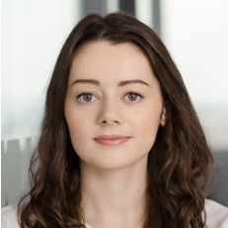
Anna Drożyńska
Senior Manager, Data Science
International Large Insurance Company – Product Owner
Leading implementation of Golden Record real-time solution based on AWS stack. Responsible for concept design, product management, delivery roadmap and execution.
British Insurance Company – Lab Lane Lead
Leading a Lab Lane delivering modernized Azure Data Platform, including development of Data Platform foundation and reporting use cases.
International Insurance Company – Data Strategy Architect
Definition of approach, scope and roadmap for post-merger data consolidation, to secure critical regulatory reporting (risk, finance) and continuation of key business processes.
North American Communications Services Provider - Delivery lead on CRM personalization engine project
Implementing personalized recommendations on ecommerce website and Mobile App.
Polish Insurance Company – Data Science Lead
Leading set of analytical initiatives, including build of Machine Learning real-time recommendation engine supporting claim settlement process (Python, Docker, Kubernetes, PostgreSQL). Building data products: Customer, Claim, Policy, Vehicle Analytical Records.
Polish Insurance Company - Analytics Lead on Data Driven Strategy project
Responsible for assessment of as-is analytics operating model, defining target state and creating roadmap of initiatives to achieve desired analytical maturity within 3 years.
Global Telecommunication Company – Data Science Lead
Design of approach, frameworks and data requirements for various data science use cases in GCP (including propensity modelling for B2B customers).
Major British Telecommunication Company - Data Scientist on Customer Analytics project
Designing and delivering a set of analytical solutions for B2B customers: Customer Analytical Record, churn and propensity to buy models.
Major Polish Bank - Modelling Next Best Action lead on CRM Transformation Program
Design of business concept for Next Best Action modelling solution, delivery of numerous propensity models (X-sell, Up-sell), model factory and model calibration process.
Major Polish Bank - Subject Matter Expert on CRM Transformation Program
Design and implementation of Real Time Marketing solution (including design of functional process, campaign development, design of RTDM Data Marts: CDM - Common Data Model, CMDM - Customer Marketing Data Mart).
University of Warsaw, Master in Economics, Computer Science and Econometrics
University of Groningen, Erasmus Student Exchange, Faculty of Business and Economics
Anna has over 10 years of professional experience in consulting, data science, machine learning and campaign management. Working on numerous programs of analytical and data-driven transformations, implementing recommendation engines, designing and developing Data and ML solutions. Experienced in delivering projects for Insurance, Banking and Telecommunication sectors.
Data Science, ML, Recommendation engines, Predictive Modelling
Business Analysis, Jira, Confluence, Azure DevOps
Customer and Claim Analytics
Data Driven Strategy
Customer Intelligence, Campaign Management, Real Time Marketing, NBA
Customer Analytical Record, Data Engineering
Azure, Databricks, Python, R, SQL, SAS Customer Intelligence, GCP (in training)
Insurance
Banking
Telecommunications
Polish English
Notes:
anna.drozynska

Slide 15
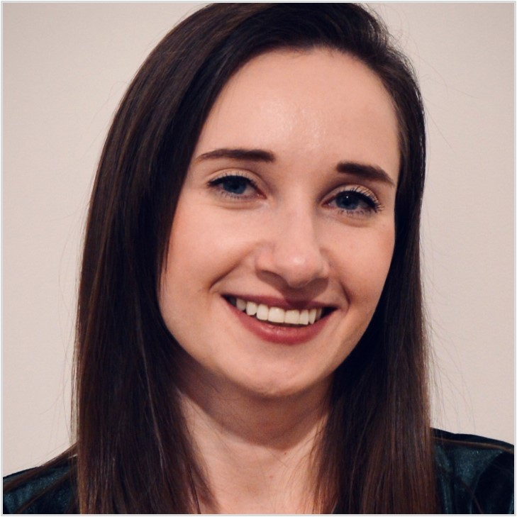
Małgorzata Fijałka
Associate Manager, Data Science
GenAI Lab – Data Scientist
Development of the Retrieval Augmented Generation Proofs of Concept. Collecting business requirements for business use case definition, design, prompt engineering and development of the application for document analysis with GPT LLMs.
International Retailer - Data Scientist
Supporting SCM and Forecasting area with analytics capabilities. Reporting various KPIs around sales, orders, availability, wastage and promotions. Analysis of Bank Holiday impact on sales. Analysis of weather forecast impact on sales forecasting. Forecast accuracy analysis and defining the root causes for inaccurate forecast.
Major German Bank - Data Analyst and Data Engineer
Performing Data Analysis, Data Engineering for AML solution together with designing Delta logic definition for the framework.
Insurance Company – Data Engineer
Designing, developing and testing ELT and ETL jobs for data processing and data management to meet business requirements and architecture principles. DWH business analysis, implementation of SAS DDS (Detailed Data Store) model for Insurance using SAS Data Integration Studio and DB2 SQL.
Global Developer of Analytics Software – Data Scientist
Fraud Detection System for internal frauds in Major Polish Insurer. Data sources detection and statistical analysis, design and code development of statistical detection algorithms, continuous cooperation with end users of the system – from collecting requirements to implementing, testing the solution and communication of business results.
Fraud Detection Platform for all Insurance Companies in Poland: project and statistical data analysis; data sources detection, project implementation with analytical methods as machine learning models: predictive classification models, segmentation models, fuzzy logic, business rules; analytical model management; development and maintenance of model performance reports; continuous cooperation with the clients – from collecting requirements to implementing, testing solution and communication of the results with business insight.
Development of classification models for real-time campaign management in banking: designing and developing datasets structures and classification models.
Global Developer of Analytics Software – Associate Analytical Consultant
Analytical detection of uninsured vehicles with classification models (logistic regressions, neural networks, decision trees, random forests, gradient boosting, ensemble models, scorecard models) in Polish Insurance Guarantee Fund. Designing Analytical Base Tables for campaign management.
Fraud Detection System in Major Polish Insurance: project and data analysis, project implementation with analytical methods as development of contextual text mining process, building classification models (logistic regressions, neural networks, decision trees, random forests, gradient boosting, ensemble models, scorecard models), optimization of business rules, ETL testing. Continuous cooperation with end users of the system – from collecting requirements to implementing, testing the solution and communication of business results based on analytical results.
Warsaw School of Economics, M.Sc in Quantitative Methods in Economics and Information Systems Specialization: Data mining Analysis
Warsaw School of Economics, B.Sc in Quantitative Methods in Economics and Information Systems, Econometrics
Małgorzata is a consultant with 8 years of professional experience, especially in insurance, banking and fraud detection. She is experienced Data Scientist working in Data and Statistical Analysis, Data Engineering and Data Mining area. Her experience is based on development of both analytical solutions like machine learning methods (data mining and text mining processes) and ETL/ELT processes. She has high analytical abilities and curiosity to find hidden patterns in data. During her studies, her specialty was Data Mining Analysis, which she still uses at work. Malgorzata is certified AWS Cloud Practitioner, SAS DIS developer and SAS analyst.
Fraud detection, AML, KYC
Data Science: Data Analysis, Data Engineering, Data Mining, Statistical Analysis, Business Intelligence, Data Visualization
Machine Learning (Logistic Regression, Decision Trees, Random Forrest, XGBoost, Neutral Networks, Segmentation models, Scoring Cards)
Python (NumPy, Pandas, Matplotlib, Seaborn, Scikit-Learn, XGBoost, CatBoost, Plotly)
SAS tools, 4GL – certified analyst & data engineer
AWS - Certified Cloud Practitioner, GCP
SPSS, SQL
Banking
Insurance
Retail
Generative AI
Polish English German Spanish
Notes:
malgorzata.fijalka

Slide 16
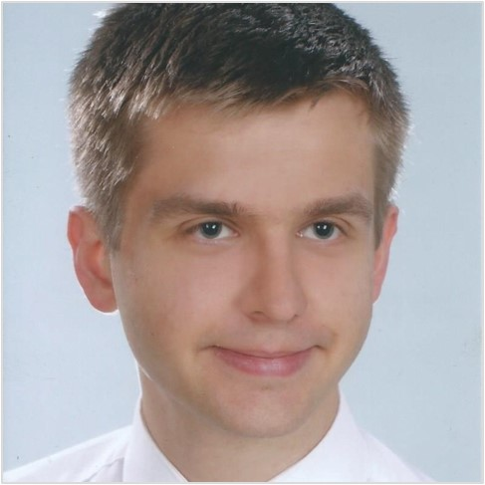
Wiktor Florek
Consultant, Data Science
Foreign Medical Company – Data Engineering (Snowflake, Python, Talend, DBT, Tableau) - Accenture project
Engagement as a developer of a Data Mesh platform. Participant in enhancement and creation of data products in Supply Chain domain. Role primarily focused on the backend and ingestion into Snowflake from SAP systems and dozens of other sources, in smaller degree on data modelling and visualization (Tableau).
Foreign Insurance Company – Data Engineering (SAS DIS, SAS EG) - Accenture project
Engagement as a developer in the initiative of ETL data integration of the life insurance data to the common data warehouse. The project was realized in agile framework.
Foreign Insurance Company – Data Engineering (SAS DIS, SAS EG) - Accenture project
Participation as a member of international agile GDPR (data privacy & anonymization) team in creation of SAS-based solution to anonymize sensitive data in the orchestrated way.
Gdańsk University of Technology - Research and teaching assistant
Conducting classes in the field of probability calculus, mathematical modeling and data analysis (also for foreign students), as well as help in the creation of scientific articles on ergodic theory.
Insurance Company – Intern
Cooperation with the life insurance modeling team.
Non-profit projects:
Prediction of gym membership (R, Python)
The basic purpose of this project was to create an appropriate machine learning algorithm to predict the interest of gym membership and describe the features having the biggest impact on the target. The task required handling structured and unstructured files with additional text information and missing data.
Winter sports database construction and maintenance (Python, tika, SQL)
A project created in collaboration. The achievement was to create a relational database with information about sports performance and the automation tool to download and process the data in a convenient way. The data were used later to provide useful insights and live predictions of the future events.
Gdańsk University of Technology,
Master in Financial Mathematics
Certificates:
Microsoft Azure Data Fundamentals,
Dataiku DSS Advanced Designer.
SAS Data Integration Developer for SAS 9,
Wiktor has over 5 years of overall professional experience and over 2.5 years of experience in data engineering in various industries.
He is interested in building the end-to-end data pipelines and data-driven solutions.
SQL (Snowflake, IBM DB2, SAP HANA, Oracle)
Python (Pandas, NumPy), R
ETL tools (SAS DIS, Talend)
CI/CD (GitLab CI/CD, Jenkins)
CDC framework (Qlik Replicate, IBM)
SAS (Base, Enterprise Guide, Visual Analytics), SAP
Web scraping, PDF data extraction
Supply Chain
FMCG
Insurance
Polish English German
Notes:
wiktor.florek

Slide 17
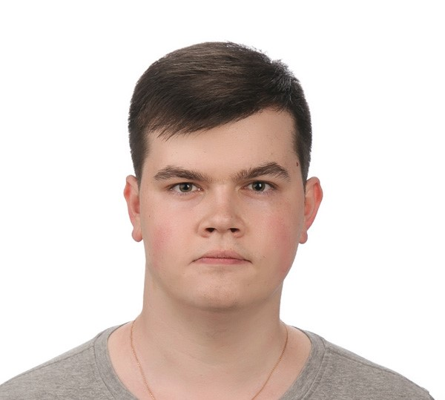
Julian Freier
Analyst, Data Visualization
Leading Producer of Optical and Digital Precision Tech – BI Consultant
Developing and maintaining dashboards in Power BI. Transferred company’s reports from Excel format into Power BI dashboards. Automating processes via Power Automate solution. Administrating user’s licenses and accesses to BI dashboards via Active Directory.
Global Technology Company – Commercial Analyst
Key contact for data analytical tasks. Core responsibilities: Providing commercial reports for Global Services organization, creating and maintaining dashboards and reports in Power BI.
Global Technology Company– Data Engineer
Worked with Power BI maintaining already existed reports and creating new dashboards for stakeholders.
Global Technology Company – HR Operations Expert
Provided operation support for Poland and Balkan countries, as well as Ireland, UK, Ukraine, Belarus, Turkey, Kazakhstan and Israel. Supported global mobility tasks. Introduced improvements to the processes via Excel, Power Automate, PowerApps. Created and maintained SharePoint Sites for team usage & documents access control.
University of Wroclaw Economy & International Business
Julian is an experienced data analyst with strong data visualization skills, Developed, optimized and maintained variety of reporting with the use of Power BI and other tools. Built his experiences in multinational tech companies working as BI consultant and data engineer.
Power Platform (adv. in Power BI)
DAX, Power Query & M
SQL
Qlik Sense
VBA
SharePoint, Jira, ServiceNow
Python
Tableau
Technology
Ukrainian Polish English German Russian
Notes:
julian.freier

Slide 18
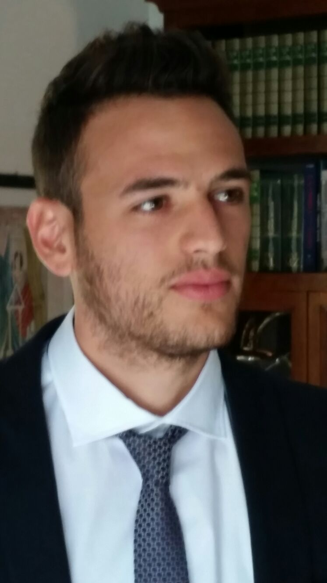
Riccardo Giussani
Consultant, Data Science
Major International Bank – Senior Specialist Model Development
Quant developer within Counterparty Credit Risk Models, CPFE and repo style-transactions
Lead Development for Counterparty and Market Risk Management projects: LSST (large scale stress testing, Sensitivities and risk pricing curves) for Bonds (callable, convertible, generic) and Listed Equity Options
Risk Metrics Manager against Murex benchmarking on sensitivities, risk factor pricing and curves
Analyses, update and Revision with regards to model documentation (Bond/Callable, CPFE) and resolving complex model challenges from validators
Major International Bank – Senior Risk Analyst
FRTB project: quantitative analysis and perform investigations with regards to Market Risk processes
Support risk managers with implementation, calculation, calibration and maintenance of risk measures
Development of Implied volatility tool to reconcile BAU Vega with UAT vega at risk factors level.
International investment Bank – Market Risk Analyst
Control, Monitor and Reporting on Traded and Non-Traded Market Risk
Responsible for production of daily, weekly, monthly and annual reports for the Netherlands branch
Risk Metrics impact analyses in relation to VAR, SVAR and risk factor sensitivities ( PV01, FX VEGA and CR01 ) in order to explain breaches, unusual spike as well as PNL drivers
Acting as intermediary between Poland, UK, India and USA for the transition and delivery of market risk processes
Active participation in the setup, review, amendments and resolution of limits
Responsible for Python training sessions and RPA projects for enhancement and improvements of processes
MSc in Quantitative Risk Management, VU Universiteit Amsterdam
MSc in Finance, University of Groningen
BSc in Economics for Finance, Banks and Insurance, Milano
Excited professional with strong analytical skills and international work experience at several top tier banks, funds, consulting and financial companies.
Expert on Data Analytics, Financial Products, Modelling, Processes and Programming backed with over 4 years of work. On top of my technical skills, excellent communication and problems-solving were utlized to promote business growth, improve decision making and deliver results.
Driving change through collaboration and responsiveness.
Programming: Python and Data Science libraries, C++, R, Matlab, OX, VBA,
Tool knowledge: Bloomberg, Thomson Reuters, Excel, Access, Visio, Qlikview
Working with databases: SQL, Access and MongoDB
Financial Models: APT, CAPM, Modigliani Miller, Fama French, Black-Scholes, Cox-Ross Rubinstein, Local Volatility-Dupire, Heston,
Econometrics: OLS, GMM, MLE, Panel and Factor Models, ARIMA and VARs, State Space models
Financial Derivatives Mathematical Valuation & Statistical Models
Financial Risk – Market, Counterparty, Liquidity, Operational
Italian English French
Notes:
riccardo.giussani

Slide 19

Sebastian Gorczyński
Consultant, Data Engineer
U.S. Communication Service Provider – Development Team Lead
Leading the Development Team on marketing personalisation engine project. Defining the requirements for new change requests. Planning an Agile Workflow monitoring and reporting progress and risks to the client. Designing integration processes with external APIs.
U.S. Communications Service Provider – Campaign Developer
Independent development of real-time trigger-based marketing campaigns using SAS RTDM and SAS ESP. Development of Python scripts and Event Stream Processing diagrams. Maintenance and enhancements of existing use cases. Retests of production level defects. Testing SAS software (RTDM, Data Integration Studio), bugs detection, writing and execution of test cases. Design of the CICD processes (UI and SQL). Developing the flow of Data originating from Kafka.
European Bank – Quality Assurance Tester
Testing software for new French bank, reporting defects in JIRA and retesting them; creating Test Cases. Building Knowledge Base in Confluence. Helping with reporting all testing process. Performing Health Checks at higher environments. Retests of production level defects
Software Quality Assurance Tester – outsourcing
Bug detection, emulation testing, carrying out test cases, providing suggestions to improve quality of test cases. Checking filed bugs and reports created by testers. Accurate describing and reporting found bugs. Microsoft Visual Studio Team Services (query, adding work items). Using custom tools provided by client to test performance. Performing a training for new hires
Cardinal Stefan Wyszyński University in Warsaw, bachelor of Informatics
Polish – Japanese Academy of information technology. Master of Informatics
Sebastian is experienced developer leading the Team on the project for one of major US based Telco companies. Proficient in SAS stack (ESP, RTDM, DI Studio), utilizing open-source technologies like Kafka, Python programming language and implementing REST API based integrations .
SAS ESP, SAS RTDM, SAS DI Studio
SQL, Kafka, Python, C#,
GitHub, Openshift, Visual Studio Team Services(Azure DevOps)
Jira, Confluence
Telecommunication
Banking
Polish English
Notes:
sebastian.gorczynski

Slide 20
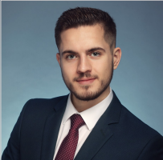
Damian Gortych
Analyst, Data Science
Multinational Data Analytics and Insurance Company – Data Scientist
Designed and implemented an actuarial decision support system including classification and regression model to help decide whether and for what premium a property should be insured. Project contained a preliminary analysis and data transformations as well as model deployment using AWS SageMaker and Snowflake Jupyter Notebook environment.
Multinational Data Analytics and Insurance Company – Data Engineer
Designed and created a significant part of ETL platform for insurance data including preprocessing, storage and transformations. Project included python and SQL scripts on AWS Lambda performing operations on S3, snowflake and Postgres databases.
Software Development Company – Cloud Migration Engineer
Performed a complete migration of ETL process from on-premise into cloud solution using IICS, PowerCenter, Python and Azure.
Multinational Telecommunication Company – Software Developer
Implemented new functionalities and automation processes for telecommunication software using Python and C++. Project included working in scrum, constant results reporting and Jira stories creating.
Polish-Japanese Academy of Information Technology
Master of Engineering in Computer Science
Specialization: Human-computer interaction
AGH University of Science and Technology
Bachelor of Engineering in Data Science
Damian is a data engineer and data scientist with almost 3 years of professional experience. His field of expertise focuses mostly on ETL/ELT process development and design and process automation. He also has a strong background in machine learning and neural networks.
Machine Learning, Deep Learning
Python, SQL, R
Data Engineering and Analysis
Statistics
AWS/Azure
ETL
Snowflake
Docker
Certifications:
AWS Certified Cloud Practitioner
Telecommunication
Insurance
Software Development
Polish English
Notes:
damian.gortych

Slide 21
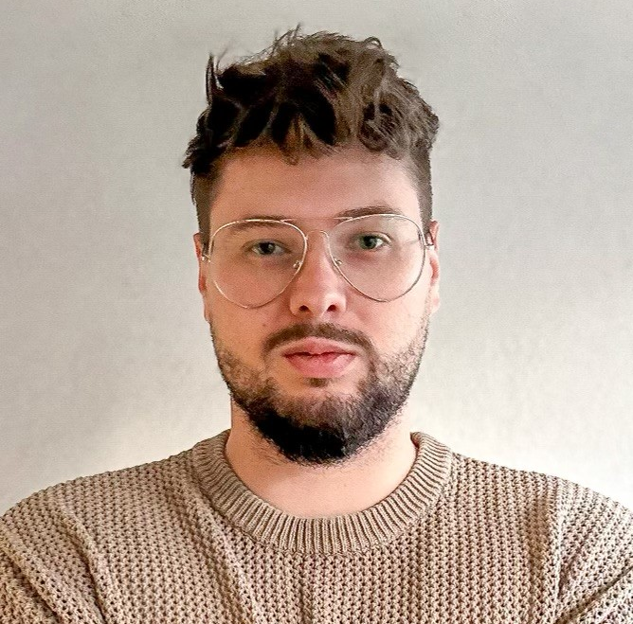
Julian Górajek
Analyst, Data Science
FMCG sector - Data Scientist
Part of the technical team in the global FMCG company that was responsible for collecting, processing and transforming data for the internal platform. The project included evaluation of available data sources and quality of data. It required designing and creation of an appropriate flow using several data sources. Data was collected, for example, using external API, processed using python, in particular pandas and pyspark libraries. The process was automated for automatic refreshing.
Retail sector - Data Scientist
Data Scientist in the technical team responsible for the segmentation process – machine learning solution. It consisted of several phases – exploratory data analysis, cleaning data, feature engineering, modeling, evaluation and segment creation. Team developed a solution to describe and visualize segments for the business and identified the most important features of each segment. The project required designing architecture of the solution. Team prepared the solution in such a way that it could be replicated for different data.
Banking sector - Data Scientist
Part of the Anti-Money laundering technical team in major global bank. Team developed the software to adjust certain thresholds based on selected external factors. This project required designing the UML diagram and prepare the python process. The process included collecting customer data from bank databases, checking whether enough pre-set conditions for change were met and updating the tables based on conditions that were met. An automated report of the process was developed, including the conditions that were met, the factors based on which adjustments were made and other information.
Certificates:
AI-102 - Azure AI Engineer Associate
DP-100 Azure Data Scientist Associate
AI-900 - Azure AI Fundamentals
DP-900 - Azure Data Fundamentals
AZ-900 - Azure Fundamentals
PL-300 - PowerBI Data Analyst
Dataiku Core Designer
University of Warsaw
MA in Big Data Management
Warsaw University of Technology
Postgraduate studies in Big Data
Warsaw University of Technology
Bsc in Photonics
Julian is dedicated data scientist with a primary focus on data analysis and machine learning. His professional background includes valuable experience in the financial sector, and he have a strong affinity for working with machine learning techniques to extract insights and solve complex data-driven problems.
Python (Pandas, Numpy, Matplotlib, Scikit-learn, PySpark, NLP)
Machine Learning, Deep Learning
SQL (MySQL, MS SQL Server)
Azure, databricks
Git
Finance
Retail
Polish English
Notes:
julian.gorajek

Slide 22
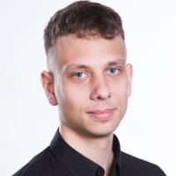
Adam Górski
Analyst, Data Science
Large International Company - Junior Data Scientist / Data Engineer
Implemented a Data Engineering Pipeline using PySpark on the Dataiku platform to enhance the processing of clients' product data and scraped reviews. Trained transformer models for sentiment analysis and managed model tracking with MLflow. Conducted backend development using SQLAlchemy and FastAPI, and wrote scalable microservices using Python and Azure Functions. Established a CI/CD pipeline using Azure DevOps and GitLab CI/CD.
Big Polish Company - MLOps Intern
Extended Kubeflow pipelines, integrated MLflow logging, and employed the NVIDIA Triton Inference Server for efficient model deployment. Developed solutions using TensorFlow and AutoML techniques.
International Insurance Company - Junior PL/SQL Developer
Contributed to Oracle PL/SQL and Oracle ADF Development within the TIA Framework.
Personal projects:
Audio Source Seperation Implemented a kedro pipeline with PyTorch-based models to enhance audio source separation using generative models (GAN, VAE). Utilized MLFlow for model tracking.
Spotify Recommender Enginer - Developed a Django, Postgres and React app integrated with the Spotify API. Created a music recommender engine based on users’ listening history. Extended with hierarchical clustering for cold-start scenarios.
Natural Language Processing - Created NLP Hate-Speech classification project for sentiment analysis of Polish football club fans’ tweets. Explored data, trained transformer models, and deployed using Streamlit or Docker with Redis and Celery.
Master of Engineering in Computer Science Warsaw University of Technology, Faculty of Electronics and Information Technology
Bachelor of Engineering in Computer Science Warsaw University of Technology, Faculty of Electronics and Information Technology
Adam is a Data Scientist with 3 years of experience. He has strong technical skills including programming, machine learning and data analysis. His main interests include implementation and deployment of machine learning solutions following MLOps guidelines. He has a background in machine learning with a focus on Deep Learning.
Python, C/C++, JavaScript
Machine Learning, Deep Learning
Docker, Kubernetes
FastAPI, Django, Postgres
Git, DVC, MLflow
Multiple Cloud Certifications (including Azure AI Engineer Associate and AWS Certified Machine Learning)
Insurance
Banking
Software Development
IT Consulting
Polish (Native), English (C1),
German (B2), French (B1)
Notes:
adam.gorski

Slide 23

Monika Grabie
Analyst, Data Analyst
Software Development company- Data Scientist
Development of machine learning and deep learning models for analysis of toothbrushing activity, and other health parameters (blood pressure, heart rate, blood saturation, etc.); research for novel models and analysis methods in the fields of Human Activity Recognition, eHealth, telemedicine; preparing concise visual presentations of computational results; cooperating closely with stakeholders of international background; data cleansing and preprocessing
Research Assistant
Performing general supervision over the participants of the examination organized by the Institute of Psychology; exercising control over the successful conduct of the study
M.Sc. candidate in Neuroscience– Jagiellonian University, Cracow
B.Sc. in Neuroscience– Jagiellonian University, Cracow
Monika is data analyst with 2+ years of experience in software development and academic research. Experience in the field of machine learning and deep learning for human activity and health parameters. Knowledge and skills in the field of machine learning, statistics and programming using Python and R.
SQL
Python (Jupyter Notebook, pandas, numpy, scikit-learn, matplotlib, seaborn, TensorFlow, Keras, Biopython, bioinfokit)
Data analysis & Machine learning
R (Bioconductor, Rsubread, DESeq2)
Linux/Unix systems
NLP
Life Sciences
Software Development
Polish English German
Notes:
monika.grabie

Slide 24
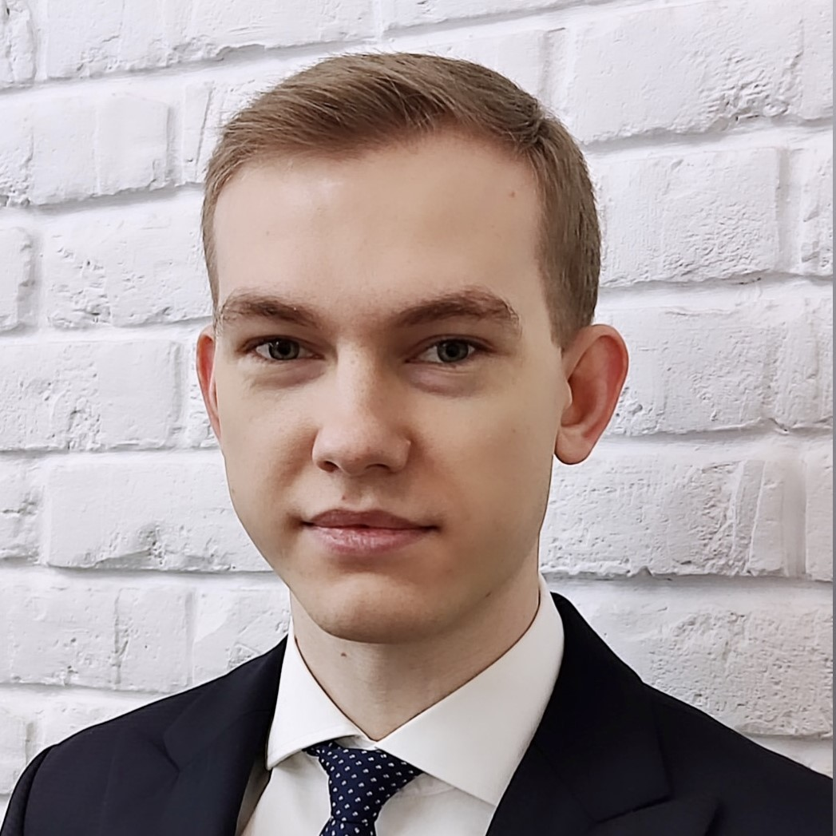
Piotr Grązka
Analyst, Data Science
Major European Bank – SQL Developer
Development of ETL process in line with business requirements, using SQL and Pentaho Data Integration tool in a large, Oracle-based data warehouse environment. Collaboration with international teams to gather and refine requirements, ensuring alignment with expectations. Performing data analysis and code reviews to identify and resolve discrepancies, enhancing ETL processes for optimal data quality. Acting as point of contact overseeing data model changes, preparing DDL scripts and documentation, adhering to database standards and ensuring collaboration among developers.
Large Polish Bank – Risk Modelling Analyst
Agile delivery of credit risk models (PD and LGD) using machine learning methods (logistic regression, decision trees) in Python. Processing, transforming and analysing data in data warehouse with SQL. Gathering and documentation of business requirements regarding model monitoring and data quality testing processes. Regular reviews of requirements with business user. Improving and automating model monitoring and data quality testing processes (SQL and Python). Participating in development of statistical methods used in the Bank.
Global Consulting Company – Intern in Actuarial & Insurance Solutions team
Actuarial modelling for Life Insurance portfolio using Prophet software and MS Excel. Actuarial models Due Diligence in Polish and foreign insurance companies.
Global Bank - Intern in Transfer Agency team
Creation of MIS reports on Fund transfers and data quality assurance and reconciliation. Communicating with counterparties to investigate data discrepancies. Work in an international environment – using Italian and English.
Data Science in Practice
Working in teams supervised by business consultants. Modelling house sales prices with machine learning methods. Use of explainable artificial intelligence techniques to interpret black box models.
MSc in Quantitative Methods and Information Systems, Warsaw School of Economics
BSc in Quantitative Methods and Information Systems, Warsaw School of Economics
Piotr holds a Master's degree in Quantitative Methods in Economics and has over 4 years of experience in the field of banking and insurance where he worked on analysing and modelling financial risk using state of art tools.
Python (NumPy, Pandas, scikit-learn, Matplotlib, Seaborn, pySpark)
SQL (Oracle, Teradata)
ETL processes
Azure (DP-100, AZ-900 certified)
Machine learning, econometrics, data analysis
Credit Risk modelling
Financial Risk
Insurance
English Italian Polish
Notes:
piotr.grazka

Slide 25
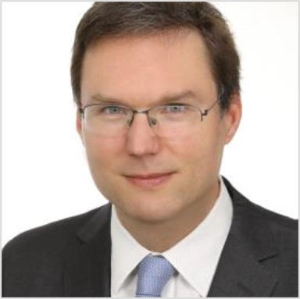
Kacper Grodecki, Ph.D.
Analyst, Data Science
US Telecommunication Company – Analyst
Developed testing automation framework using python, bash and oracle sql.
Developed framework in python to automate processes present in SAS RTDM.
Building data pipelines in SAS RTDM.
Working in Scrum Agile methodology. Using Oracle SQL, Python, unix Bash and SAS RTDM.
Academic, present Adjunct of Science and Teaching
Developing an application used to reduce noise based on the ICA algorithm. The result was a highly scored scientific publication (python, tkinter, ICA, PCA, pandas, numpy). Creating a program used to calculate time-resolution spectrum of photoluminescence (python, pandas, numpy, scipy). Developing calculation algorithms in C++. Creating an application to control several scientific equipment and to collect data (LabView). Conducting scientific and didactic work. Managing a small scientific group.
Open-source project
Managing real estate market analysis project at the turn of 2020/2021 - data collection, data analysis, model building and embedding it on a website in wordpress (tensorflow 2, js, wordpress).
Project for Institute of National Memberence
Developing an application to read text from old, low-quality documents and perform ML algorithms to extract information such as keywords and connections between them as well as surnames of people. (OpenCV, pytesseract, NLP, word2vec).
Phd in Physics – University of Warsaw, Faculty of Physics
MSc of Physics – University of Warsaw, Faculty of Physics
Azure Fundamentals AI certificate
Kacper is a Data Scientist with 4 years of experience in building scientific and open-source projects. As a scientist, he learned several tools and techniques such as Python, SQL , Machine Learning, Data Analysis, Visualization, Data Engineering and Automation. He attended courses of Databricks, GCP Data Engineer as well as Azure Fundamentals AI.
Python (OpenCV, OCR, pandas, sciki-learn)
Machine Learning, Deep Learning
Data Engineering (Azure (AI fundamentals certificate)
pySpark, Databricks
Github, Linux, Bash
SQL,NLP
Gen AI
A
Telco
Research Institutions
English
Notes:
kacper.grodecki

Slide 26
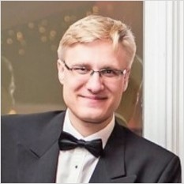
Jan Gruszczyński
Analyst, Data Science
Large European Insurance Firm – Architecture Consultant
Post-merger roadmap definition for infrastructure integration in the data domain – Cloud storage, on-premise, analytics platforms
Large European Insurance Firm – Architecture Consultant
Post-merger roadmap definition for infrastructure integration in the data domain – Cloud storage, on-premise, analytics platforms
Global Petrol Retailer - Consultant
Business development project into client’s digital strategy and analytical roadmap definition.
Global platform for AI models development - Associate AI Analyst
Data analysis on sales and community engagement. Consulting on NGO AI projects. AI projects sales consulting – pre – sales categorization, client calls, sales strategy. Technical feedback on AI/ machine learning articles, blog & website design.
Biotech company – Project Manager, Financial analyst
Managing a software project on clinical trials monitoring. Overseeing a conversion from a private company into a public company. Developing financial models for new and portfolio molecules. In charge of IT, web design.
Masters' thesis
Developing and validating Machine Learning models for Computer Vision in medical imaging. Technologies: PyTorch, sklearn, pandas, numpy, SciPy, matplotlib, state-of-the-art ML models.
Public Institute – Student project
Consulting project of Net Zero energy system for a housing estate of 2200 homes. Specializing in storage operation, financial, corporate and legal evaluation of the project. Student project – Neural network design and verification
University of Oxford, Master of Engineering
Engineering graduate with experience in financial, medical and consulting experience with strong technical acumen.
Capable both as a consultant and data scientist.
Machine Vision, Machine Learning, Neural Networks
Python, SQL, C++, Docker
PyTorch, sklearn, pandas, numpy, SciPy, matplotlib, FastAPI
MLOps
Google Cloud Platform Digital Leader
Medicine
Sales
Finance
Polish English German Russian
Notes:
jan.a.gruszczynski

Slide 27
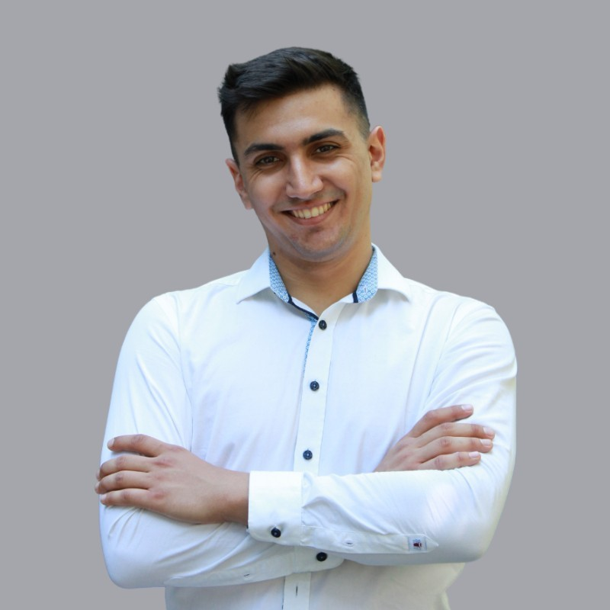
Adel Hachim
Analyst, Data Science
Gen AI Lab – Data Scientist
Collaborated on a project focused on Language Model (LLM) applications, developed multiple use cases of Retrieval Augmented Generation. Enhanced model performance through optimization strategies, incorporating prompt engineering among various techniques. Additionally, contributed to the development of a user-friendly interface and RAG-powered chatbot.
IT Services Company - Junior Data Scientist
Performed survival analysis for factory workers of one of the largest beverage companies in the world. Quantified probability of an accidents happening and classified its severity level.
Developed a Question Answering system for medical data by using NLP techniques and state of the art transformer models. Deployed the final version of the model to AWS.
Created a content based recommender system for furniture items based on the similarity of their descriptions.
Built a cryptocurrency price prediction model based on the historical price data and market analysis
Energy trading company - Junior Data Scientist
Performed Exploratory Data Analysis of European energy markets. Investigated market liquidity, import, export and price differences of neighbouring countries. Time series forecasting of energy prices by using variety of models such as ARIMA, LSTM and Prophet. Utilizing historical pricing data, market dynamics, weather patterns and regulatory changes. Provided insights into automated trading algorithms. Leveraging advanced data analysis techniques and machine learning algorithms for anomaly detection of energy outages for European countries.
AGH University of Science and
Technology, Bachelor's degree, Automation and Robotics
AGH University of Science and
Technology, Master’s degree, Computer Science - Data Science
Adel is a data science analyst with over two years of experience, working on Machine Learning projects in diverse range of industries.
Python (NumPy, Pandas, Sickit-learn, Tensorflow, Pytorch)
SQL
Machine Learning
Data Visualization (Matplotlib, Seaborn, Plotly)
Natural Language Processing
Recommender systems
AWS
Git
Energy
Health
Financial Services
Polish English
Notes:
adel.hachim

Slide 28
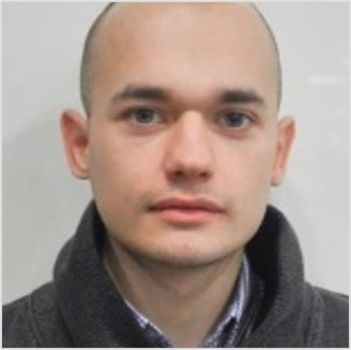
Mateusz Hamczyk
Associate Manager, Data Engineering
German Insurer - SAS Administrator
Responsible for administration and maintaining of SAS platforms (SAS 9.4, SAS Viya) installed on Linux/Unix operating system (SUSE Linux 12SP2/5) and administration of SAS Customer Intelligence 360 platform used by Next Best Offer project.
Swedish Bank - Database Programmer / Tester
Responsible for creation, develop/test and tunning of database code by using Oracle Databases and Teradata Data Warehouse for Bank Treasury Management project.
British broadcaster and telecommunication company - SAS Programmer / Administrator
Responsible for administration, maintaining and performance tunning of SAS software (SAS 9.4) installed on Windows Server (Windows Server 2016).
Polish telecommunication provider - SAS Programmer / Administrator
Responsible for administration and maintaining of SAS platform (SAS 9.4) installed on Linux/Unix operating system (Red Hat Linux), designing and building data integration processes, creation of database structures and code by using SAS software, Oracle Database and Teradata Data Warehouse for Next Best Action project.
National Bank - SAS Programmer / Oracle Programmer
Responsible for building data integration processes by using SAS software for Risk Management system.
Polish Bank - SAS Programmer
Responsible for building Data integration processes by using SAS software and Oracle Database for Fraud Management system.
Lodz University of Technology: MSc in Intelligent Database Systems
Lodz University of Technology: BSc in Databases Systems and Expert Systems
Mateusz has over 7 years of professional experience in projects connected with SAS software and various types of Databases and Data Warehouses. Mateusz possesses experience in roles of SAS system administration, SAS and SQL programmer and ETL developer.
SAS programming: SAS 9.4, SAS Viya and SAS Customer Intelligence 360
SAS administration
Data Integration
SQL programming: SQL, PL/SQL, T-SQL
Databases and Warehouses: Oracle, MS SQL, PostgreSQL, Teradata
Banking
Insurance
Telecommu-nication
Media & Entertainment
Polish English
Notes:
mateusz.hamczyk

Slide 29
Anna Herud
Analyst, Data Science
International Consulting Company (Financial Sector) - Data Science Consultant
Participating in Credit Risk Modelling projects for various financial institutions, including European G-SIBs. Contribute by developing and validating econometric models using statistical techniques like logistic regression, decision trees, and time series analysis. Proficient in SAS, SQL, and R, ensured the accuracy and reliability of these models, enabling informed decision-making regarding lending practices and investment strategies while meeting regulatory requirements.
The role involved close collaboration with multidisciplinary teams, leveraging data-driven insights to deliver solutions that enhance risk management practices. Played a crucial part in fortifying the clients' ability to navigate complex risk environments effectively, promoting stability and resilience.
International Insurance Company – Claims Analyst
Responsibilities included data entry into databases, data manipulation and payment processing. Ensured accuracy and availability of claims data, processed payments efficiently and maintained compliance with strict industry regulations. Communicated with stakeholders and provided them with ad-hoc support for any issues that arose during claim processing.
Warsaw University of Technology: Msc in mathematics
Jagiellonian University: Bsc in mathematics
Anna, with over 3 years of professional experience, is a data scientist, specializing in Credit Risk Modelling. She has experience creating models specifically tailored for financial institutions.
Additionally, she possesses practical experience working with databases.
R (tidyverse, randomForest, survival, glmnet, caret)
Python (pandas, numpy, scikit-learn, tensorflow, pytorch, keras)
SAS
SQL
PySpark
Git/GitHub
Latex
Finance
Insurance
Polish English German Spanish French
Notes:
anna.herud

Slide 30
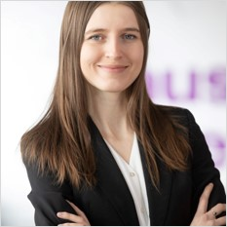
Magdalena Horosz
Associate Manager, Data Science
International Retailer – Data Scientist
Development of sales forecasting tool with price simulations and cross-elasticity frequent patterns algorithm. Tool helps price managers to forecast sales demand depending on the article price. Main tasks: time series modeling, configuring models deployment, designing the ETL pipeline, modifying the frontend part of the dash web application, tool industrialization.
Development of price elasticity tool based on linear regression model - main pricing tool used by pricing managers internationally for price setting.
International Retailer – Analytics Consultant
Figuring out and designing processes of analytics use cases lifecycle including ideation, development, industrialization and continuous improvement focusing on the ML Ops part. Conducting client workshops with business and technical stakeholders on aligning the way of cooperation in the use case lifecycle.
Insurance Company - Developer
Designing, building and configuring ETL and ELT jobs to meet business requirements and architecture principles. DWH business analysis, solution design and implementation of SAS DDS (Detailed Data Store) model for insurance in SAS Data Integration Studio environment and DB2 SQL. Creating Test Framework (design and execution), providing support to business users in UATs, fixing defects.
Worldwide Leader in Enterprise Analytics and Mobility Software – BI Consultant
Creating new BI application objects to support the business decisions in retail area and maintaining the existing ones. Continuous cooperation with end users of the system – from collecting requirements to implementing and testing the solution. Performing data processing, data management analysis and reporting. Reviewing data sources, reporting requirements ensuring effective and efficient management of business data. Validating data in database, checking out scripts and examining Data Warehouse ETL Processes.
Multinational Industry Company – Category Management Intern
Reporting market data for non-alcoholic beverages market. Performing multiple ad-hoc data-driven analyses strategic for assortment planning and sales analysis including examination the effectiveness of promotions.
Warsaw School of Economics, Master degree in Big Data – Data Analysis
Warsaw School of Economics, Bachelor degree in Quantitative Methods in Economics and Information Systems
Magdalena is a data analytics graduate with experience in machine learning models development and evaluation. Magdalena has over 6 years of professional experience in data management projects in the fields like retail, FMCG and insurance.
She is experienced the pricing tools development, industrilizing data science solutions, designing ETL/ELT process, performing data analysis and BI reporting. She is fluent in SQL, Python and SAS.
Magdalena is certificated Azure Data Scientist, Google Cloud Professional Data Engineer and SAS DIS developer.
Azure: certified Data Scientist Associate (Azure Databriscka, Azure ML flow, Azure ML studio, Azure DevOps)
GCP: certified Professional Data Engineer
Data Science: Data Analysis, Data Engineering, Data Mining, Statistical Analysis, Business Intelligence, Data Visualization
Machine Learning: Logistic Regression, Decision Trees, Random Forrest, Neutral Networks
Python: NumPy, Pandas, Matplotlib, Scikit-Learn, Plotly, PySpark
Business Intelligence: MS Power BI, MicroStrategy
SQL and RDBMS: DB2, Teradata, MS SQL Server
ETL, ELT: SAS DI Studio
SAS Software: certified Data Integration Developer
(SAS E-Guide, Miner, Data Integration Studio)
Retail
FMCG
Pricing
Insurance
Business Intelligence
Polish English German
Notes:
magdalena.horosz

Slide 31
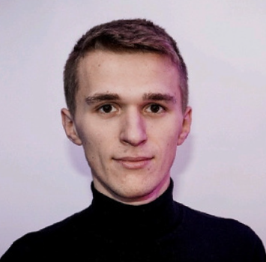
Mateusz Izdebski
Analyst, Data Science
Data Scientist, International Insurance Company
Orchestration of advanced machine learning algorithms to detect financial fraud and estimate customer retention probabilities.
Implementation of MLOps practices to deploy and manage ML models using Docker for containerization and Kubernetes for orchestration.
Development of risk models as part of the motor insurance price optimization process.
Continuous improvement of tariffs for other non-life insurance at each stage of the process (risk modelling, A/B tests, price optimization).
Conducting advanced statistical analysis of large datasets.
Evaluating and exploring the implementation potential of new tools and algorithms.
GenAI Engineer, Accenture Internal
Contributing to the development of a Streamlit application utilizing OpenAI's language models (GPT-3.5, GPT-4), for natural language database querying.
Engaged in Azure DevOps for streamlined deployment processes and management of project workflow.
Conducting research on potential future implementations, focusing on multi-agent solutions and function calling for improved functionality and efficiency.
Data Analyst, Leading German Bank
Managing monthly operational processes for Model Risk Management.
Preparation of data reports for the Bank's Risk Management Board.
Research Assistant, Top Polish University
Conducting scientific research.
Creation and publication of scientific papers such as systematic reviews and essays.
Master’s degree, Quantitative Methods in Economics and Information Systems, Warsaw School of Economics
Bachelor’s degree, Quantitative Methods in Economics and Information Systems, Warsaw School of Economics
Mateusz is an experienced data scientist with strong back-ground in financial services area.
He is a hardworking, ambitious and fast learning person. He easily establishes contacts and has the ability to talk about technical matters in a simple way.
Machine Learning and Deep Learning (GBMs, GLMs, NNs)
Python (mainly NumPy, Pandas, Scikit-learn, PyTorch, fastAI)
SQL
Azure Certified - DP-100 – Azure Data Scientist Associate; AZ-900 – Azure Fundamentals
genAI (OpenAI, Streamlit)
MLOps (Git, Docker, Kubernetes)
Stream processing (Apache Spark)
Banking
Insurance
Polish, English
Notes:
mateusz.izdebski

Slide 32
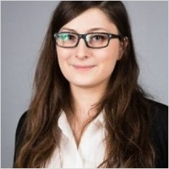
Martyna Jabłońska
Consultant, Data Engineer
Large Swiss Insurance Company
Cooperation on modeling data structures and implementation of Data Mart used for tariffication in business insurance. Development and testing using SQL and SAS (SAS DI, SAS EG 9.4.). Creating technical concepts for additional functionalities including SAS Stored Processes.
Global healthcare company – Senior Data Engineer
ETL developer. Designing, modeling and creating ETL processes in Order Management and Install space. Taking active part in gathering and technical assessment of requirements.
Global healthcare company – Data Engineer
ETL Developer. Data Warehousing and data analysis. Designing data flows and reporting for Global Supply Chain, Order Management space. Helping create data catalog and documentation for GSC.
Global healthcare company – Data Engineering Specialist
ETL and Data Virtualization developer. Creating ETL processes sourcing from multiple databases. Data warehousing and data analysis. Reporting for Global Supply Chain, Order Management space. Working with Teradata and Informatica.
Global healthcare company – Associate – Data & Analytics
Data Virtualization developer creating data catalog and data sets in Cisco DV tool.
International IT company – Junior Oracle Developer
International IT company - Intern
AGH University of Science and technology, Master degree, Computer Applied Science
AGH University of Science and technology, Bachelor degree, Computer Applied Science
Martyna is a Data Engineer with over 7 years of professional experience.
She gained experience as a data engineer in projects related to the health and insurance industry. In her career, she acquired technical expertise in designing, modeling and implementing data sets.
SAS (SAS DI, SAS EG 9.4.)
Teradata
SQL
ETL
Informatica
Data Analysis GIT
DP-900: Microsoft Azure Data Fundamentals – In Progress
Healthcare
Insurance
Polish English
Notes:
martyna.jablonska

Slide 33
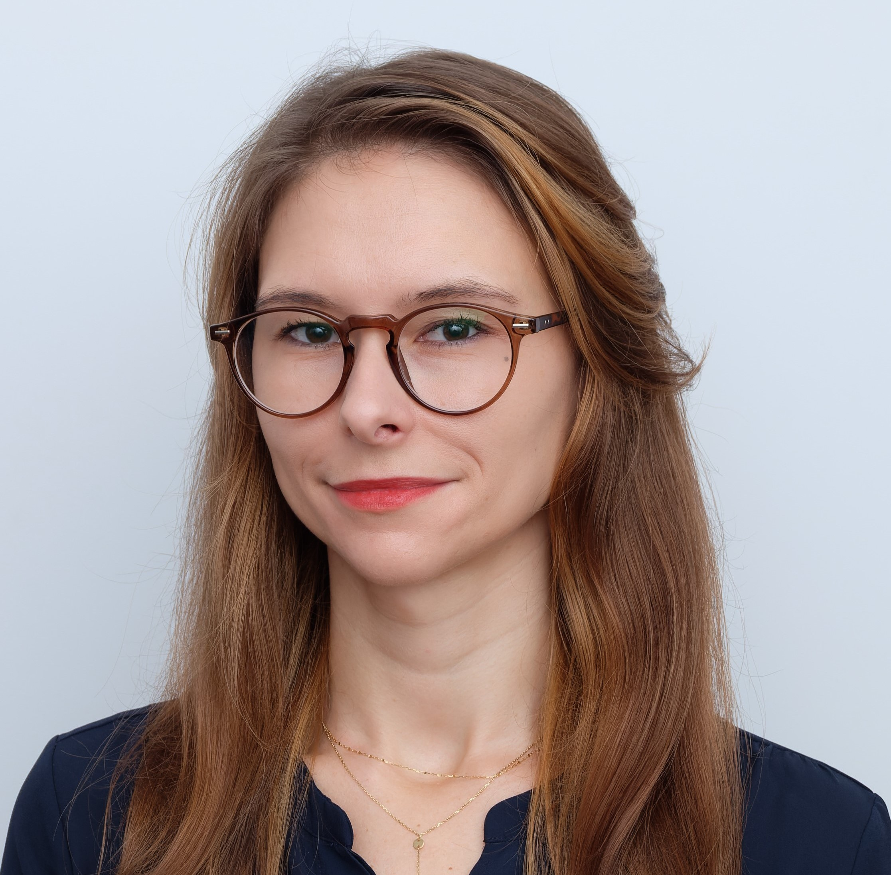
Agnieszka Jach, Ph.D.
Manager, Data Science
German Retailer – MLOps Engineer / GenAI SME
Design and development of an MLOps Platform in a central team for an international retailer. End-to-end deployment and adoption of Azure Machine Learning Platform in an existing infrastructure.
Development of a solution for customer feedback analysis leveraging Generative AI (Azure Open AI)
Continuous support in driving adoption of LLM-based solutions and use cases. / Technologies involved – Azure Cloud, Azure DevOps, Databricks, Terraform
Major Polish Bank - Expert Data Scientist / MLOps SME
AI Chapter Lead; development of a platform for deployment of real-time ML models in production; standardization of machine learning pipeline execution (training, deployment and monitoring); AI Academy Mentor; implementation of a process for risk management of AI models. Numerous PoCs: Face recognition systems; Document Intelligence, Invoice Booking Automation / Technologies involved – Python, Docker, Kafka, Kubernetes, Azure DevOps.
Major Biotechnology Company – Research Test Engineer
Design and development of an automated integration testing suite for a platform processing bioinformatics pipelines in Google Cloud Platform. The testing suite consisted of system health checks, integration tests and a framework for testing bioinformatics pipelines. / Technologies Involved – Python (Pytest and multiple Google Cloud SDK), Azure DevOps, Google Cloud Platform (multiple services and their APIs: Pub/Sub, GKE, Airflow, BigQuery, Storage, etc.)
Polish Scientific Institute – Lead Developer
Development of a workflow for analysis of the satellite imagery and development of Machine Learning models for crop types identification and monitoring of crop health (remote sensing). Leading development of a web application for farmers presenting valuable insights from analysis of satellite and meteorological data. Managing the team of 6 people. / Technologies involved – Python (PySpark), Computer Vision, Machine Learning (PyTorch, scikit-learn), Prefect, Docker, Kubernetes
Major Oil&Gas Company - Senior Data Scientist
Responsible for development and execution of a data science pipelines in Oil & Gas, IoT and Smart Building industry with focus on three main areas: (1) Anomaly Detection, Sensors’ Monitoring, Predictive Maintenance, (2) Computer Vision with Object Detection for Document Intelligence, (3) energy consumption optimisation in buildings. / Technologies Involved – Python (Pytorch, scikit-learn, PySpark etc.), Docker, SQL, Cassandra, Kubernetes
Major Chemical Company (US) - Data Scientist
Responsible for exploratory data analysis and development of two types of models: (1) predictive model of end product quality parameters based on deep neural networks and historical data and (2) a system for process engineers recommending which parameters to adjust in order to reach production goals. In total fifteen models were created for three different products. Technologies Involved – R (in-house Deep Learning library), Shiny
Warsaw University of Technology, Post-grad, Big Data
Warsaw University of Technology, PhD, Power Engineering
Warsaw University of Technology, Bachelor of Engineering and Master of Science in Power Engineering
Agnieszka is a highly skilled data science professional, specializing in machine learning operations, AI, and cloud technologies. Her expertise lies in developing strategies and operating models for AI and ML, contributing significantly to organizations' success. Agnieszka excels in seamlessly integrating AI technologies into business processes, optimizing models for efficiency, and ensuring smooth operations in the cloud environment. Her strategic mindset and hands-on approach make Agnieszka an indispensable asset for organizations navigating the complexities of AI and ML implementation.
Machine Learning, Python - PyTorch, Tensorflow, Prophet, Detectron2
R, Matlab (Fortran, C - used in academia)
AI – OpenAI API, Large Language Models, Generative AI
Data Engineering - Apache Kafka, PySpark, Airflow, Prefect, PostgreSQL, Cassandra, MongoDB.
DevOps/CICD - Docker, Docker Swarm, Kubernetes, Git, Azure DevOps, pyTest, FastAPI
Cloud (AZURE, GCP, AWS), Terraform
Banking
Oil & Gas
Energy
IoT
Polish English
Notes:
agnieszka.jach

Slide 34
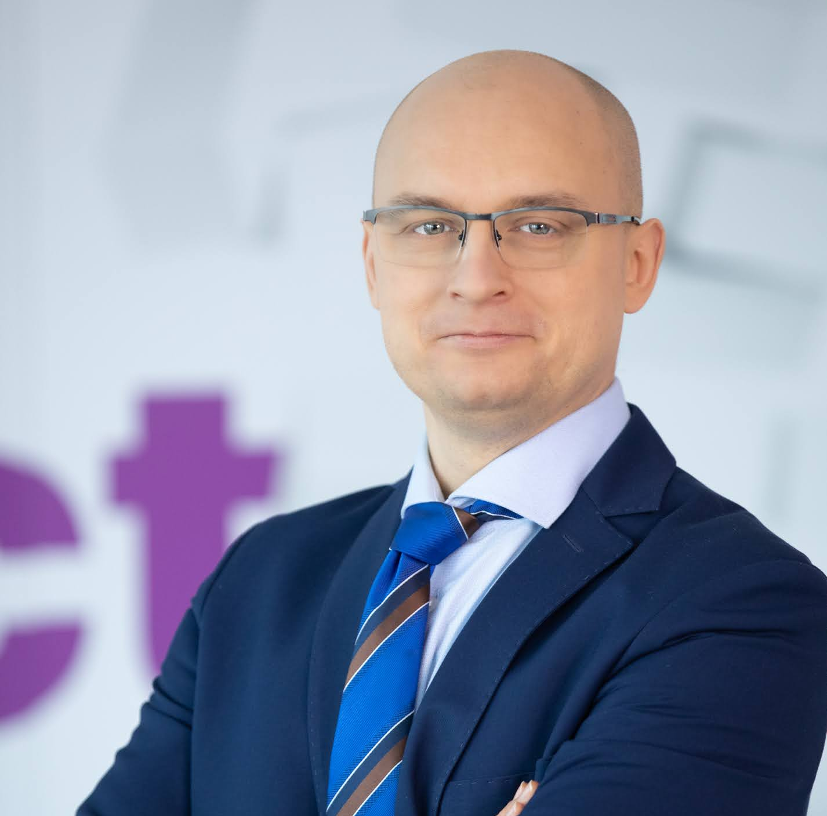
Piotr Janczewski
Manager, Data Science
Global Petrol & Chemicals Retailer Company – Lead Data Scientist
Lead an Accelerators team, dedicated to reinforce the main loyalty program via thoroughly designed and accurately targeted, data-driven marketing campaigns. Supervised implementation of Cloud processes, including ETL, ML and BI, crafted in SQL, Python and client-proprietary tools. Pioneered in paving the way for the Client towards development of consumer journey schemas, based on combination of multi-source data.
Global FMCG Company – Team leader
Lead 5 Data Engineers; Dedicated to e-commerce, AI and Python standardization in Azure environment; Contributed to growth of the account by another 2+ openings and delivered several presentations to senior client stakeholders
Data Science Company - Principal Data Scientist
Lead 2 Data Science teams (9 associates) and 3 matrix R&D teams; Supervised service of 20+ major clients, contributing to 100+ portfolio optimizations/improvements; Managed 50+ machine learning, choice modelling, driver or clustering analyses; Shaped mid to long-term team strategy; Delivered 10+ workshops, 50+ trainings for 250+ participants; Received 10+ internal awards (Bronze, Silver and Gold)
Education and Research Company - Owner and founder
Statistical support for 15+ PhD students; Workshops and trainings for ~20 clients; Online & offline ad-hoc research projects for 10+ clients
Technology Company – Research Manager
Provided web analytics & SEM campaign reporting to 50+ clients; Developed CAWI unit, reported surveys of P4 (mobile operator). Managed & reported 50+ CAWI surveys, desk researches and R&Ds.
Warsaw School of Economics - Master of Quantitative Methods And Information Systems
In the market intelligence sector for nearly two decades, including 10+ projects for pharmaceutical sector. Combined strong coaching and business development abilities with high technical skills. Efficient in tackling tasks requiring intense multi-tasking and high-level project management. The more complex a machine learning, choice modelling or big data task, the greater the excitement with which I look forward to undertake the challenge.
genAI concepts (eg. Responsible AI, capabilities and limitations)
AWS Certified Cloud Practitioner
GCP Cloud Digital Leader
Azure Data Scientist Associate
Coaching and mentoring
Consultative Storytelling
Data Science & programming Python, SQL, R, VBA, SPSS
FMCG
Pharma Banking
Telco
Entertainment
eCommerce
Retail
Fuel & Chemicals
Automotive
English, French, Italian, German
Notes:
piotr.janczewski

Slide 35
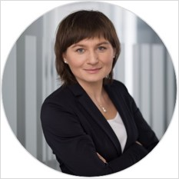
Kamila Jakubowska
Manager, Data Science
Major Swiss Bank – Ensuring financial risk regulatory compliance – IT Project Lead
Designing, development and testing of ETL for data sourcing and data transformation dedicated for NSFR/LCR regulatory reporting in ORACLE SQL and Python. Close cooperation with IT, upstream systems and BI teams guaranteeing smooth transformation of end-to-end calculation process across all systems and technologies. Agile project management with the usage of Jira.
Major Polish Bank - Transformation of CRM system - Data Scientist Lead
Developing marketing customer segmentation and propensity models in SAS for the usage in optimization of marketing campaigns and marketing strategy. Data quality analysis in Teradata SQL. Workshops with Client and project management.
Major British multinational Bank - Transformation of AML system - Data Scientist
Performing data quality analysis, data aggregation and statistical data modelling to improve parametrization of Anti Money Laundering (AML) scenarios with the usage of Hadoop and SAS.
Accenture Internal – Intelligent automation of model validation - Project Lead
Leading the project aimed at developing new innovative asset accelerating validation of regulatory risk models. Developing Demo of working solution which extends functionalities of SAS MRM (Model Risk Management) Software product by intelligent automation with the usage of R programming.
Global American IT Company - Sales Forecasting Transformation - Data Scientist
Analysis and verification of data sources, processes, systems and advanced analytics techniques engaged in actual Sales Forecasting Management. Delivering recommendation and roadmap for future state and advising on the practicality of ML application and integration with IT tools for the future state.
Major Polish Bank - Financial Risk Management - Financial Risk Specialist
Risk management reporting on business intelligence platform based on SAS Risk Dimension. Developing business intelligence tool for reporting the Basel 3 Liquidity Risk Requirements. Stochastic modelling of deposit portfolio in SAS for the purpose of building Cash Flow Scenarios and Liquidity stress-testing.
Major Polish Bank - Transformation of ALM system - Business Analyst
Customization of SAS Risk Management for Banking (RMfB) in the area of derivative pricing models, VaR and stress-testing with the usage of SAS macro programming. Developing Low Level Design for Funds Transfer Pricing (replicating portfolio model) in the area of Asset Liability Management (ALM).
Warsaw School of Economics, Master, Quantitative methods in economics and information systems
University of Groningen, The Netherlands, Socrates Erasmus Scholarship, Statistics
Kamila has 15 years of solid technical experience in application of statistics and machine learning for modelling of customer behavior in banking, telecommunications and healthcare sectors. In addition, she has strong functional skills in financial liquidity and market risks. She managed polish and international medium-sized teams. She demonstrates active and problem-solving approach. She finds easily common language with both business and technical partners.
ML: Supervised / Unsupervised learning, Time series analysis, Survival analysis, Linear optimization
Financial risk: CRD 4/Basel 3, Liquidity / Market Risk, Stress Tests, ALM, Replicating Portfolios, FTP, Model Risk Management, AML
Technical: SAS (Base, Macro, IML), Python (NumPy, SciPy, Pandas), R, SQL, Hive(Hadoop), GCP (BigQuery, Vertex AI, TensorFlow), Jira
Banking
Financial Risk
Leasing
Market Research
Telecommu-nication
Polish English Russian
Notes:
kamila.jakubowska

Slide 36
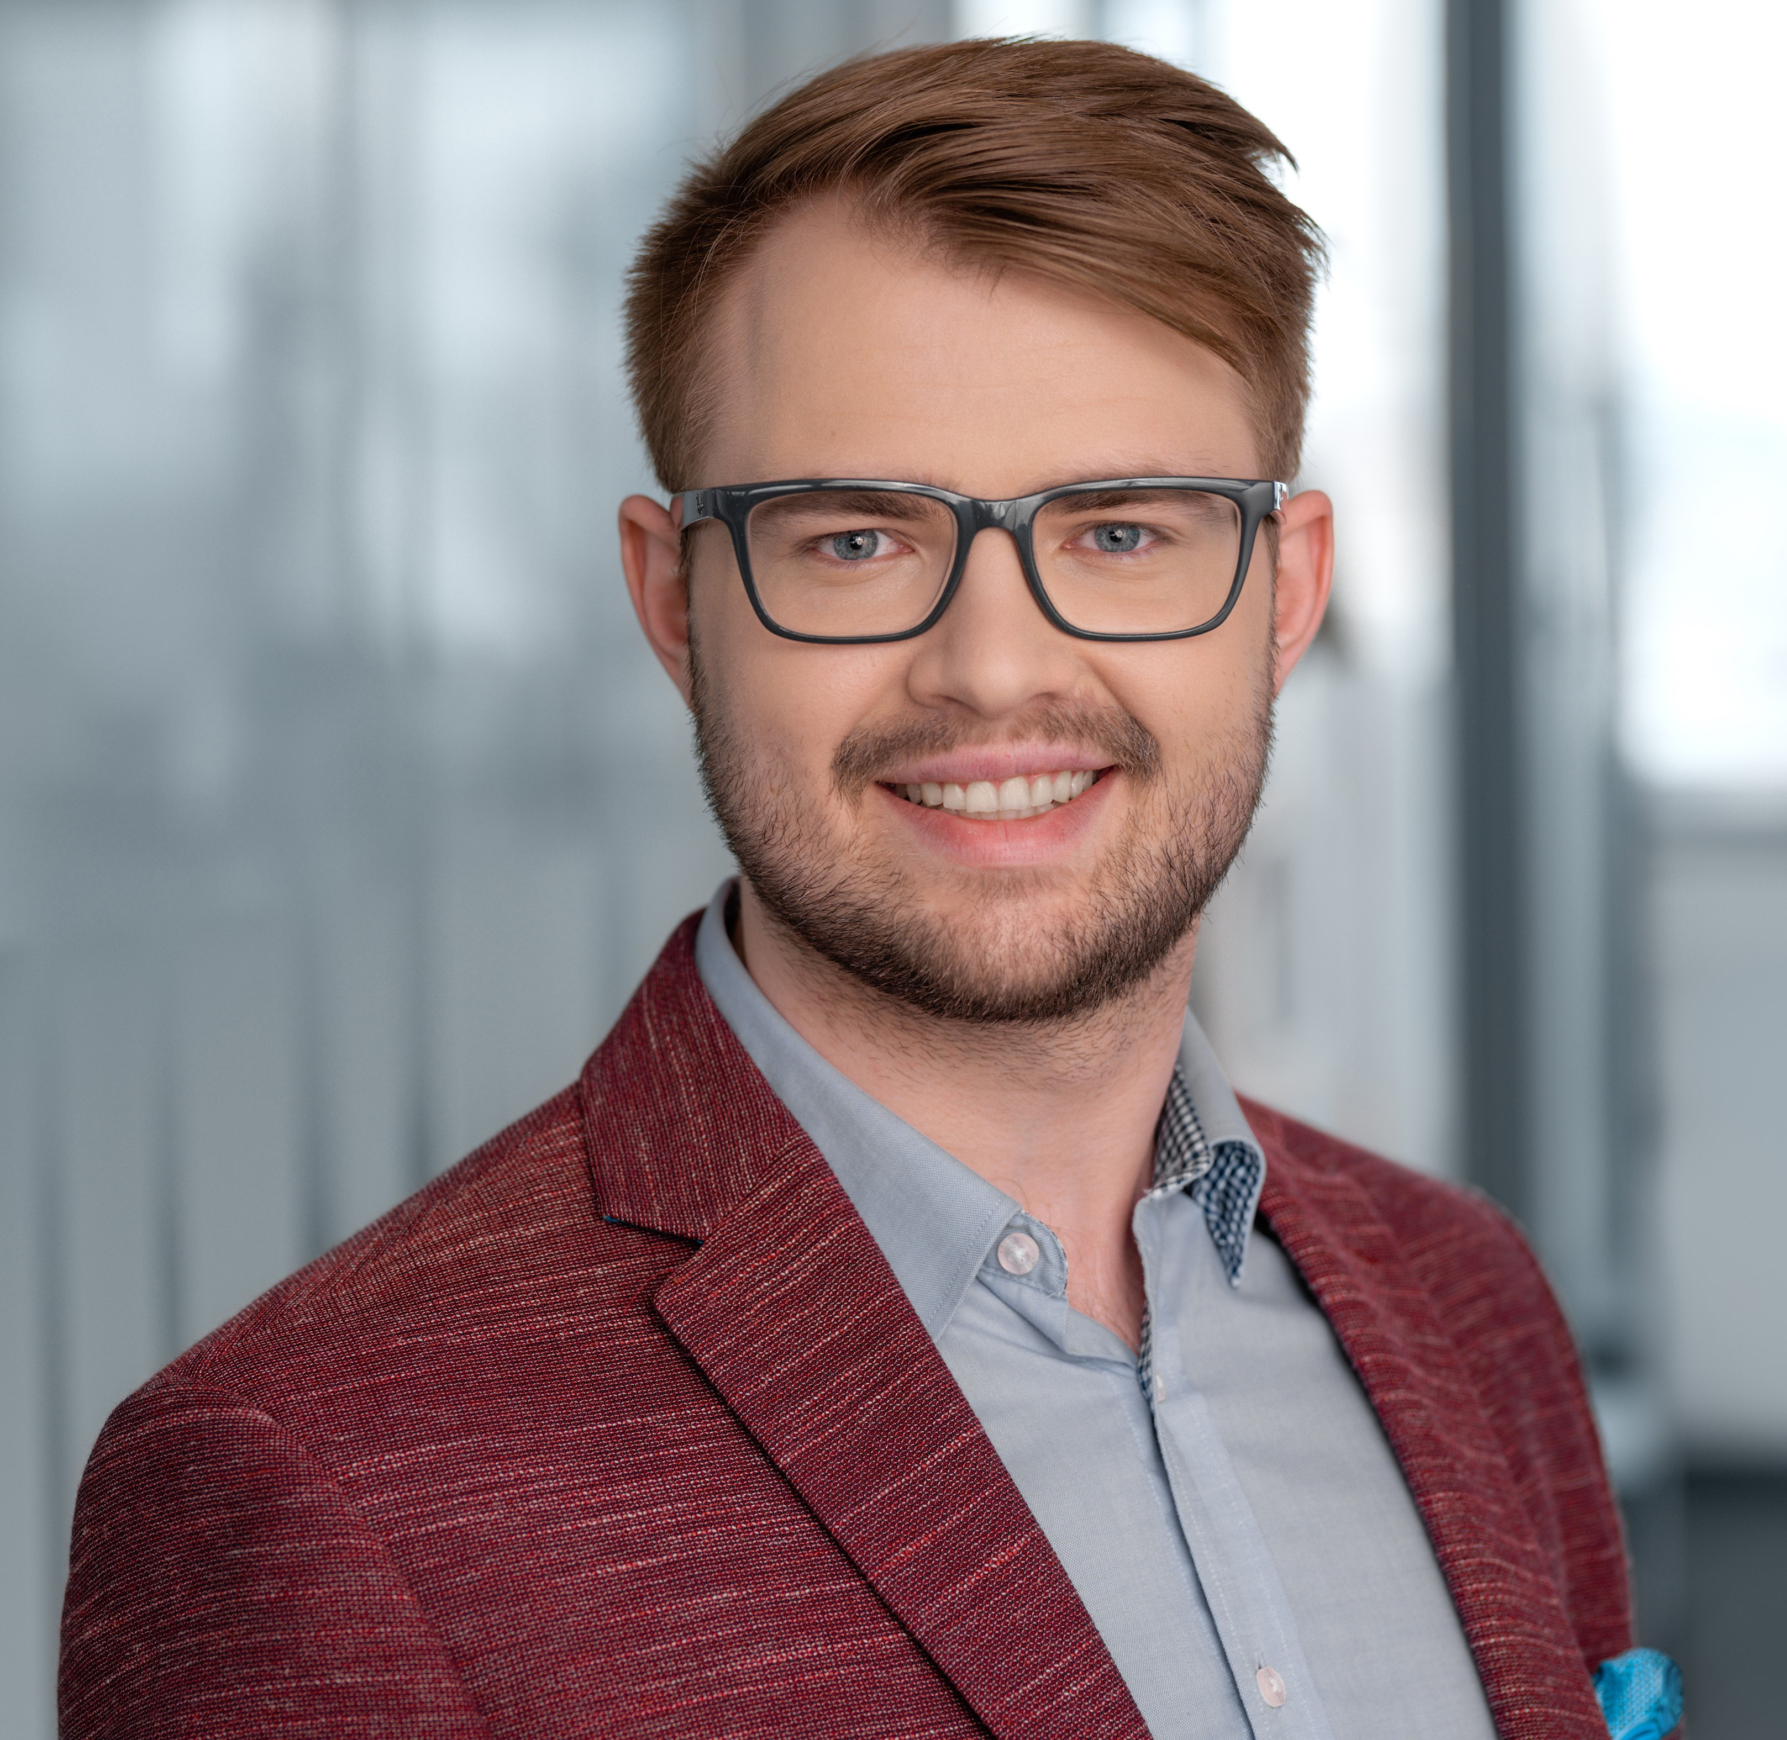
Karol Jankowski
Consultant, Data Science
International Retailer – Data Scientist
Supporting SCM area with analytics capabilities. Coordinated development of analytics based KPI for accessing availability of fresh goods from shelf perspective with visualization requirements gathering and execution.
Polish Retailer – Strategy Consultant
Conducted 15+ business and technical workshops with Client to grasp current state, technical capabilities, target picture and necessary changes in processes and technology for offer and communication personalization. Supported creation of analytics roadmap use cases leading to desired state.
Major Global Bank - Data Scientist
Data Scientist in team preparing network-based AML solution based on the Quantexa framework for a global bank. Risk scoring scenarios investigations and development. Extensive network analysis with data preparation. Product development aligned with programming best practices.
UK Telco company – Data Scientist
Data Scientist in B2B customers microsegmentation project aiming at new tariffs outline. Built a microsegmentation model in pySpark. Data preprocecssing, results validation and stability checks in pySpark.
Technology Company in UK - Data Scientist
Prepared full path of AML process for network analytics – building ETL pipeline (raw importing, preprocessing, cleansing, transforming into defined model), building connection between entities, creating scoring algorithms for entities and networks. Development with good programming practices (clean code, TDD, unit tests, shadow programming, features on new branches, code review).
Global FMCG Company – Data Scientist
Delivered optimization algorithm supporting B2B e-commerce platform with analytics based recommendations for FMCG Client. End-to-end optimization pipeline based on Customer’s cart products and transportation limitations.
Prediction pipeline development for next purchase date B2B Clients prediction based on ordering history with model operationalization via MLFlow.
Product Recommendations requirements gathering and validation. Defining possible recommendations Use Cases on e-commerce platform with out-of-the box solution, limitations and missing functionalities.
Kozminski University, Postgrad: Manager Academy (in progress)
Kozminski University, Postgrad: AI Projects Management
Warsaw University of Technology, BSc, MSc in Automation Control and Robotics
Karol has more than 5 years of experience in data analytics and Data Science solutions preparation. He combines technical skills with business oriented goals.
Recommender systems enthusiast.
Social Network Analysis
Programming: PySpark , Python, Scala
Microsoft Azure – Storage, Databricks, Azure Machine Learning
MLOps: MLFlow, Hyperopt
Git, GitHub, Jira, Jenkins user
TDD, Clean code, Peer code review
AML/Fraud detection
Retail
FMCG
Banking
Telco
Polish
English
Japanese (JLPTN5)
Notes:
k.jankowski

Slide 37
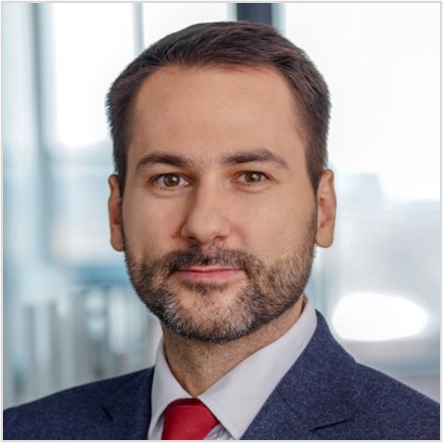
Mariusz Jasek
Senior Manager, Data Engineering
Project delivery– Leading Tobacco Company
Overall project delivery and coordination of work of nearly 30 Business Analysts, Data Engineers, Testers and Power BI developers (including the client team). The team developed multi-layer data platform in Snowflake, uniform across 6 markets, which has been enriched by over 200 internal and external data sources. The data platform formed a basis for creation of Power BI data models and reporting dashboards
Delivery lead – Insurance company
Overall project delivery and management of the team of 12 Data Engineers. The project aimed to migrate ETL processes and their components by automating conversion of SQL Stored Procedures using BladeBridge utility into Snowflake SQL. Additionally, the team analysed SSIS packages for batch orchestration and ETL process migration to ADF
Other related experience (across multiple projects)
Model development, validation and implementation
Re-development and validation of AML detection model (Netreveal implementation); Scoring/ Rating models development (application, behavioural, collection, anti-fraud) (SAS); Valuation of Non-Performing Loans portfolio available for sale; PD and LGD models development for the purposes of Basel II IRBA; Estimation of PD and LGD for loan impairment calculation; Development of stress testing models for retail and corporate portfolios; Validation of PD and Stress Testing models for the purposes of CCAR (SAS)
System implementation – Data and ETL testing
Data reconciliation for financial instruments and market indices (SQL); Definition of ETL Business requirements for different data sources and alignment with system’s data requirements; Coordination of system and ETL – related defects resolution; Definition and coordination of ETL processes testing and data quality verification in order to avoid processing failures in the implemented system; Liaising with DBAs, Solution Architects, Code developers, IT BAs and Operations representative in order to resolve system defect
University of Warsaw, Master's degree in Computer Science and Econometrics
Agile PM Practitioner
Mariusz is an expert in Risk Management area with nearly 15 years of experience in Financial Services industry. He has rare collection of analytical, process-oriented, regulatory and IT –related experience which he has gained in Poland, Switzerland and UK. In his career he gained experience in Data Science, Data Engineering and Business Analysis. His versatile skills allowed him to take diverse analytical and managerial roles.
Project delivery
ETL Testing
SQL, SAS
Agile, PM
Credit Risk Management
Risk modeling
Fraud and AML
Regulatory Risk
Banking
Consumer Goods
Polish English
Notes:
mariusz.jasek

Slide 38
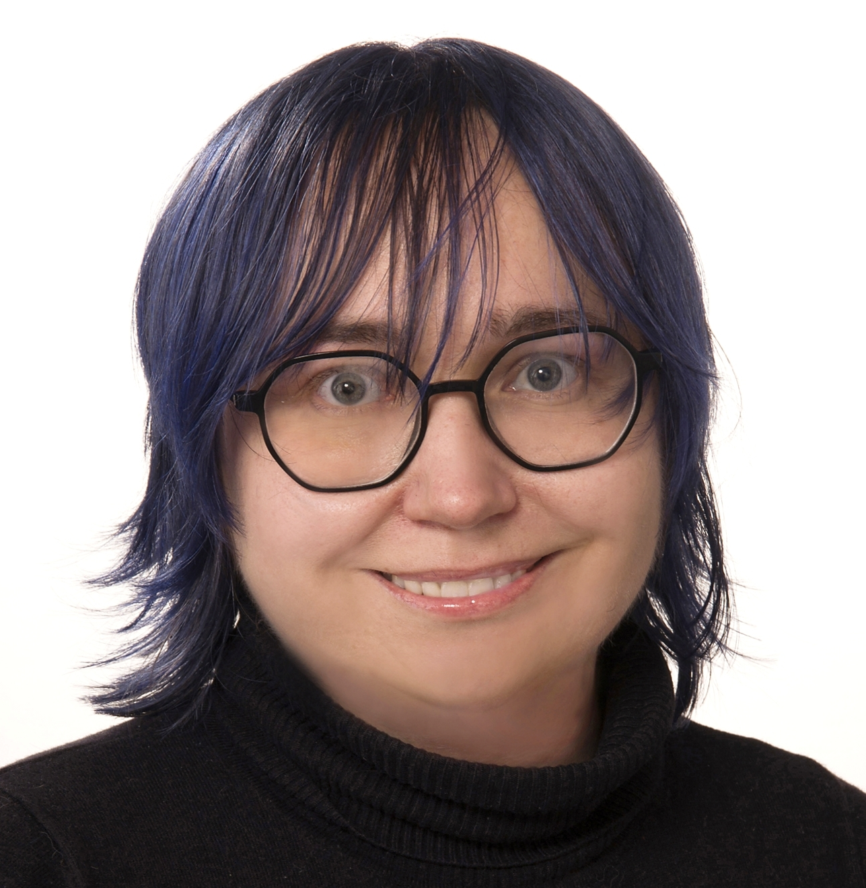
Iga Korneta, Ph.D.
Analyst, Data Analytics & Visualization
Analytics – Healthcare
Miscellaneous statistical and business analyses and reporting to the Management, using MS Power BI, MS Excel, R and Python. Creation of MS Power BI reports and dashboards to communicate insights and aid in strategic business decisions. Requirements analysis. Software analysis. Healthcare data analyses and management. Liaising with vendors, governmental and private sector agents as well as internal counterparts in the IT and Operations Departments.
Data Governance – Healthcare
Establishing robust data standards, managing diverse data sources, compliance with industry regulations. Fostering data-driven culture; facilitating cross-functional team collaboration.
IT Department Head – Healthcare
Overall team management, including managing the day-to-day activities of the Department; reorganizing and managing the growth of the Department; formalization of IT procedures and processes; liaising with vendors and internal stakeholders; requirements analyses for new software; analyses and reporting to the Management.
Onboarding of the MS 365 tenant and the MS Power BI Service.
Project Manager – Healthcare
Estimation and planning, scope management, data analysis, requirements analysis and team management.
International Institute of Molecular and Cell Biology, Ph.D. Bioinformatics
University of Warsaw, Individual Interdisciplinary Studies in Mathematics and Science, M.Sc. Biology of Cell and Organism
Warsaw Institute of Technology, Computer Science and Internet Technologies, postgraduate studies
Iga is a perpetual learner with a background in the healthcare industry and a Ph.D. in Bioinformatics. She thrives on challenges and embraces continuous learning, expanding her knowledge independently online. Beyond her analytical skills, she is a creative writer, a language afficionado, and a passionate traveler.
Visualization/BI: MS Power BI, MS Excel, MS PowerPoint, Tableau
Programming: R, Python, SQL
Other: Github, Atlassian JIRA
Certificates:
MS Power BI Data Analyst Associate
MS Azure Data Scientist Associate
MS Fabric Analytics Engineer Associate
MS Azure AI Fundamentals
DataCamp Data Science Professional w/ R
Healthcare
Polish (native), English (C2), German (C2), Spanish (C1), Japanese (B2)
Notes:
Iga.korneta

Slide 39
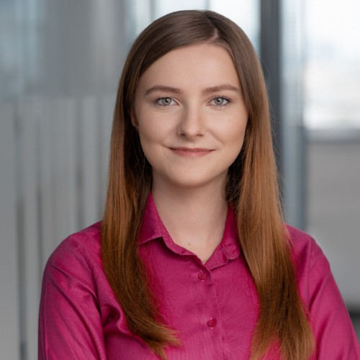
Michalina Kostrzewa
Consultant, Data Science
Leading E-commerce Platform - Senior Data Practitioner
Customer behaviour analytics lead. Provided key strategical insights regarding how customers buy, churn, onboard and spend time on the platform which led to reconstructing the whole marketing strategy.
Leading the ‘Coupon Team’ of Analysts responsible for brainstorming, inventing, implementing, maintaining and monitoring majority of marketing promotional actions (coupons, special offers, newsletters). Working in a close cooperation with Business Units, Graphics, Copywriters. Leading the analytical team in a cooperation with business counterparts from almost non-existing promo actions to hundreds of thousands coupons delivered every month.
Leading project of geolocalisation, from finding the right data, addressing the data noise, performing clusterization based on hundreds of attributes to full operationalisation of the approach.
Maintained the technical side of data wrangling, analysis, reporting, data inputs for other systems, data science models using GCP, Composer, Airflow, creation of data science algorithms.
Analysing online data, Google Analytics events, upper/lower funnel metrics, good experience in AB test, working with tracking system
Telco Company 3 - Senior Data Scientist
Designed and implemented predictive models, such as Churn and Customer Lifetime Expectancy, Overbundle Service Usage prediction, Clustering, Segmentation.
Responsible for Data Science Factory project. Refurbished the way of working with developers, performed assessment, reinvented the roadmap and implemented new testing process.
Telco Company 2 - Senior Data Scientist
Social Network Analysis predictive model design and creation.
Telco Company 1 - Data Scientist
Designed and implemented predictive models, such as Churn and Customer Lifetime Expectancy, Overbundle Service Usage prediction, Clustering, Segmentation.
Tobacco company - Functional Lead for multiple Data Warehouse and BI projects.
Translating business requirements to technical language. Design and creation of 360 view of the customer (Data Layer in DWH for acceleration of future Data Science projects). Design of E2E data flow from the data source to the visualization layer for a new BI Platform. Design of the harmonization rules, aggregations, KPI and data mapping.
Insurance company, Telco companies - Strategy Development in field of Data Driven Company Evolution. Working as an expert for Advanced Analytics and BI related fields.
Other analytical experience – FMCG, Banking, Automotive
MSc in Big Data Analytics, Warsaw School of Economics (SGH)
Michalina is Data Scientist with 8 years of professional experience in fields of data science, machine learning, campaign management, insights and value creation.
She is strongly business oriented, with her strong communicational skills she helps with cooperation between business and technical stakeholders.
Programming: Python, pySpark, SQL, Google Big Query, SAS, Basics of R
Platforms: Google Cloud Platform, Treasure Data, Composer, Airflow, Teradata
BI: Tableau, Google Analytics, Looker Studio, Power BI
Other: ETL pipelines creation, data warehousing, machine learning, forecasting, working in SCRUMs, Social Network Analysis
E-commerce
Consumer Goods
Telco Banking
Automotive
Insurance
Polish English
Notes:
michalina.kostrzewa

Slide 40
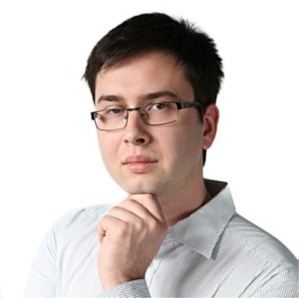
Paweł Kowalski
Consultant, Data Science
Global Insurance Company
Data engineer and data scientist. Developing PySpark and SQL notebooks to process company internal data regarding health insurance segment. Ad-hoc analyses and reports, code bug-fixing and production. Databricks and Azure DevOps tools.
Multinational Telecommunications Company
Data engineer (ETL process implementation) and data scientist. Implementing scores for searching prospect companies. Scala/Spark.
International FMCG Manufacturer
Data engineer (ETL process implementation) and scientist (analyses in jupyter notebooks) in a team preparing PoC in Quantexa framework for international FMCG manufacturer. Scala.
Major Global Bank – Scala Developer
Scala Developer in a team developing network-based solution based on the Quantexa framework for a global bank. Scala.
Trading and Investment – Quantitative Researcher and Data Scientist
Development of the automatic trading models – HFT (python: pandas, numpy, matplotlib, jupyter notebooks); analysis of time series. Python jupyter notebook investigations.
Software Engineer
Development and maintenance of open source C++ system security projects; development of scripts in python and bash for internal processes’ optimization and for Jenkins managing; managing git repositories (Gerrit and GitHub) and code reviews. C++ and python programming.
National Center for Nuclear Research – PhD Researcher and Administrator
Specialist in the field of PET simulations in the GATE software and in the field of administration of the computing cluster; member of the J-PET collaboration, whose aim is to build a novel PET tomograph based on plastic scintillators. C++ and python programming.
Telecommunication – C++ Developer
Project and implementation of editor of simulation scenarios of flights of planes (editor is the part of application used to control radar devices). Window applications based on FLTK library, simulations, developing of mathematical algorithms, doxygen and technical documentation
National Centre for Nuclear Research – PhD, Monte Carlo simulations of Positron Emission Tomography (PET)
Warsaw University of Technology: M. Sc. in Modelling of Complex Systems; parallel engineer studies at 2 faculties: B. Sc. in Electronics and Computer Engineering, B. Sc in Technical Physics
Paweł has valuable experience in field of Research and Data Science. He has strong programming skills in languages like python, C++ and scala. Paweł had an opportunity to work in various industries and got experience in development, programming, administration and analysis. He has solid education background, and he is an author and co-author of more than 100 science publications.
Quantexa certified, Scala, Spark
Python (pandas, numpy, scipy, matplotlib, jupyter), C++, bash
Git (GitHub, GitLab, Gerrit)
JIRA, Confluence
Linux, Jenkins, HPC cluster
R&D
Healthcare
Nuclear Sector
Trading and Investment
Banking
Polish English
Notes:
pawel.a.kowalski

Slide 41
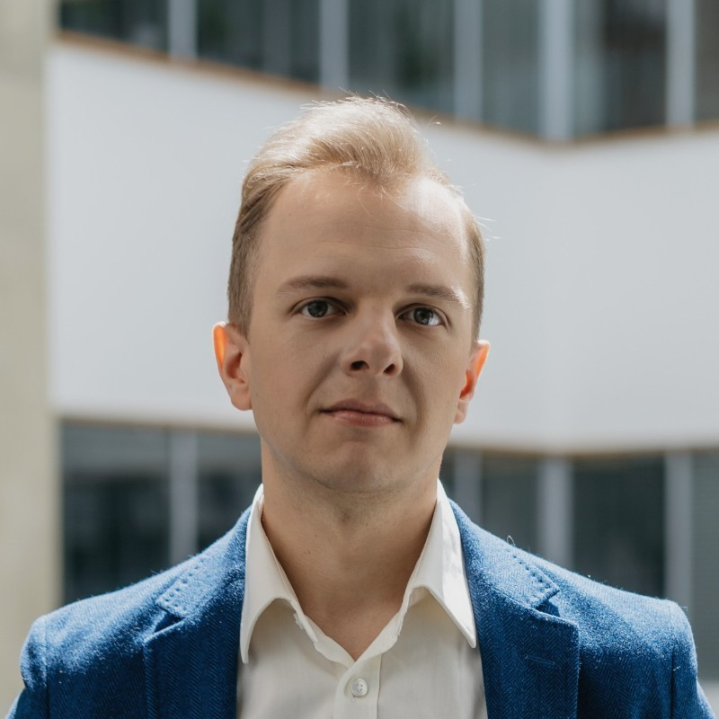
Łukasz Kozdroń
Consultant, Data Science
Power BI Developer & Data Engineer. Leading Insurance Company (current).
Design, develop, and implement data modelling solutions using Databricks to support the insurance company's core business analysis and product performance. Develop and maintain data models in Power BI to analyze insurance claims data, customer data, and market trends to identify patterns, trends, and insights that can be used to improve decision making, claims processing, and customer engagement. Collaborate with business stakeholders, such as sales, customer service, quality, and marketing managers, to understand their data needs and develop tailored data solutions.
Power BI Developer. Leading multinational pharmaceutical company.
Led the implementation of an end-to-end business intelligence system using Power BI. Designed and developed dashboards and reports to provide insights into sales performance and market trends. Trained business users and developers on how to use Power BI to perform analysis. Established a company knowledge hub for Power BI training and education. Created and delivered training modules for business users and developers. Provided guidance on how to use Power BI reports to drive business decisions. Developing dashboards, reports and automated solutions in Power BI.
Demand Planner. International consumer goods company
Demand Planner. Managed S&OP process and demand consensus in highly seasonal and volatile ice cream category. Partnered with international traders to accelerate sales of slow-moving goods. Collaborated with manufacturing partners to develop new production technology for ice cream production. Led a project to optimize factory costs for pre-manufacturing operations.
Military University of Technology Master’s degree in Logistics
Military University of Technology Engineer’s degree in Logistics
Specialized in PowerBI platform with complex knowledge of data modelling and visualization.
Certifications:
Azure Enterprise Data Analyst (DP-500), Azure Data Engineer (DP-203), Power BI Data Analyst (PL-300) , Databricks Data Engineer Associate, Tableau Desktop Specialist
PowerBI, DAX, PowerQuery, Azure, Databricks, MS Fabric, SQL, PySpark, Data modeling, Data storytelling, Data visualization, Tableau
Insurance
Healthcare
Consumer goods
Polish English
Notes:
lukasz.kozdron

Slide 42
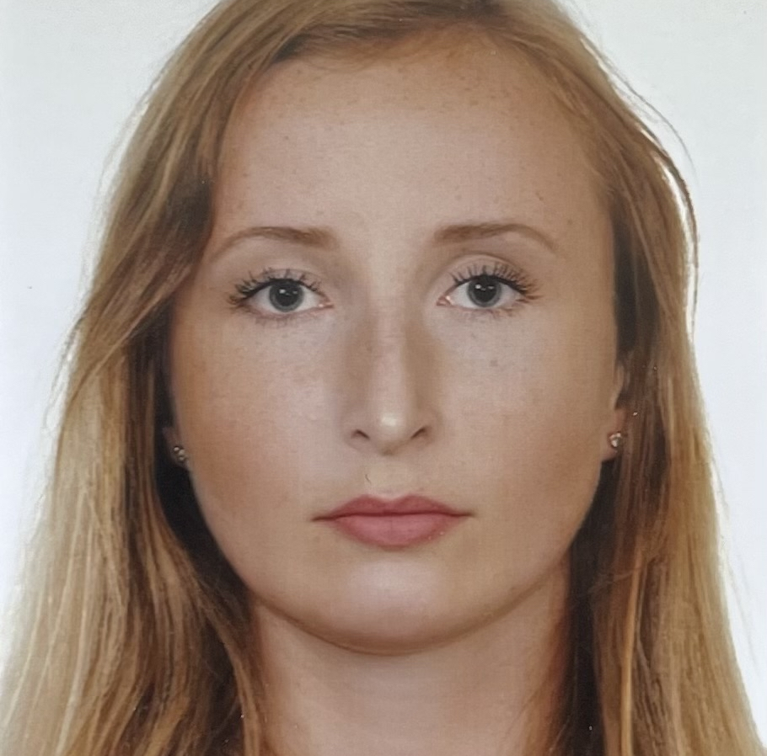
Katarzyna Kubica
Associate Manager, Data Science
German Retail Company - Data scientist
Responsible for statistical analysis and forecasting of timeseries in Supply Chain Management area and resolving ad-hoc demands from business. Working in Databricks using PySpark and Spark SQL.
North American Communications Service Provider - SAS developer and data analyst on personalization engine implementation project
Responsible for applying machine learning algorithms to real time decisioning, configuring marketing campaigns, creating custom 4GL code to extend standard functionalities, implementing REST API integrations using Python. Using SAS CI, RTDM, Oracle DB.
Polish Reading Research (non-Accenture Experience) - Senior Data Scientist
Responsible for building customized questionnaire, coordinating the work of analytical team and supervision of the project on reading emotions from faces on videos. Using Python, R, SPSS.
Polish Reading Research (non-Accenture Experience) - Data Scientist
Responsible for building algorithms, increasing quality of analytical processes, automating of solutions, combining and modeling data from different sources, performing statistical analyzes and substantive and technical support for external client.
Universal Insurance Institution (non-Accenture Experience)
Consulting the amount of discounts in insurance communication.
Warsaw University of Technology, Master's degree in Mathematics
Warsaw University of Technology, Bachelor's degree in Mathematics
Katarzyna holds Master’s degree in Mathematics with specialization: Mathematical statistics and data analysis. She is fluent in Python, R, SAS and SQL. She has experience with Statistics, Data Mining and Machine Learning.
Machine Learning, Python, Prophet, pySpark, pyTest, Mlflow, Git, Azure DevOps, Data Mining, Statistics, R, SPSS, SQL, SAS 4GL, CI, RTDM
Large Language Models, Generative AI
Microsoft Certified Azure Data Scientist Associate (Azure Machine Learning, Databricks)
AWS Certified Solutions Architect - Associate
Retail
Market research
Insurance
Telecommu-nication
Polish English
Notes:
katarzyna.kubica

Slide 43
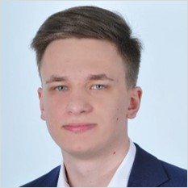
Tomasz Kuczak
Manager, Data Engineering
Insurance Holding
Led a development team in a project to ensure GDPR compliance of the data warehouse, data marts and interfaces. The team was responsible for the end-to-end delivery of the solutions. Requirements engineering together with the legal and business stakeholders; Business analysis and impact assessment of the anonymization/deletion of the data warehouse operations; Business object identification mechanism based on retention classes for the purpose of GDPR compliance; Two-way communication with the orchestration system over Kafka – eg. sending identified objects (deletion candidates) and receiving objects to delete/anonymize (delete orders); Highly configurable data deletion/anonymization mechanism based on metadata; Mechanism for reporting on deleted or anonymized data. The project was delivered in a Nearshore model in scrum.
International Telecom
Preparing data for analysis integrating data from several sources. Predicting customer call reasons using advanced analytics.
Heavy Industry Company
Improving stock levels and supply chain effectiveness using analytics. Forecasting demand for inventory parts. Creating analytical tools for the business users.
Polish bank
Customer segmentation for an international bank for CRM purposes.
Warsaw School of Economics, BS: Quantitative Methods in Economics and Information Systems
Tomasz has over 4 years of professional experience in analytics and data engineering projects. He combines technical skills with business approach. He has experience in data architecture and ETL design. He also has a good understanding of business GDPR compliance topics.
Database design
ETL
SAS (4GL, EG, DI)
SQL (DB2, Oracle, PostgreSQL)
Python, Javascript
Bash, Docker
Insurance
Telecom
Polish English German
Notes:
tomasz.kuczak

Slide 44
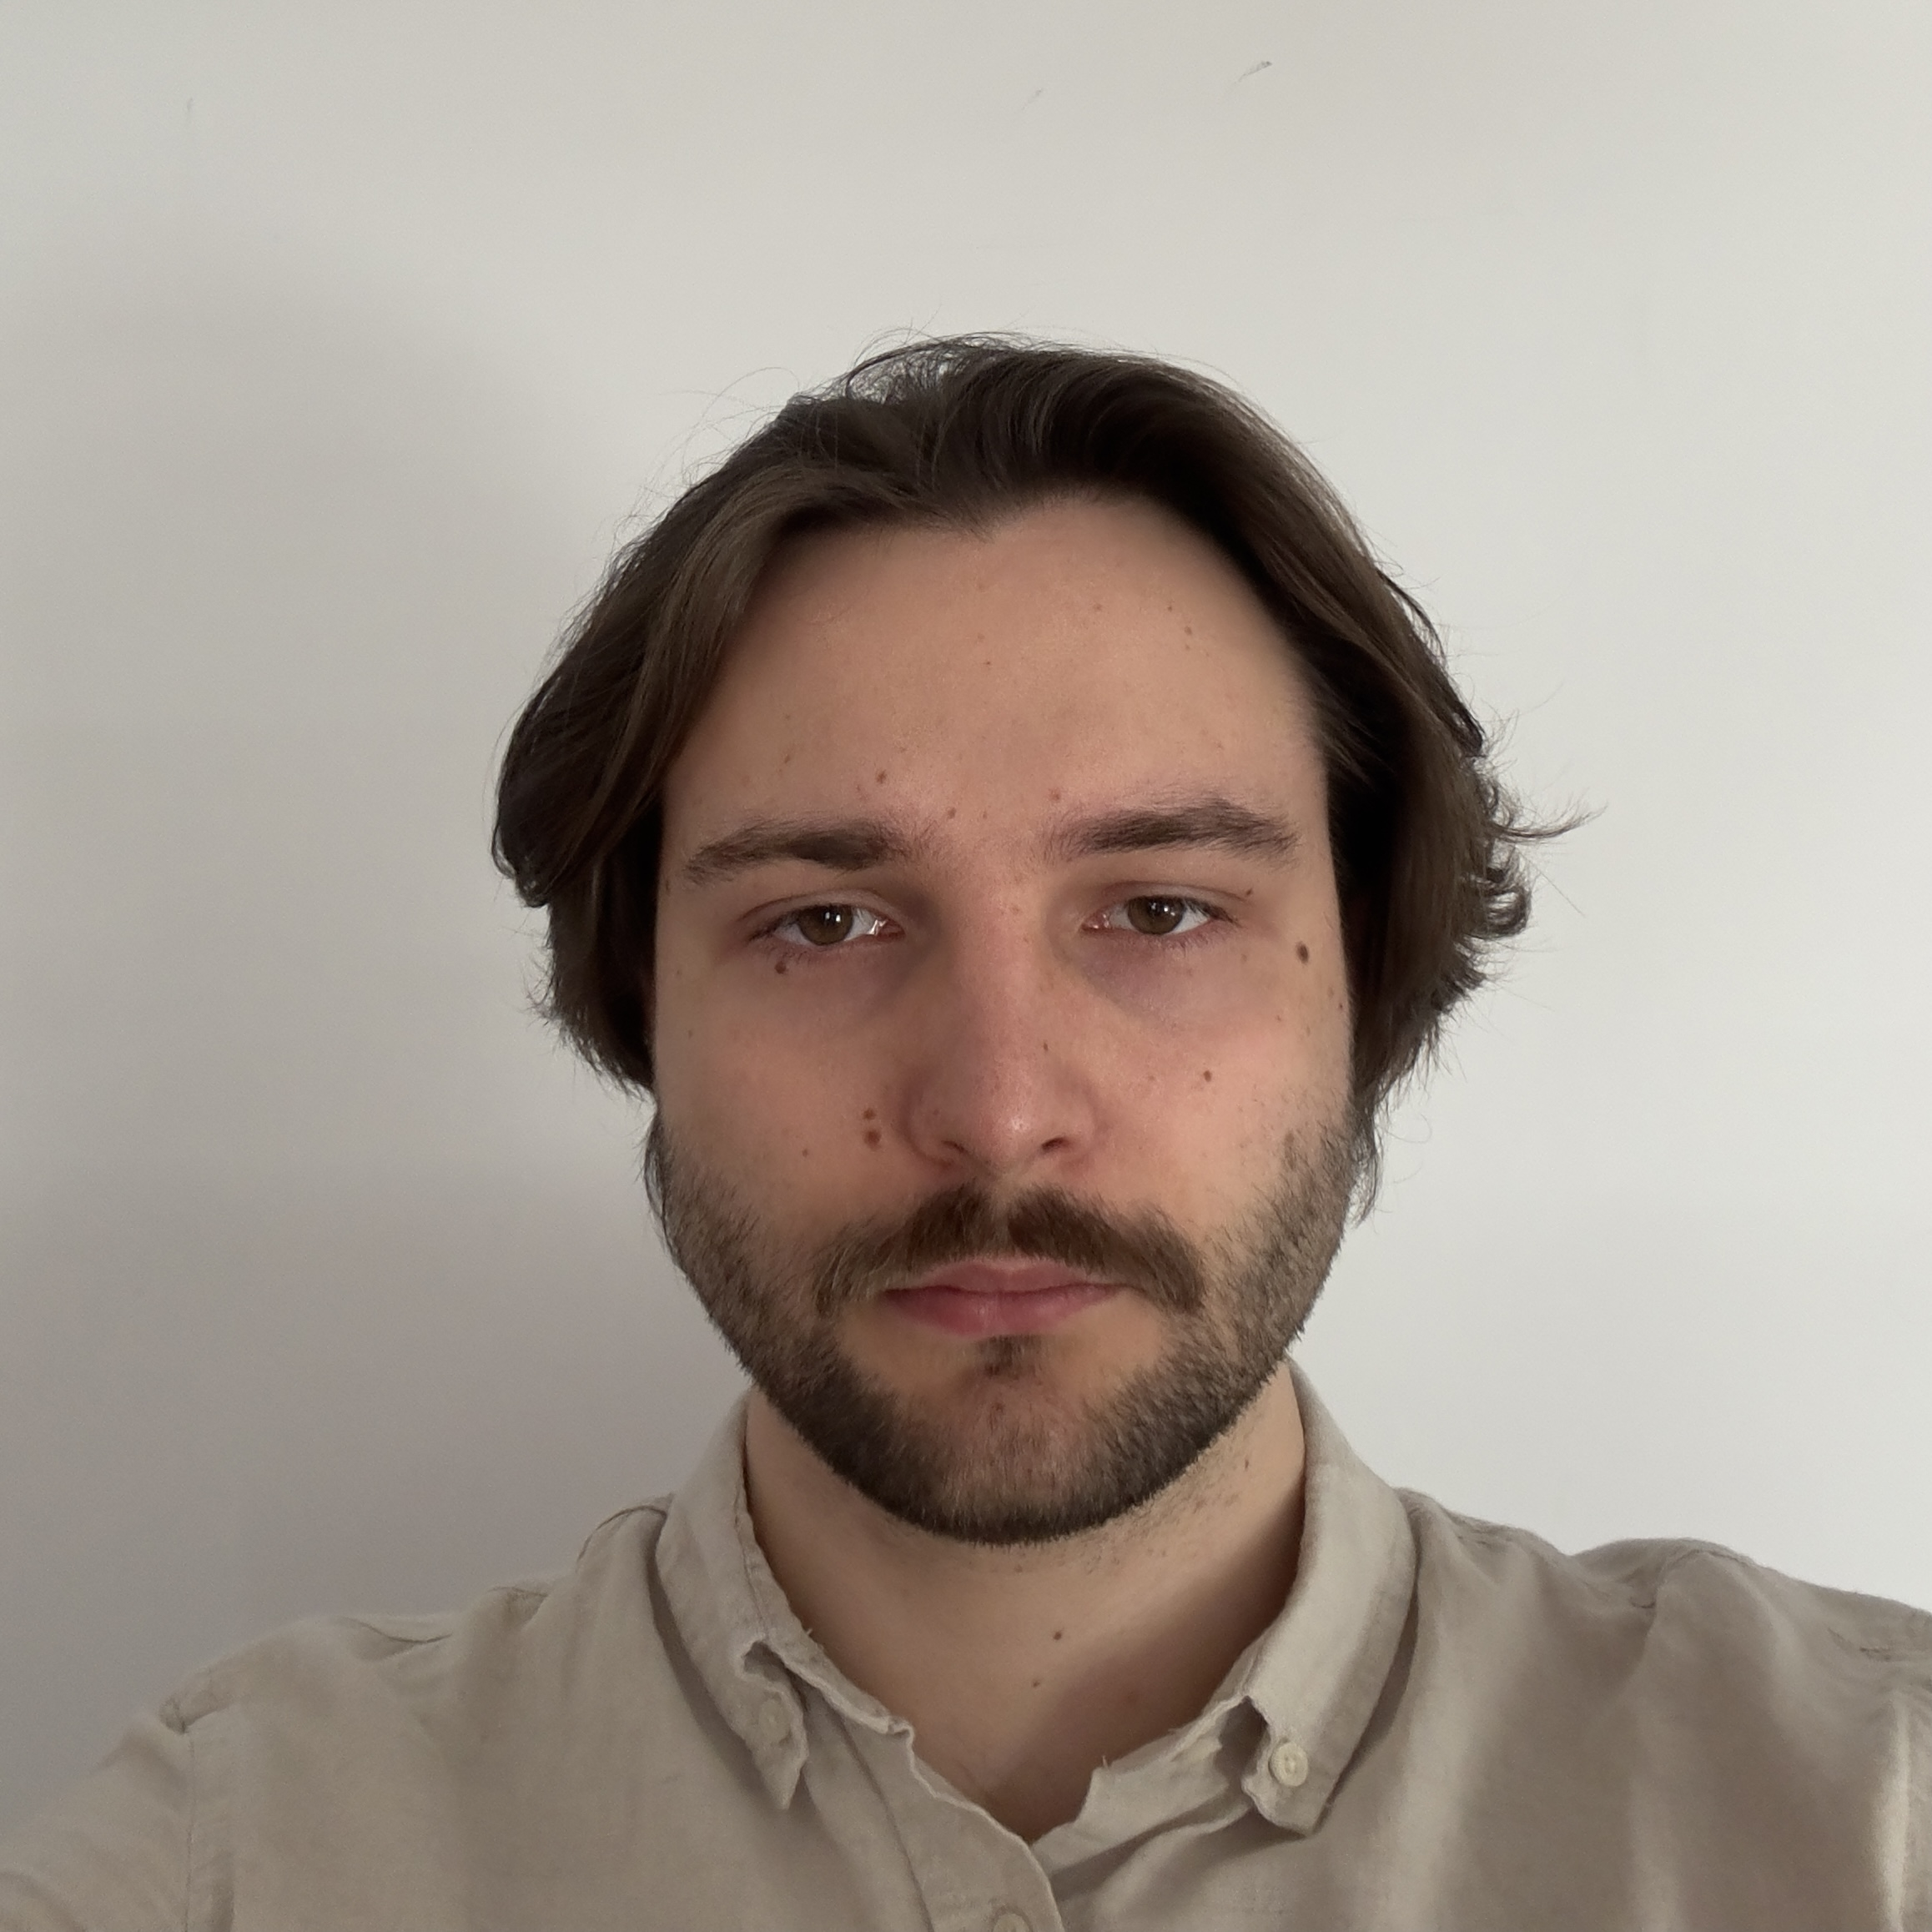
Adam Kuliński
Analyst, Data Engineering
International company
Played a crucial role in migrating the existing Teradata data warehouse infrastructure to AWS. It involved optimizing ETL processes for AWS Redshift, ensuring strict data compliance and integrity throughout the transition. Developed AWS Step and Lambda functions to provide custom functionality to SQL scripts.
Actively collaborated with team members to troubleshoot complex data-related issues, and thorough analyses of data sources were conducted to identify and rectify root causes of discrepancies and errors. Carried out several initatives improving data integrity and processing efficiency.
Designed and implemented monitoring and reporting dashboards in Grafana to track the performance of AWS services. Developed specialized Python tools for data migration and comparison between Teradata and Redshift, utilizing packages such as Pandas, redshift-connector, pyodbc, and ggplot2.
Marketing agency
Utilized SQL Server Integration Services (SSIS) to extract and transform data from various data sources and load it into the SQL Server Analysis Services (SSAS) data models, optimizing performance and data accuracy. Developed advanced SSIS packages using components such as Data Flow Tasks, Control Flow Items, and various transformations to efficiently extract, clean, and validate data from multiple sources including CSV, Excel, and XML files, as well as database connections.
Created measures in SSAS tabular model using DAX (Data Analysis Expressions) language to provide comprehensive insights into the organization’s sales and financial metrics.
Designed and implemented SQL Server Reporting Services (SSRS) reports to help the organization analyze monthly spending, sales trends, and other key performance indicators
Warsaw School of Computer Science, BSc Eng. In Compuer Science
Databricks Certified Associate Developer for Apache Spark 3.0
Fundamentals of the Databricks Lakehouse Platform Accrediation
SnowPro Core Certification
Adam holds a bachelors of engineering in Computer Science. He has experience in cloud technologies, particularly within the AWS ecosystem, he made pivotal contributions to migrating the existing Teradata data warehouse infrastructure to the cloud. He has a very good knowledge of several SQL flavours, Python and multiple Cloud native tools.
Apache Spark, SSIS, RSQL
AWS, Databricks, Snowflake
Power BI, Jupyter Notebook, Grafana
MS SQL, MySQL, PostgreSQL, Redshfit
AWS Dynamo DB, AWS S3, Google Cloud Storage
Python
Marketing
Polish English
Notes:
adam.kulinski

Slide 45
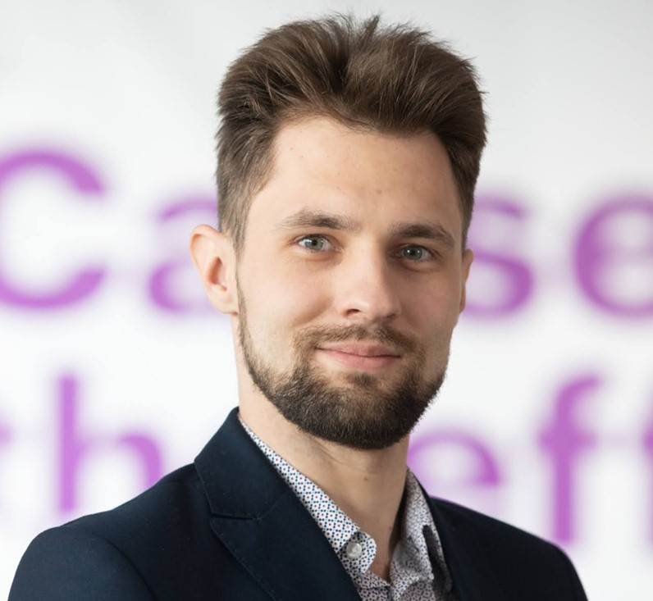
Kamil Kuźniak
Consultant, Data Science
International Insurance Company
Data scientist in a team working on claims cost reduction project. Main tasks were data analysis and anomaly detection model creation to generate insights for the audit team on care provider unacceptable behaviours. Main technologies used were PySpark, SparkML and SparkSQL.
International Insurance Company
Data modeller, data analyst and data engineer in a team working on the performance reporting of new products. Main tasks were analyzing the source data to find the relevant information, improve the quality of the data and engineer new features, and then using that analysis to design and develop ETL solutions (using PySpark and SparkSQL) to provide data for the reporting dashboards.
Proof of concept LLM project
Developer working on preparing a streamlit application that uses GPT-4 to create SQL queries based on the database schema and a question from a user. Development of the streamlit app, prompt engineering and testing of the solution.
Swiss Insurance Company
ETL Developer in a team handling data transformation from Datahub to the enterprise data warehouse based on SAS DDS (Detailed Data Store) model for Insurance; ETL Developer in a GDPR team, delivering end-to-end custom solutions for data warehouse (implementation, unit testing, user acceptance testing)
Major International Bank
Data consultant on a multinational Risk transformation programme. Aiding in the design and building of the data products (with the aid of python and pandas library), analyzing the data for the expansion of these data products, tracking the data lineage through the analysis of SQL scripts, defining the operating model and the governance of the project and working across regions to identify use cases and requirements for the data refinery.
Own Projects
Classification Modeling of Gym Interest
A complete business case study and machine learning modeling project consisting of the analysis and transformation of structured and unstructured data to identify the best strategy for entering a new market for a gym chain and to predict the interest in gym memberships of potential clients.
Lodz University of Technology. Master’s degree in Electronics and Telecommunication
Ghent University. Master’s degree in Electrical Engineering
Lodz University of Technology. Bachelor’s degree in Mechatronics
Kamil holds a masters degree in Electronics and Telecommunication and is a data scientist with experience in banking, financial risk and insurance industry. He also has experience working with PySpark, SQL databases, data transformation and common data science packages for Python as well as Azure cloud services.
Cloud: Azure, AzureML, Databricks (DP-100 certificate)
Python data science packages (Sklearn, Matplotlib, Seaborn)
PySpark and SparkSQL
Data transformation using Numpy and Pandas
SQL and SAS
Financial Risk
Banking
Insurance
Polish English
Notes:
kamil.kuzniak

Slide 46
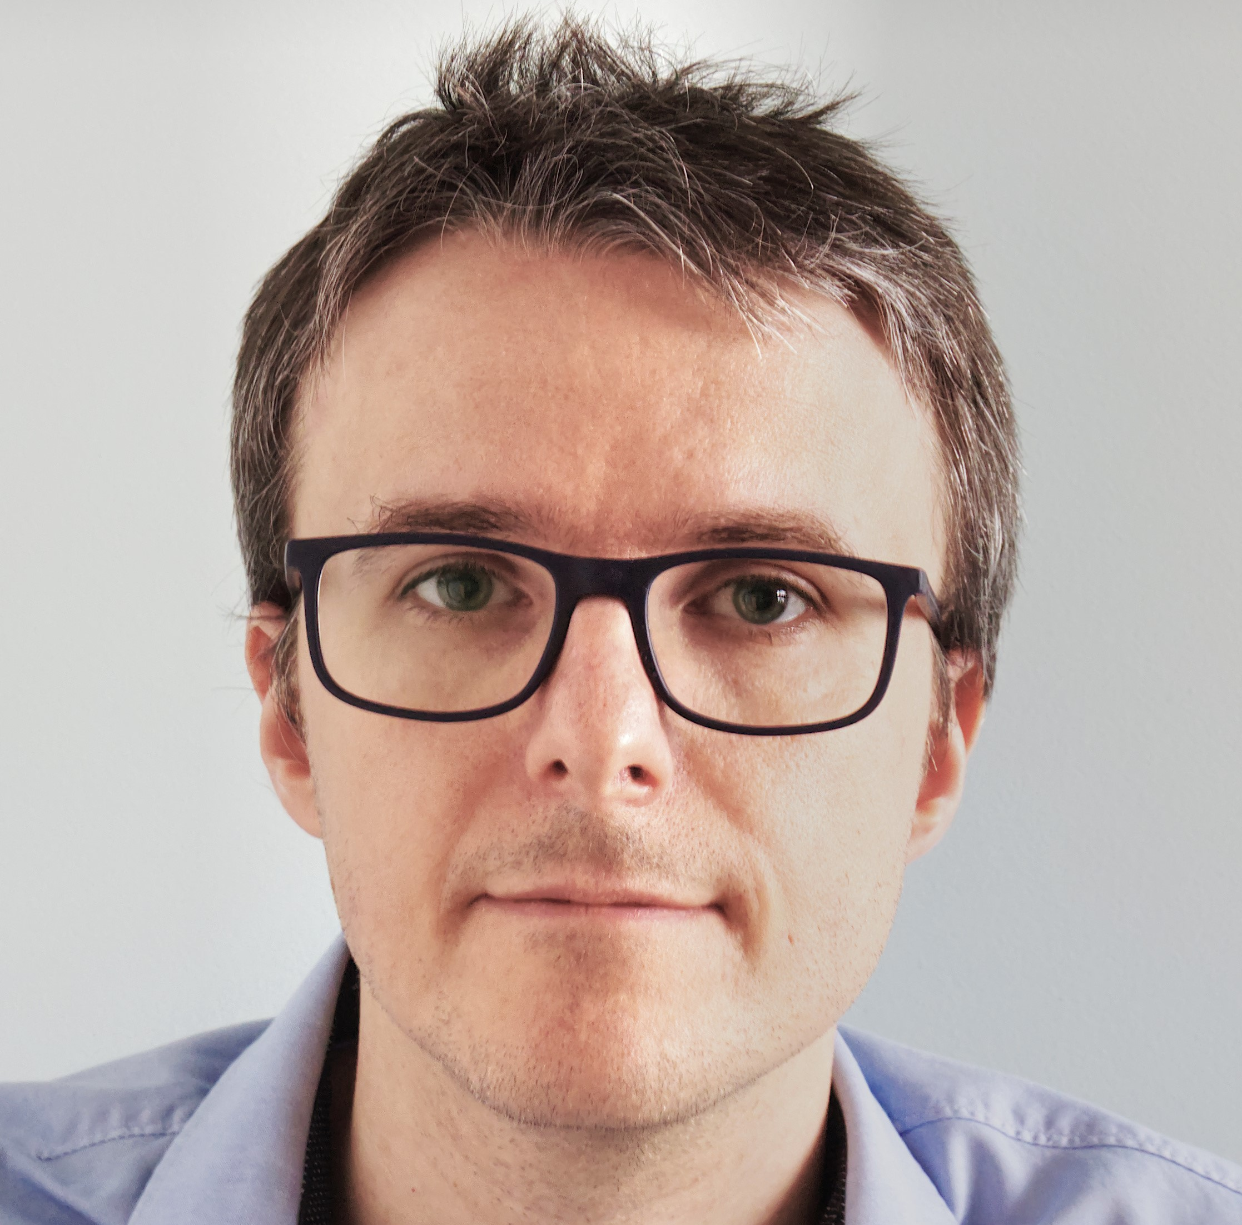
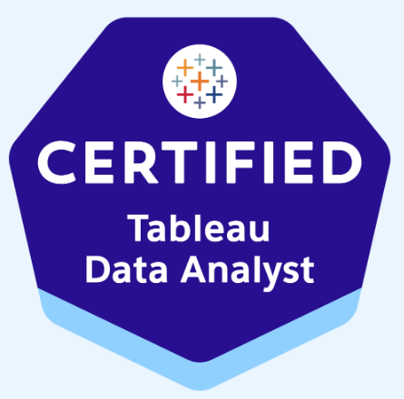
Michał Leś
Analyst, Data Analytics & Visualization
Large Social Media Company – Visualization Engineer, BI offshore Lead
BI offshore Lead for IDC team. Maintenance and optimization of dashboards in Tableau, adding new features, redesign of existing visualizations, improving an ad hoc analysis of issues. Root cause analysis of issues. Support the recruitment process and training new colleagues. Main tools: Tableau, Presto SQL.
Business Process Outsourcing Services – Visualization Developer/ Data Analyst
Creating analytics reports in BI tools (visualizations in Tableau, Super Set + CSS; data source in SQL in Presto, PostgreSQL, db2); gathering requirements for new reports or modifications; investigating the issues, data flow modification; deployment of components for data analysis & products reporting (gathering feedback from business stakeholders, cooperation with other IT teams, product improvement); project coordination; organizing meetings; preparing documentation.
Business Process Outsourcing Services – Business/Data Analyst (implementing existing tools - KPI/SLA or Custom Reports)
Project management (client, stakeholders, developers); business and data analysis; gathering requirements; preparation of technical documentation (for developers); communication with stakeholders; tool presentation; training sessions (external and internal users); user acceptance tests; working on tool improvements ideas, gathering feedback on user experience; root cause analyzes in case of issues and 2nd line support; basic development tasks (SLA/KPI configuration in Dev module, SQL).
Business Process Outsourcing Services – OTC/PTP/RTR Team Leader
Team management (10-15 persons) in area of
Cash Application/Billing/Rebate processing/ Customer and Vendor Master Data Maintenance/ Vendor Payments, Supplier invoice processing/Travel & Entertainment/ Query management; operational issue and escalation management; monitoring of performance quality in accordance with SLA/KPI; team workload management; writing and update of procedures; analyze and implementation of process improvements; Experience with various finance ERP systems (SAP, QAD and PeopleSoft), PTP work flow management (COUPA) ticket management & Close Monitoring (JIRA).
Business Process Outsourcing Services – Order to Cash accountant with Italian
Performing tasks in various OTC processes (cash collection, billing, customer queries, master data management); knowledge transfer) in client headquarter (Milan, Italy); preparing data for SLA calculations; Team Leader’s backup and process coordination; process improvements with Continuous Improvement Team; creating and update of procedures and process maps.
Jagiellonian University - International Relations (Master Degree)
Jagiellonian University - Comparative Studies of Civilizations (Bachelor's Degree)
University of Bologa (Italy) - Erasmus
Michał is an experienced data and business analyst with strong data visualization and reporting skills, who translates data into actions. Developed, optimized and maintained reporting solutions based on a variety of platforms, incl. Tableau and Super Set with CSS. Successfully led teams for multinational companies.
SQL
Visualization (Tableau, SuperSet, IBM Client Vantage), CSS
Python (Pandas/Numpy/Matplotlib)
Excel, Power Query, VBA basics
ERP accounting systems: SAP, People Soft, QAD
JIRA (Help desk, Close Monitoring)
Certifications: Tableau Data Analyst (2023)
Outsourcing Services
Finance
HR
Automotive
English Polish Italian French
Notes:
michal.les

Slide 47
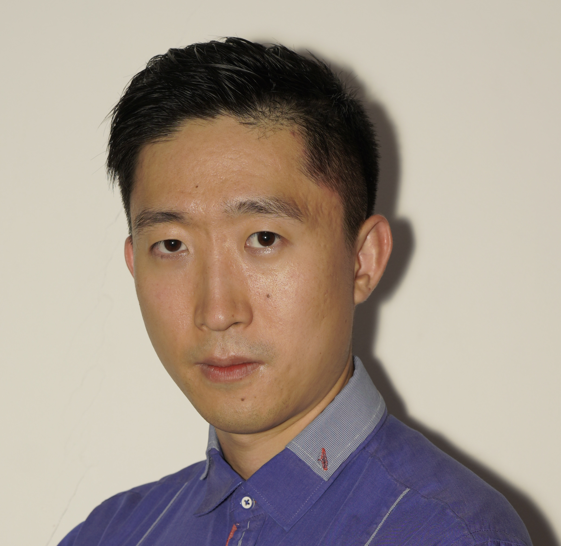

Yunpeng Lyu
Consultant, Data Analytics & Visualization
Consultancy Services– PowerBI Developer
Implementing ETL procedures in transforming data between different environments for end-user consumption. Developing end to end streaming and batch data analytics pipelines. Mainly using Microsoft Power Platform technology (Power Apps, Power Automate) and database/data storage technologies (Azure SQL DB, Azure Data Factory, Azure Blob Storage, Google BigQuery/DataStudio) Expediting multi-source and multidimensional methods of data analysis and reporting. Utilizing Power Query Editor and visual modeler to connect to different data sources. Writing DAX queries that are performant against complex/big datasets.
Consultancy Services - ServiceNow Administrator
Design multiple clients' global quantity, quality and CSI reporting frameworks. Produce performance analytics and dashboards based on defined measures, metrics and indicators. Collaborated with Service Desk, Change Management, Asset Management, Incident Management, CMDB and Discovery Project Management.
Leader in Technology Automotion - Data Analyst
Develop, manage, and improve service data base in Python language (pandas, numpy) and R. Analyze service data created within support systems and existing databases; create Power BI reports to support business performance. Maintain BI folders for analytical purposes of management teams and KPI monitoring. Apply machine learning functions to discover abnormality, allocate prospects, and comprehend customer behaviours.
Global Animal Health Company - Procurement Specialist
Verify accuracy of suppliers' bills against original purchase orders to avoid billing errors. Check requisitions to evaluate accuracy, terminology used, and outlined specifications against established requirements. Act as a first line of support for Master Data related questions. Resolve invoices on hold by working with accounts payable.
Rutgers University Bachelor in Geography and Statistics
Lyu is an experienced data analyst with strong data visualization skills, Developed, optimized and maintained variety of reporting with the use of Power BI and other tools.
Built his experiences in multinational consultancy and technology companies working as BI consultant and data engineer.
Power BI (DAX)
SQL
R, python (numpy, pandas)
Power Platform, Google BigQuery/Data Studio
Business Intelligence Consulting
Certificates: MS Azure – data enginner associate, data scientist associate, administrator associate
Consultancy
Healthcare
Technology
Automation
English Polish Chinese
Notes:
yunpeng.lyu

Slide 48
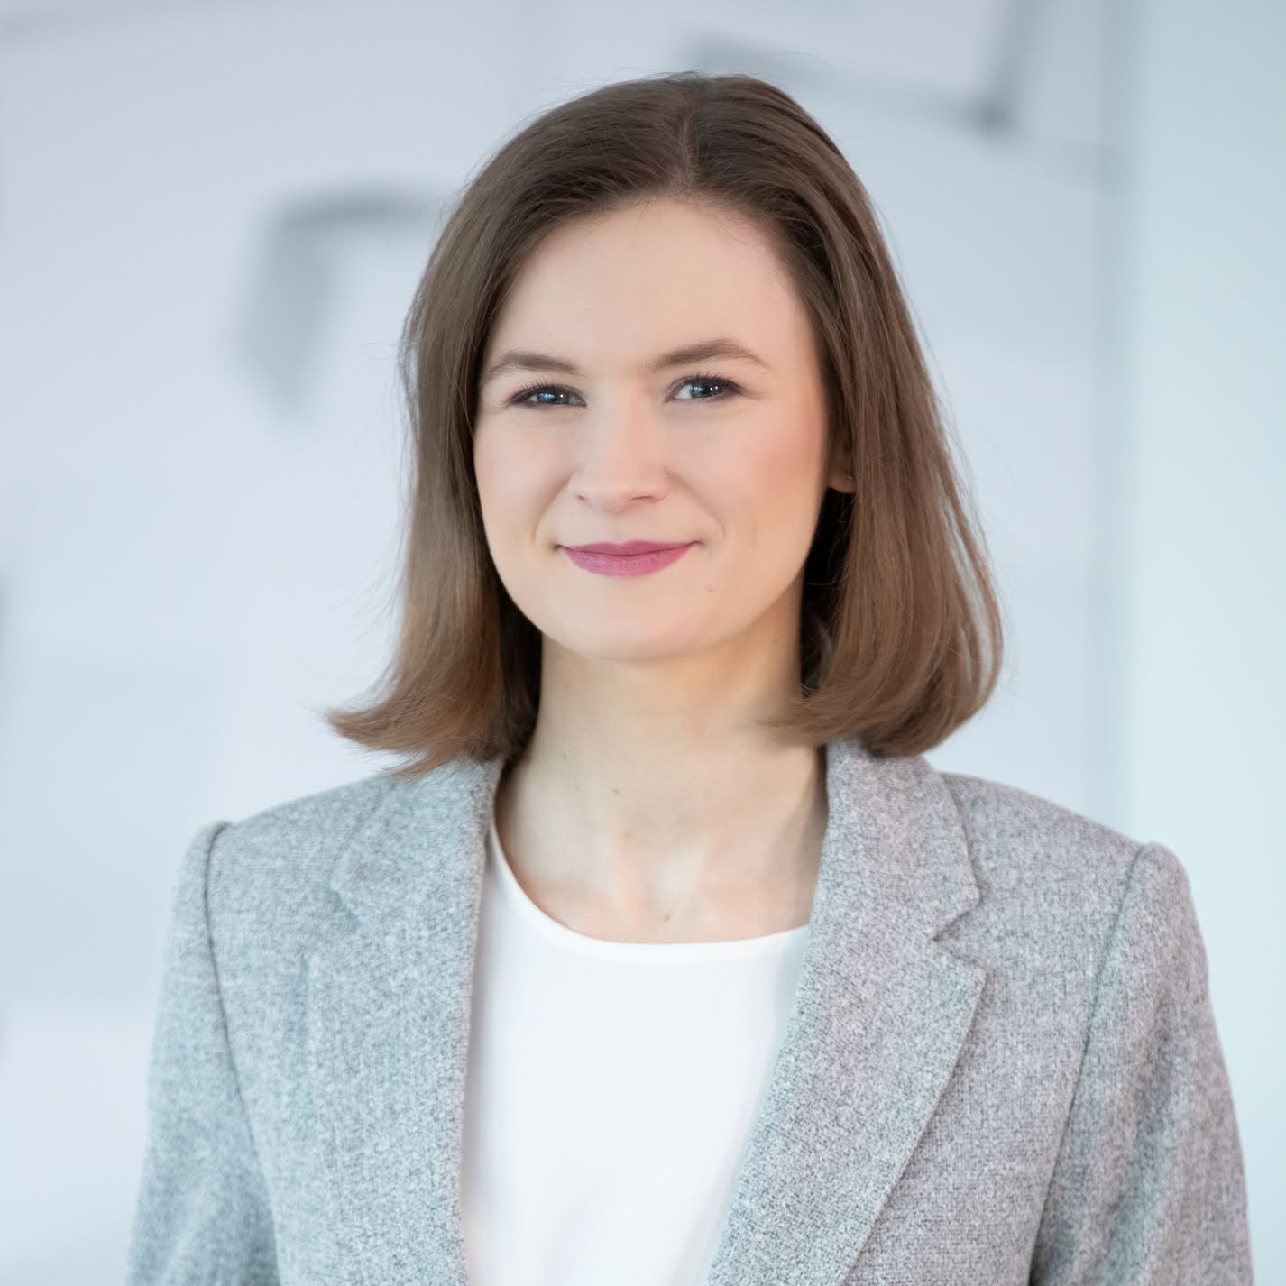
Aleksandra Łysik-Figat, Ph.D.
Analyst, Data Science
Swiss Insurance Company – Data Engineer
Designing and implementing ETL solutions for delivering data in IFRS standards (to DB2 and Oracle databases). Creating, analyzing and bug fixing SAS jobs, scripts and flows. Designing streams to trigger SAS flows for end-users (Streamworks). Data modelling (Erwin data modeller). Preparing test concepts and scripts, testing and documenting results
Belgian Insurance Company – Data Engineer
Designing, configuring and developing SSIS solution to ensure GDPR compliance of data warehouses (MSSQL, DB2). Creating, analyzing and debugging SQL scripts, DWH business analysis, creating docummentation, providing test scenarios (in collaboration with the client) and support to business users in UATs.
Warsaw University of Technology – Research scientist
Manufacturing fuel cell components, conducting scientific experiments, processing and analyzing obtained data, presenting results in descriptive and graphical forms; Study of the influence of microstructure and chemical composition on catalytic properties of open-porous components of molten carbonate fuel cells; Novel molten carbonate/ceramic composite materials for sustainable energy technologies with CO₂ capture and utilization; Improved production of fuel cells in order to extend the life, improving the operating parameters and to reduce investment and operating costs through the use of alternative catalytic systems in printing technology
Warsaw University of Technology – Doctor of Engineering, Faculty of Materials Science and Engineering
Warsaw University of Technology - Postgraduate studies, Data Science - algorithms, tools and applications for Big Data problems
Warsaw University of Technology - Master of Science, Materials Engineering
Warsaw University of Technology - Bachelor of Engineering, Materials Engineering
Aleksandra has been working in the field of materials technology development for use in alternative energy sources. She is a quick-learning, creative person who discovered a passion for data science. Additional asset is her experience in science outreach which allows her to talk about complicated ideas in an approachable way.
SQL
SSIS
Python
Git
R
Tableau
Cloud (Certified in Azure)
SAS (Base Programmer certification)
Insurance
Materials Engineering
Research Institutions
Polish English
Notes:
a.lysik-figat

Slide 49
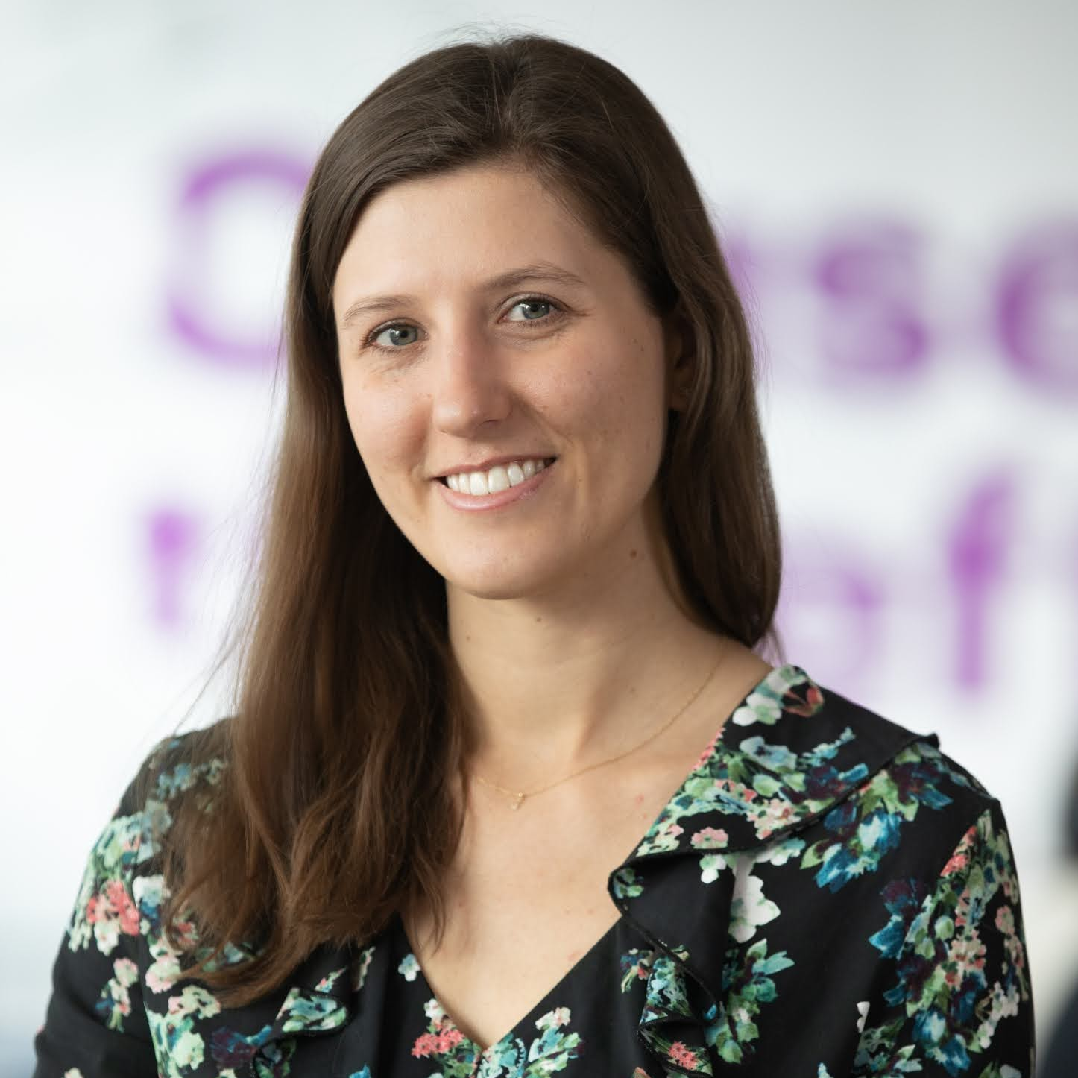
Barbara Łysoń-Uklańska, Ph.D.
Consultant, Data Science
Social Media Company – Data Scientist
Model development and experimentation for marketing campaign measurement and optimization. Translate data insights into actions and recommendations that will help drive brand sentiment, user growth and engagement, and marketing effectiveness. Collaborate with research teams to understand the target audiences for specific marketing campaigns and establish both baseline (pre-campaign) and impact (post-campaign) sentiment via surveys. Provide guidance which may be used by marketing partners to make data-driven decisions based on product usage data and consumer surveys.
Insurance Company - Developer
Developer for integrating indemnity insurance data content to the enterprise data warehouse (EDWH, SAS DDS data model ) together with dependent systems for currency rates and coinsurance information. Creating ELT jobs using SAS Data Integration Studio and DB2 SQL using the approach allowing Near Real Time data load. Performing manual test as well as designing and executing mass tests (SAS EG). Providing UAT support to business users. Promoting code using Promotion Wizzard and using BitBucket for DDLs request.
Biomechanic Research Company – Intern
Leading research project for footwear company (Influence of shoe's pitch and thickness on kinetic and kinematic gait parameters)
Ministerial Grant contractor in University of Physical Education in Warsaw
Using mathematical modeling for analysis and optimalization of sport technique in acyclic sport disciplines. Performing musculoskeletal simulations using OpenSim software, data analysis in Matlab software, participation in research papers preparation, participation in Polish and international conferences.
PHD Research
A method of designing a new, individualized ankle joint brace; kinematic and kinetic data collection (Vicon Nexus) and analysis (Matlab), musculoskeletal simulation (AnyBody, Python), statistical analysis (Statistica), 3D geometry capturing and processing (Artec), ankle joint brace geometry project (Autodesk Fushion 360).
Medical Center– Functional Diagnostician
Performing and analyzing functional tests (2D/3D motion analysis, muscle force tests, electromyography, stabilometry, podobarography) for clinic patients and athletes.
Math Center– Mathematics Teacher
Teaching children mathematics according to The Math Circle program.
Warsaw University of Technology, PhD in Biomedical Engineering
Warsaw University of Technology, Master in Biomedical Engineering
Warsaw University of Technology, Bachelor in Biomedical Engineering
Barbara has over 9 years' experience in Biomechanics, Statistics and Data Analysis. She has good educational background related to IT and engineering in medicine as well as practice in leading scientific projects, public speeches and teaching. Working in various industries, Barbara became especially experienced in data integration and analyses supporting data-driven decisions.
Azure Machine Learning, Azure Databricks (DP-100 certified)
SAS (DIS - certified , EG)
Data analysis and programming: SQL, Python (NumPy, Pandas, Matplotlib, Scikit-learn, SciPy Turi Create), Matlab, R, Java, C++, Statistica
Insurance
Social Media
Biomechanics
Statistics
Medicine
Polish English German
Notes:
b.lyson-uklanska

Slide 50
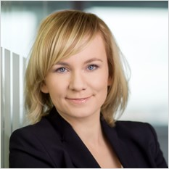
Monika Makuch
Associate Director, Data Science
Internal Gen AI Data Insights Asset – Project Lead and Product Owner
Building an asset providing business users with data insights based on questions written in natural language. Harnessing OpenAI's advanced code generation capabilities, along with LangChain, prompt engineering, NLP, and data management techniques to translate data-related queries into SQL commands executed on the database, resulting in actionable results.
Global Tobacco Company - Data & Analytics Hub Lead
Supporting the client in building a modern, sustainable and scalable enterprise data platform. Designing a data model for handling data ingested from diverse sources. Migrating legacy systems onto the new platform. Facilitating platform adoption through functional and technical assistance. Aiding business users and data managers in effective Master Data Management (MDM) usage. Delivery of data and analytics products within B2B, consumer data, IoT, and marketing areas. Leveraging Azure and Snowflake ecosystems.
UK Telecommunications Company - Analytics and Data Squad Lead
Shaping analytics and data strategy. Leading a team composed of data modelers, data engineers, and data analysts in their tasks of defining data models, building data pipelines, creating visualization dashboards, and delivering customer analytics use cases.
American Tobacco Company - Data Architect
Data Architect on multinational program of building modern Data Warehouse in the cloud and global reporting platform. Leveraging a mix of technologies (AWS S3 buckets, Snowflake, WhereScape and Power BI). Design of target data model based on Data Vault 2.0 modeling, coordination of development and testing.
Nordic Transmission System Operator - Reporting & Monitoring Team Lead
Shaping reporting system architecture, designing reporting dashboards, data models and data flows. Coordination of off-shore development team. Applying performance improvement solutions.
Major UK Banking Group - Analytics Team Lead
Coordinating data and analytics streams, which involved optimizing data ingestion processes, creating a products data mart, developing new data visualization dashboards, and delivering customer analytics use cases.
Norwegian Telecommunications Company - Functional and User Experience Lead
Design of dashboards for a self-service reporting solution. Coordination of technical design, development and test activities.
German Insurance Company
Design & implementation of data integration for Solvency II, defining delivery standards & data management guidelines.
Warsaw University of Technology, Postgraduate Studies in IT Resource Management
Warsaw School of Economics, Master in Quantitative Methods in Economics and Information Systems; Master in Finance and Banking
Monika has over 16 years of professional experience with focus on data management, data architecture and analytics. She has been working on the intersection between business and technology helping organizations turn their data into valuable insights and actions. Her work spanned from project and team management through requirements specification, functional architecture to solution development.
Generative AI, LLM, OpenAI, Azure OpenAI Services, LangChain
Data management, data modelling
BI and DWH solutions
SQL, Python
Azure, GCP, AWS
Snowflake, Teradata, Oracle
Wherescape, ADF
Project Management (PRINCE2 certified)
Telco
FMCG
FS
Utilities
Polish English German
Notes:
monika.makuch

Slide 51
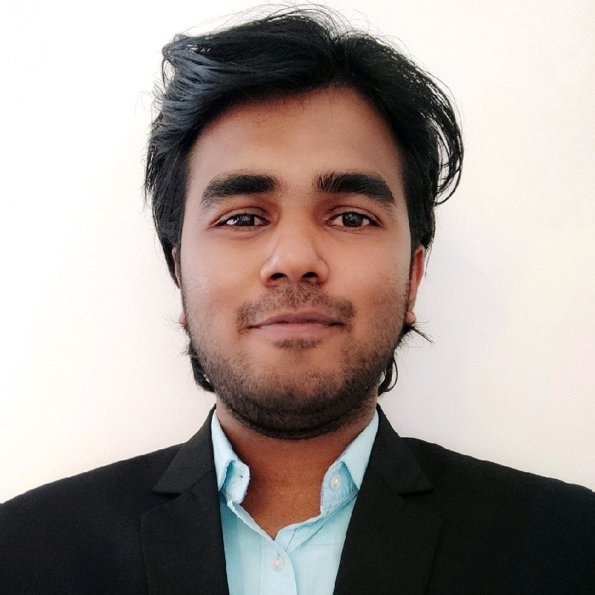
Akshay Manchakadavath
Consultant, Data Science
Major Global Bank – Data Engineer/Business Analyst
Data provisioning for AML transaction monitoring system- NICE Actimize global rollout. Gathering business requirements and implementation of the desired data pipelines. Analyzing the data gaps in the ETL stream and fixing them to ensure high quality data for tuning. Data analysis and documentation within the business context to facilitate the upcoming scope of the development lifecycle. Documentation of the logics and data models by creation of data dictionary, functional mapping document, runbooks etc. Performing various levels of testing and supporting deployment activities for the global rollout.
Major European Bank – Data Engineer
Understanding and analyzing business requirements and designing the desired data models for BASEL Capital reporting. Identifying the data sources and gathering the required data for modelling. Prepare the data and information by applying complex logics using data transformation techniques. Maintaining the environments, setting up data validation strategies to ensure high quality in the business reports. Creating an automated testing regression and integration testing suite to seamlessly identify data gaps earliest in the reporting pipeline. Documentation of the logics and data models by creation of data dictionary, functional mapping document, runbooks etc and taking lead of the deployment activities.
Accenture Internal – Gen AI Engineer
The goal of the project is development of a web-based application to support Transaction Monitoring case investigation. Developing and tuning the model using techniques such as prompt engineering, RAG, embedding, vector store, etc to integrate LLM capabilities into the TM processes from alert generation until SAR filing. Developing flask backend and react frontend, dockerising and hosting the application on Azure cloud to facilitate seamless usage.
Major European Bank – Gen AI Engineer
The goal of the project is development of a web-based application to facilitate customer KYC journey for financial institutions using the capabilities of Gen AI and LLMs. Developing a model using techniques such as prompt engineering, RAG, embedding, vector store, etc to integrate LLM capabilities throughout the KYC journey from Due Diligence till Approval. Using LLM frameworks such as langchain to make use of the agents to optimize the model performance. Developing flask backend, React frontend, dockerising and hosting the application on Azure cloud.
Internal Gen AI asset creation – Gen AI Engineer
Developing a model that can retrieve data from database by converting natural language to SQL and convert retrieved organization data into visual representation by receiving user prompts. Enhancing the model's capability to answers specific questions with regards to the data and providing accurate responses. Developing a data summary and visualization recommendation engine using LLM frameworks and techniques.
Bachelor’s degree, Technology in Mechanical Engineering Amrita Vishwa Vidyapeetham, Amritapuri, India
Akshay is proactive professional with 4+ years of experience and a proven knowledge of data analysis, data model, testing lifecycle, agile principles and application development. Aiming to leverage my skills to achieve high career growth through a continuous learning process and keeping myself dynamic, visionary and competitive.
Data Science
Gen AI, LLMs, OpenAI, Azure OpenAI services, Langchain
ETL, IBM Infosphere Datastage
MS SQL Server, Hive, Impala
Python, Flask, React
Tableau, BEx Analyzer
HTML, CSS, Javascript
GIT, Bitbucket, CI/CD, Jenkins, Teamcity
JIRA, Scrum, Agile
Banking
English
Notes:
a.manchakadavath

Slide 52

Bartosz Mazur
Analyst, Data Science
Warsaw Main School of Economics (10.2023-current) :
Msc in Quantitative Methods in Economics and Information Systems
Warsaw University of Technology
Bsc in Computer Science
Global Bank – Data Scientist
As a Data Scientist at Global Bank, I was part of a cross-functional team where I delivered data science and analytics solutions. My role involved conducting extensive data analysis on both financial and personal client data using Python and SQL. This included analyzing and comparing customer incomes and expenditures. I also built interpretable regression models based on current and historical financial and personal data. Additionally, I identified data sources and prepared data for dashboards.
Internal non-Accenture projects:
I have a diverse range of experience in machine learning. One of my projects involved sound classification on AWS Sagemaker, where I dealt with a multiclass classification of audio insects data. This project required me to train models on AWS Sagemaker. In another project, I applied object detection techniques to medical image data, training a model to identify and locate objects of interest within these images. Beyond machine learning, I've also worked on data automation and migration. I automated the process of pulling data from APIs and constructed a database using SQLAlchemy.
Non commercial projects:
In my academic journey, I have undertaken several significant projects. For my bachelor's thesis, I focused on short-term energy price forecasting, a critical topic in the energy sector. I also conducted a regression analysis to explore the relationship between a country's diet and COVID-19 mortality rates, providing valuable insights into the potential impact of nutrition on pandemic outcomes. Furthermore, I delved into the realm of unsupervised learning with a project on diamond clustering. This project involved building and comparing different methods for clustering, enhancing my understanding of various clustering techniques and their applications.
Certificates:
Azure Data Scientist Associate
Azure Data Engineer Associate
Power BI Data Analyst Associate
Azure Fundamentals / Data Fundamentals/ AI Fundamentals
Dataiku Core Designer
Dataiku ML Practitioner
Bartosz is dedicated data scientist with a primary focus on data analysis and machine learning. His professional background includes valuable experience in the financial sector, and he have a strong affinity for working with machine learning techniques to extract insights and solve complex data-driven problems.
Python (Pandas, Numpy, Matplotlib, Scikit-learn)
Machine Learning
Deep Learning (PyTorch, Keras, NLP)
PySpark
Power Bi
SQL (MySQL, Teradata, MS SQL Server)
Azure, Git
Finance
IT Consulting
Polish English
Notes:
b.mazur

Slide 53
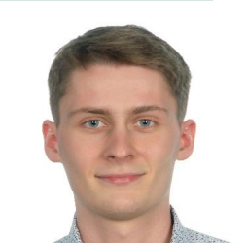
Jan Matynia
Analyst, Data Science
Junior Software Developer – Polish Automotive Company
Developer job in team responsible for route planning and task scheduling systems for autonomous robots. Creating and implementing mathematical optimization models to accelerate and improve robot performance. Gathering and analysis of data flowing from test environments.
Junior Data Scientist – Financial Services Company
Member of a Data Science Team working on the fraud detection process for the needs of UK market. Data mining and preprocessing of insurance data, creating pipelines and constructing fraud detection models and subsequent tuning on the DataIku cloud platform. Preparing customer analyzes and segmentation.
Internship in the Data Science Team on the project of Intelligent Automation of the Underwriting Process. Creating data processing pipelines, analyzing insurance data.
Intern – Telecom Company
Internship in the Department of Optimization and Development of Business Processes. Automating the reporting process, creating interactive dashboards and analyzing financial data regarding the company's investments.
Warsaw School of Economics, Big Data and Advanced Analytics, MSc
Warsaw School of Economics, Quantitative Methods in Economics and Information Systems, BSc
Johannes Gutenberg University Mainz, Economics, BSc – foreign exchange
Jan is an ambitious student of Big Data and Advanced Analytics with 2 years of experience in data science and optimization work. He is keen to explore the world, always eager to learn new ones and then use them in practice. Currently, he is looking for valuable projects, that will help him in the future, which he associates with data.
Python (NumPy, Pandas, Scikit-Learn, Tensorflow, Keras, Matplotlib, Seaborn)
AWS Certified Cloud Practitioner
SQL, R, Julia, VBA, Linux, Git, Docker, DataIku, Power BI
Machine Learning, Deep Learning, Optimization Models, Statistics, Econometrics
Automotive
Insurance
Telecom
Polish English German Spanish
Notes:
jan.matynia

Slide 54
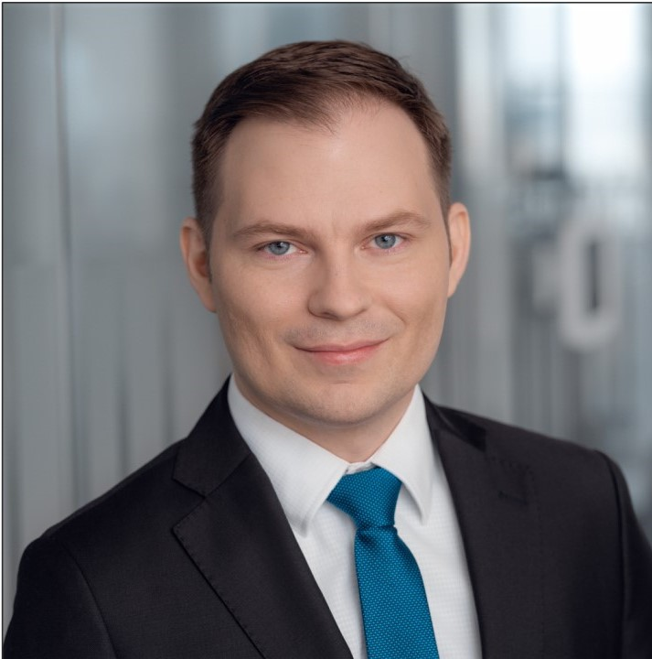
Piotr Michałek
Manager, Data Science
Major Swiss Insurance Holding
Developer job in a team handling transition to new data model. Involving work on solution architecture, developing jobs using SAS DI Studio and building process flows in SAS management console. Implementation of data quality layer. Designing and automating test framework
Leading German Bank
Architecture and development of external ratings database (S&P, Fitch, Moody’s). Validation of mapping from external Agencies Ratings to Bank’s internal masterscale. Development of Industry sector credit rating, as a part of Risk model for start-ups. Qualitative and quantitative Validation of PD models for Corporates, SME and Countries rating. Modelling Foreign Currency Rating combining economic risks together with transfer risk
Major Polish Bank – Risk Analysis and Modeling
Conducting workshops regarding scoring modeling process
MIS reports preparation and automatic reporting tools development. Basel parameters calculation (PD, LGD).
Polish Commercial Bank – Risk Analytics
Designing and creating risk analytical data repository. Development and monitoring of credit risk models (Behavioral client-centric, Credit Bureau, CRM model for cross-sell score). Preparing model documentation for internal and external auditors. Internal post-development validation for collection model and preparation of monitoring framework.
Warsaw School of Economics, Quantitative Methods in Economics and Information Systems, Master’s degree
Piotr Michalek is a Manager in Accenture Warsaw bureau. His professional experience spans over Risk & Fraud area with a special interest in development and validation for PD models. He has 7 years of experience gathered between one of the largest German banks and 3 Polish commercial banks. He has studied quantitative methods in Economy and Information Systems in Warsaw School of Economics.
Development, maintenance and validation of credit risk models: application, behavioural, credit bureau, PD/LGD
Business Intelligence and Data Warehousing Solutions
Experience with: SAS( Foundation, Stat, DIS), SQL, VBA, Python
Certification: SAS Data Integretion Developer
Banking
Insurance
Polish English German
Notes:
piotr.michalek

Slide 55
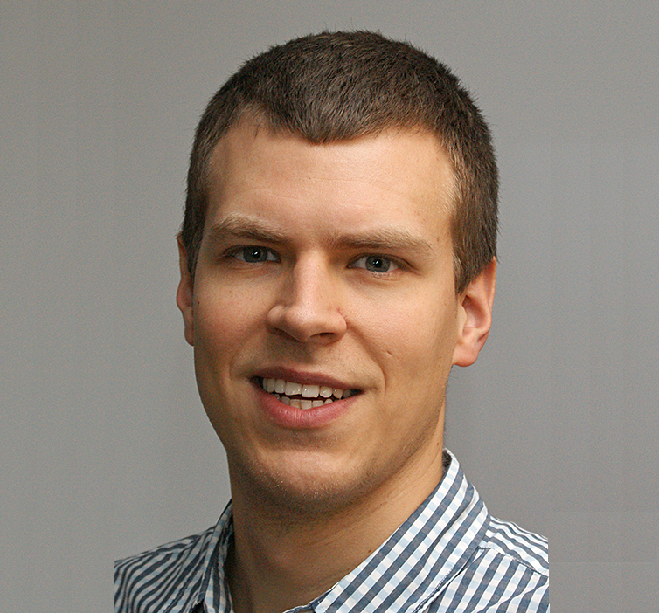
Jurek Michniewicz
Consultant, Data Science
GenAI Lab
Developing various Retrieval Augmented Generation (RAG) Proofs of Concept.
Playing active role in covering business usecases by design, development, prompt engineering, prototyping UI and research on new tools feasibility. The common characteristics of all tools is extraction of structured answers from HTML/PDF documents for further processing, content validation & Visualization. The tools are talking to OpenAI API and the familiy of GPT LLM.
Generative AI for Automotive Holding
Developing chatbot application, that allows Natural Language communication with NoSQL database, using OpenAI API. Implementing UI in Streamlit.
Generative AI for Major Polish Bank
Prototyping UI for a RAG-chatbot, based on Google’s PaLM LLM
Global Pharma Company
Maintaining Data Catalogue covering transiton of supply chain processes from SAP to AI solution
Maritime Technology Company - Data Analyst / Ship Performance Engineer
Acting as both Data Analyst and SME. Translating customer needs and regulations set by shipping sector authorities into pseudocode and UI-guidelines for developers.
Prototyping tools & developing production-ready scripts (API) with Flask and Docker for ship performance- & fleet-tracking app. Building data-ingest interfaces to Azure Data Lake.
Working on all stages of data pipeline, from sensory data extraction & processing (SQL) to mathematical modelling of ship performance in terms of energy efficiency. Using Python with Pandas on daily basis, with few successful Machine Learning implementations, i. e. classification, clustering, change detection
Major Classification Society - Engineer
Modelling ship geometry for stability/tonnage calculations purposes. Automating processes with custom macros written in NAPA Basic.
Modelling geometry and performing hull strength calculations using Finite Element Method.
Gdansk University of Technology
Postgraduate studies:
Numerical simulations for Engineers
Gdansk University of Technology
Master of Science in Naval Architecture
Data Scientist with experience in processing operational data enhanced by domain expertise in Naval Architecture & Engineering. Specialized in ship performance modelling and sensory data analytics, combined with strong interest in GenAI solutions.
OpenAI API, LangChain, Prompt Engineering
Python, Flask, Docker
MySQL, NoSQL
AZ-900 - Microsoft Azure Fundamentals Certificate, Azure Storage Blob library
Machine Learning
Naval Architecture
Technology solutions
Generative AI
LLMs
Shipping
Shipbuilding
Engineering
Polish, English, German
Notes:
jurek.michniewicz

Slide 56
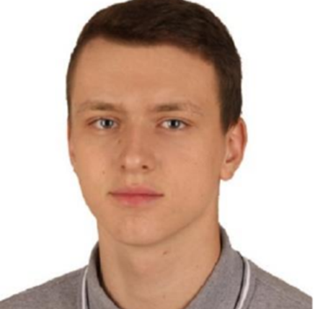
Dominik Mika
Analyst, Data Science
Data Scientist – Telco company
Data Scientist in AI team. Collaborating in developing an optimization model for supply chain using linear optimization tools (Python, cvxpy, pandas, Azure DevOps, Git). Performing data and feature analysis for sales prediction neural network model (Python, Excel, Power Point). Implementating custom tools in Python and Excel that assist in performing analysis.
Data analyst – Financial services company
Data analyst in credit risk modelling team. Cooperating in creating the decision model for client engagement to credit-related communication (R, SQL, XGBoost, randomForest). Developing internal tools: improving internal R packages, creating model features storage in SQL. Creating and developing a methodology of searching for statistical dependencies (data mining).
University of Wrocław, Mathematics, MSc
University of Wrocław, Mathematics, BSc
Dominik is a data specialist with professional experience in building machine learning models and performing business analysis. I am also a master of science in mathematics with strong interest in machine learning and software development in Python.
Machine Learning
Python (Pandas, Numpy, Pytorch, Scikit-learn, Pcaret)
SQL
R
Azure DevOps
Docker
Scrum
Financial Services
Telco
English Polish
Notes:
Dominik.mika

Slide 57

Magdalena Mikielewicz
Analyst, Data Science
Deep-tech company - MLOps Engineer
Development and integration of MLOps solutions such as MLFlow and DVC for Computer Vision models. Help in the process of creating ML models. Creating analytical pipelines running on Jenkins.
Healthcare company – Data Scientist
Improvement of algorithms evaluating sleep quality (detection of apnea/hypopnea, detection of awakenings, determination of sleep position, classification of breathing episodes - snore detection). Quality control of signals recorded by the wireless sensor. Synchronization of multimodal signals. Data exploration.
PhD Research
Designing a new training program for soccer players. Analysis of cardio-respiratory parameters. Causal discoveries between physiology and sport results.
Research Institute – Trainee
Modeling of bioelectromagnetic phenomena with the use of SIM4LIFE program. Preparation of data for statistical processing in Excel and Statistica.
Warsaw University of Technology,
PhD in Biomedical Engineering
Warsaw University of Technology, M.Sc. in Biomedical Engineering
Warsaw University of Technology, B.Sc. in Biomedical Engineering
Data Scientist and Engineer with approximately 3 years of professional experience across multiple industries. Strong educational background in biomedical engineering.
Programming: Python (Pandas, Numpy, Scikit-learn, Matplotlib, PySpark),
R (Shiny, Markdown), SQL, Matlab
MLOps: MLFlow, DVC, Azure (AI Fundamentals, Storage, Databricks), Git (GitHub, GitLab, Bitbucket)
CI/CD: Jenkins, Docker
Other: Data Mining, Data Quality, Computer Vision
Healthcare
Computer Vision
R&D
Polish, English, French (B1)
Notes:
m.mikielewicz

Slide 58

Joanna Mioduszewska​
Manager, Data Science
Major Global Bank – Data provisioning for Actimize implementation.
Data transformations in Hive; Data mapping; Analysis of existing ETL processes; Data requirements gathering and clarification.
Major UK Bank - CCB Financial Crime Remediation Programme
Development/delivery of tactical MI to support end-to-end management of the remediation process (SAS and Tableau CRM).
Major Swiss Investment Banking Company – Model Review & Calibration Team Lead
Leading transaction monitoring system calibration. Coordination and delivery of data-driven analysis and scenarios tuning for all regions. Managing people. Effectively presenting result and successfully defending the analysis during validations
Major Financial Services Company – Manager for Scenario Development & Enhancement Team
Leading and developing an analytic team that delivers timely and high-quality analyses for Anti-Money Laundering monitoring purposes. Successfully coordinating and delivering the scenarios tuning projects (including Consent Orders) for EMEA region. Development and improvement of AML optimization methodology. Working cross functionally to proactively and systematically identify and implement any enhancements in AML monitoring processes. Serving as SME and sharing knowledge by training organization.
Major Financial Services Company – Statistician in Scenario Development & Enhancement Team
Participation in AML Optimization projects. Performing statistical analysis of scenario thresholds. SAS code development and improvement. Documentation preparation and management
Major Consulting Company – Risk and Fraud Analytics Team
Participation in project covering: Database migration, transformation and development using SAS and Teradata. QlikView modeling: data cleansing, manipulation and transformation, designing functional model (big data), designing and development analytical insight by dashboards and data extracts.
Large Polish Universal Bank
Debt collection strategy optimization: Design, implementation and development of econometric models (in SAS) to improve debt collection processes. Manipulating, cleansing and processing data using SAS, SQL Server, Teradata, Access, Excel, reporting tasks.
Large Polish Media Company
Creating analysis on TV advertising market and sales - identifying trends, correlations, developing recommendation, prediction of TV ratings using time series models and neural networks. Improving and automatization reporting processes using SQL and VBA programming.
Postgraduate Studies: Information Systems and Data Analysis SGGW - Warsaw University of Life Sciences
M.Sc. in Computers Science and Econometrics University of Warsaw
Data-driven analytics manager with advanced organizational, analytical and problem-solving skills.
Joanna has 10 years of overall experience in data analyses in banking industry. For 7 years she worked on AML projects related to the optimization of the transaction monitoring systems. She specializes in advanced analytics.
Statistical Analysis
Data Mining
Econometric Models
AML Optimization/Tuning
Relational Databases
SQL, SAS, Teradata, Oracle, Hive
QlikView, QlikSense, Tableau
CAMS (Certified Anti-Money Laundering Specialist), PRM (Professional Risk Manager)
Banking
Insurance
Advertising
Media
English Polish
Notes:
joanna.mioduszewska

Slide 59

Albert Młodziejewski
Analyst, Data Science
Major UK Telecommunication Company
Creating a python scripts and generating JSON files to create tables on GCP. Preparing SQL queries feeding the tables according to the strategy. Developing ETL process in Ab Initio for hive. Automating output data verification with Python scripts. Analysis of source and process output data for anomalies. Preparing, executing and verifying test scenarios in SQL.
Global Bank – Junior Big Data Scientist
Applied qualitative and quantitative data analysis methods. Conducted statistical data mining. Formulated appropriate recommendations based on the conducted analyzes. Conducted simulations of the monitoring system using SAS and Oracle (SQL). Implemented continuous improvement program of effectiveness monitoring. Ensured high quality of generated data and reliability of data processing processes. Designed and implemented SAS and Oracle data quality verification methods. Analyzed data, designed and implemented periodic reports.
Global Bank – Data Engineer
Maintained and adjusted PySpark code that monitored the compliance of users' accesses with business requirements, as part of IT compliance effort.
Global Bank – Investment ARM - Research & Development Intern
Created monthly reports dedicated to the investment funds market. Supported in creating market research in relation to the product offer of the competition. Prepared analysis dedicated to new product solutions. Supported current product offer analysis. Helped in the preparation of product concepts. Assisted in market analysis and research in terms of implementation of legal regulations.
Warsaw School of Economics, M.Sc in Big Data – Advanced Analytics
Warsaw School of Economics, B.Sc in Quantitative Methods in Economics and Information Systems
Albert is a Data Scientist with a Big Data background and a Data Science in Python certificate. He has experience in investment funds, banking and telecommunications industry.
Python (NumPy, Pandas, SciKit-Learn)
PySpark
Data Engineering
Machine Learning
Statistical Analysis
SQL, R, SAS, Ab Initio, Foundry
GCP Professional Data Engineer – certification in progress
Telecommu-nications
Banking
R&D
Polish English
Notes:
albert.mlodziejewski

Slide 60

Tomasz Mostowski
Accenture Leadership, Data Science
Major German Bank
Leading validation of new IFRS9 models including transfer criteria and PiT PD.
Major Israelian Bank
Reinvention of the credit risk process including development of new scoring system in Python and Hue
Accenture Internal project for Insurance
Leading development of ML models for optimization of claims handling as part of Claimbox solution on Azure. Tasks included creation of valuable products for claims handling, defining data model, building data pipelines, creating of ML models and linking them to production environment.
Various clients
Oversight of analytical projects in area of Risk modelling, data engineering, KYC/AML and CRM.
Major Nordic Bank
Support in AQR and stress testing within the comprehensive assessment
Major German Bank
Advanced modelling of Operational risk in R
Major German Bank
Enhancing in SAS historical data base for compliance with RTS on materiality threshold for credit obligations past due (DB2, GIT). Development of statistical methods of calculating risk parameters for Impairment calculation (IFRS 9). Validation and redevelopment of PD non-retail models in SAS. Mapping of external rating to internal master scale.
International Investment Bank
Validation of Ecap and Credit Risk Models (stress testing, CCAR) in line with SR 11-7 for Intermediate Holding Company
Major German Bank
Developing a SAS based tool for ICAAP calculations. The project included requirements gathering and delivering working solution. Delivering the specifications and code delivery
Major German Bank
The project included analysis of the current status of OpRisk Management, Processes and data quality in the Bank as well as delivering a new solution to manage and quantify the Risk. Design of statistical approach for calculating OpRisk and delivering Matlab solution with Excel GUI.
Major International Insurer
Validation of Operational Risk Model
Financial Services Authority
Developing new regulatory environment for calculation of mortgage portfolios impairments. The new methodology allows FSA to introduce intrusive approach to stress test mortgage portfolios of all UK banks
Major Polish Bank
Modelling value of collaterals for mortgages portfolio in an automated way to properly manage and measure credit risk
Major International Insurer
Support in validation and testing the new internal Operational Risk Model. The tasks including preparation of the group model to be validated by the regulator, preparing and implementing calculation engine
Major International Bank/ Major insurer
Analysing the risk profile of a Bank to quantify and create a market product through Special Purpose Vehicle to transfer the risk. This SPV was capped as an insurance product and marketed for major insurance and reinsurance companies. Main focus was on Operational Risk
PhD Candidate: Econometrics
Warsaw University, MA: Informatics and econometrics
Warsaw University: BS: Mathematics
Tomasz leads Polish Advanced analytics and data practice (100+ team) and possesses over 15 years of consulting experience in quantitative risk management. Tomasz worked across Europe for big financial institutions in Poland, UK, Switzerland, Germany and others on projects in Risk Management including Credit, Market and Operational Risk modelling and validation as well as stress testing and ICAAP. He has experience in delivery of projects in different cloud technologies.
Data Strategy
Risk Management
Econometrics, Statistical Analysis, Data Modelling, Data Science, ML
Data Engineering
Impairment (IFRS 9), CRR/CRD
SAS, R, Python, Matlab, SQL, Databricks
Hadoop, GCP, Azure (AI900 Certfifed)
Financial Services
Banking
Insurance
Polish English German
Notes:
tomasz.mostowski

Slide 61

Edyta Mróz
Analyst, Data Science
Multinational pharmaceutical and biotechnology company
Designing, building, optimising data pipelines to deliver data to data science models with Python
Building and evaluating data science models aimed at increasing the crop effeciency
Analysing and visualizing results with Python libraries
Preparing data driven recommendations for business stakeholders to increase the crop growth effectiveness
Cooperating with business stakeholders to evaluate models and results
International bank
Designing and building automated testing framework in Python for the bank’s internal reporting system
Performing manual checks on created reports
New technologies start-up
Preparing Python packages and APIs for the analytics team, supporting data collection and modelling.
Kraków University of Technology, Msc in computer science
AGH University of Science and Technology, Bsc in applied computer science
Edyta is a data scientist and data engineer with almost 3 years of professional experience. She specializes in data preparation for data science use cases. She has experience in biotechnology and banking industries.
Python (Pandas, GeoPandas, NumPy, matplotlib, boto3, scikit-learn, SciPy, Flask);
SQL;
Docker; Linux; Git;
Statistics, Machine Learning, Numerical Methods;
AWS Certified Cloud Practitioner
SAS Certified Specialist: Base Programming
Banking Biotechnology
Polish English
Notes:
edyta.mroz

Slide 62

Mikołaj Niziński-Dyszlewski
Consultant, Data Science
Large Social Media Company – Digital Data Engineering Practitioner
Data pipelines maintenance and optimization, debugging failures, rerunning/backfilling missing partitions (Airflow, SQL, Python, Spark, Presto, VS Code, Mercurial source control)
Digital Marketing Agency – Head of Data & Programmatic
Leading the Data Analytics and Programmatic Ads projects (Bash, PostgreSQL, Tableau, webpage-debugging, Google DV360, Campaign Manager, Adform DMP+DSP, Google Analytics)
Digital Marketing Agency – Programmatic Media Planner
Managing accounts with Digital Advertising Strategies (AppNexus/Xandr DSP; webpage-debugging, Google DV360, Campaign Manager, MediaMind/Sizmek)
Digital Marketing Agency – Business Development Manager
Managing accounts with campaign briefs, integration and analysis
Research and Technology Company – Junior Web Analyst
Web data processing and analysis (Bash, Google Analytics, gemiusDirectEffect, gemiusPrism)
University of Warsaw, MA in Sociology
Warsaw University of Technology, Postgraduate in Data Science
Data Scientist / Engineer with 7 years of experience in Digital Advertising (incl. 5 years in Programmatic Media Buying and 4 years in Data Analytics / Engineering). Built and lead a 4-person team combined of Analytics and Programmatic Ads Trafficking. Presented twice at Data Science Summit conference (2019 & 2020). Participated in winning digital advertising awards of Mobile Trends Awards, IAB's Mixx Awards.
SQL; Python; Airflow;
Spark; Presto; Hive;
R; Bash
NumPy; Pandas, SciKit-Learn
Data Mining; Text Mining
Machine Learning; Deep Learning
SAS Enterprise Miner
Digital Advertising
Marketing Research
Polish English German Italian
Notes:
mikolaj.nizinski

Slide 63

Mateusz Norel
Analyst, Data Science
Data Scientist & Software Engineer
Developing statistical Python package and associated with it web application. Maintaining repository as the DevOps engineer taking care of Azure CI/CD pipelines. Working on the Azure infrastructure with Terraform.
Data Engineering (integration project)
Developing and maintaining Kafka Streams solutions for handling data flow between SAS products and Salesforce.
Lead Management Project
Designing and delivering Lead Management solution in Agile methodology with SAS CI 360 & SAS Intelligent Decisioning toolset. Development of JavaScript, and REST API interfaces. E2E solution delivery, from design, through development, testing to production deployment and monitoring.
Internal Projects in Accenture
Working on frontend and backend for data science solutions. Using LLM as a backbone of the product. Forking on integration of different services utilizing microservices architecture.
Data Science Trainer
Professional teaching organized groups the subject of Data Science. Covering topics ranging from analytics, EDA, Python to training models in various scenarios (time series, NLP, tree-based algorithms etc).
Institute for the Agricultural and Forest Environment in Poznan – Data Scientist (R&D)
Modeling environmental data using machine learning means. Applying number of sequence modeling architectures on multivariate time series data.
Poznan University of Technology- Student Data Scientist projects:
Analysis and modeling based on microfinances data. Analysis and modeling based on market data; Analysis of medical data of patients with cancer.
Teaching Data Science
Two years of experience in teaching various topics from the domain of Data Science in the form of gatherings of DS enthusiasts.
Poznan University of Technology, Master degree in Computer Science
Poznan University of Technology, Bachelor degree in Computer Science
Mateusz has a master's degree in Computer Science, specializing in data modeling using machine learning. He took part in the Kaggle data analysis competitions and was also a teacher at a Polish Chinese seminar about using machine learning for assessment risks of the floods. He also has experience of developing various functionalities for a CRM project. He has an experience working on integration project with Big Data tools.
Machine Learning (Feature Engineering, Modeling, Architecture, Time Series, NLP, LLM)
Python, Java, C++, C#, JS
Dash, TensorFlow, Pandas, SciPy, Numpy, PyTorch, HuggingFace, PySpark, Databricks
Spring Boot, Kafka, SQL, noSQL
GNU-Linux, Bash, Git, DVC
Azure, GCP, Terraform, MLFlow
Finance
Medicine
CRM
Natural Environment
Polish English
Notes:
mateusz.norel

Slide 64

Michał Nowocień
Manager, Data Engineering
Large Swiss Insurance Company
Insurance data warehouse business analysis, solution design and implementation in agile and SAS Data Integration Studio environment. Lead Developer in the team delivering health accidents claims content to the enterprise DWH based on SAS DDS (Detailed Data Store) model for Insurance. Defining architecture of SAS DIS jobs, creating metadata for source and target data, creation of advanced data processing reusable transformations (SCDx historizations, data bulk loads, metadata logging), deploying and scheduling jobs via the Platform Suite for SAS.
Leading Polish Telecom Company - Real Time Marketing System implementation
Solution architect of Client's Profile for Real-Time-Marketing usage. Lead solution architect and developer of daily data ingestion and transformation jobs via SAS Data Integration Studio. Gather, analyze and model client data (customers, financials, operational, organizational, access channel), key performance indicators, and market data (competitors, products, suppliers), using a broad set of analytical tools and techniques to develop quantitative and qualitative business insights and improve decision-making.
Major UK Telecommunication Company
Leveraging machine learning & visualization for data driven bad debt management. Minimize bad debt relating to digital products and services for Multinational Telco and their customers. Usage of SAS and developed Machine Learning framework that manages and controls self-training algorithms, delivering set of automated models and recommendations. Enable to move from multi files, manual business led processes to an automated, AI enabled model, controlled through a set of visual dashboards.
Major Polish Telecom Company
Telecom data warehouse business analysis and lead developer using agile methodologies and Teradata environment. Performance tuning for existing ETL jobs and dashboard queries with the in-depth expertise in the Teradata cost based query optimizer. Identification of bottlenecks with queries from the aspects of query writing, skewed redistributions, join order, optimizer statistics, physical design considerations (PI and USI and NUSI and JI etc).
Major Polish Telecom Company
Analyst and Developer on a BI development project. Development and delivery of a new business intelligence solutions on Teradata enterprise data warehouse. Design and implementation of new dashboards, key predictive indicators for revenue, commission and margin optimization. Designing and performing testing case scenarios - integration and functional tests. Working under the Agile methodology.
Major Polish Bank
Credit Risk Analyst - Importing and exporting data from Teradata/Oracle to SAS as well as importing raw data files from source systems, manipulating and transforming data, combining data sets, creating detail and summary reports using SAS procedures for measuring indicators such as PD, DTI, DPD, Vintage Analysis in SAS environment. Performing a variety of data quality tasks, including profiling data, cleansing data and monitoring data for usability. Designing data standardization schemes. Business rules monitoring in loan approval process
Polish-Japanese Academy of Information Technology - Big Data -postgraduate studies
Warsaw University of Technology, Master degree in Medical Physics
Michal has over 8 years of experience in BI development, data warehouse design, ETL/ELT process development, data analysis and manipulation mainly in banking, telecommunications and insurances area. During this time, he has covered roles like developer, analyst, team lead and solution architect. He is certificated SAS stack developer and Google Cloud Professional Data Engineer. Certified Data Architect – Master Data Architect Program, in collaboration with MIT Professional Education.
BI and Data warehousing services - data replication, ingestion, migration, transformation in Teradata/Oracle/DB2/SAS
GCP, AWS, Azure - certified data engineer
Configuration of the environment for Big Data analysis in Open Source technology – HDFS, YARN, MapReduce
Machine Learning and Deep Learning
SAS (Base, EG, DIS, EM), Python, SQL, VBA, MATLAB, R, Azure ML
Banking
Insurance
Healthcare
Telecommu-nications
Polish English German
Notes:
michal.nowocien

Slide 65

Andrzej Olijnik
Analyst, Data Engineering / Data Science
Healthcare technology company – Data Engineer
Participate in the ETL process for Healthcare clients (SQL/Snowflake, DDL, DML, Azure Data Factory, Azure Dev Ops ). Data extracting and further transformation based on client requests and working with providers/patients’ data. Data sources migration for different reporting tools. Creating Power BI and Tableau reports.
Major Bank – Data Scientist
Create a model predicting the weekly mortality rate in the USA. Worked on a model predicting Oil production based on infra-red satellite pictures. Worked on a model predicting oil production in Texas based on DMV traffic permits.
University – Researcher, Scientist, Lecturer
Participation in scientific research.
Member of the research team in the projects:
KIC Innovation Project: Compressed Natural Gas Home Refuelling Station
GEKON ZEC-KHW-AGH: Optimization of coalbed methane extraction
Author/co-author of 40 scientific articles.
AGH University of Science and Technology Ph.D. candidate
AGH University of Science and Technology Master’s degree in Petroleum engineering
Andrzej is an Analytics and Data Engineering specialist with Machine Learning skills. He is experienced with data collection, transformation and reporting. He has a strong academic background, being author/co-author of 40 academic papers.
SQL, Snowflake, Mongo DB
Python (Numpy, Pandas, Matplotlib, Scikit-Learn, Keras, Tensorflow), R, Power BI, Tableau, Azure Data Factory, Azure Dev Ops
Certifications:
Snowflake SnowPro Core certificate
Microsoft Azure Fundamentals AZ-900 and DP-900 certificates
Insurance
Healthcare
R&D
Banking
Oil & Gas
Polish, English, Ukrainian, Russian
Notes:
andrzej.olijnyk

Slide 66

Jakub Paczusko
Analyst, Data Science
Telco company – Data Scientist
Member of internal centre of excellence for time series analysis and forecasting. Engaged in end-to-end projects touching upon sales forecasting, prediction of churn and logistics. Built interactive explorative data analysis dashboard tailored for time series analysis. Developed library of components and pipelines in Vertex AI.
Telco company – Data Scientist
Engaged in data monetization project focused on providing client with country-wide data aggregates. Designed a scalable method using Python to allocate base transceiver stations' locations data to pertinent communication paths. Wrangled base transceiver stations' data in BigQuery, resulting in enhanced efficiency and reduced overall weight for more streamlined model consumption.
Danish Energy Company – Data Analyst
Played a pivotal role in optimizing data workflows by designing and coordinating ETL processes within the department. Leveraged advanced machine learning techniques to enhance analytical capabilities. Constructed comprehensive sales and data quality reports. Led the initiative to outline a strategic plan for the potential migration to an Azure cloud solution, paving the way for a more scalable and efficient infrastructure in the future.
Non Commercial Projects
Participated in a plethora of data science projects touching upon various areas of data analysis, including collaborating on a machine learning project predicting ports of refuge, experimenting with convolutional neural networks for classifying various pulmonary diseases in chest x-ray images, delving into song topics through latent Dirichlet allocation on lyrics and user-inputted descriptions, forecasting Berlin cyclist numbers using ETS and ARIMA, exploring machine learning methods to predict bankruptcy in Polish companies, and conducting an analysis of unexpected wins in basketball using econometric methods.
Copenhagen Business School, Business Administartion and Data Science, MSc
Warsaw School of Econometrics, Quantitative Methods in Economics and Information Systems, BSc
Jakub is an ambitious and goal oriented data scientist with proven experience in data-driven teams. He is a team player equipped with both theoretical knowledge about quantitative tools and practical approach of applying them.
AI: Machine Learning, Deep Learning, Generative AI
Programming: Python (pandas, numpy, scikit-learn, tensorflow, matplotlib), SQL, R
Cloud: Azure, GCP
Data Viz: Power BI, Tableau
Energy
Telco
English German Polish
Notes:
jakub.paczusko

Slide 67

Agata Papież
Associate Manager, Functional & Industry Analytics
Large Swiss-based Insurance Company - ETL Solution Designer
Large Swiss-based Insurance Company – ETL Solution Designer Lead Developer in teams delivering health accidents and business insurance data into EDWH. Designing technical concepts for Data Mart consolidating multiple data sources (GWR PC, custom applications) used for pricing and tariffication. Implementing end-to-end solution in SQL (DB2) and SAS DIS involving business analysis, development, testing and UAT support. Managing team workload in Agile methodology.
Major Norwegian Insurance Company - ETL Developer
Leading SAS 9.4 upgrade project: SAS MC set up, metadata migration, automated testing, maintaining customized scheduling tool based on SAS Stored Process WebServer. Maintaining SAS DI based Data Warehouses for Claims, Life Pension and CRM.
Large Swiss-based Insurance Company - ETL Developer
Data Warehouse business analysis, solution design and implementation of SAS DDS (Detailed Data Store) model for insurance in SAS Data Integration Studio environment. Developing ETL jobs for Oracle and DB2 in use of SAS DIS. Creating Test Framework, developing automated tests.
Major Investment Bank and Financial Services Company - Financial and Regulatory Reporting Specialist
Ensuring data quality in data cubes for daily, weekly and monthly reporting. Delivering regular and Adhoc reports for P&L, Net New Money and Invested Assets for Wealth Management business area, performing ad-hoc analysis on client and financial products level. Handling Ad hoc analysis of company's financial development i.e. analyzing liquidity risk. Automating financial reporting process.
Multinational Content Analytics - Data Science Manager
Owning data migration, data quality assurance and data validation processes for Data Warehouse. Performing data quality checks and implementing new solutions to QA process.
Jagiellonian University, Cracow Master in Financial Mathematics
Jagiellonian University, Cracow Bachelor in Applied Mathematics
Data engineer with over 8 years of professional experience in multinational projects mainly in data management area for Insurance and Banking. She is specialized in ETL/ELT process design and development, automated testing, quality assurance, data analysis and reporting.
Data Warehousing services - SAS, Oracle, MSSQL, DB2
Azure (Data Fundamentals certificate)
AWS (Certified Cloud Practitioner)
Automated testing and quality assurance
SAS Certified Advanced Programmer
SAS Certified Data Integration Developer
CFA Level 1 Exam Passed
Insurance
Finance& Banking
Polish English
Notes:
agata.papiez

Slide 68

Daniel Paprocki, Ph.D.
Analyst, Data Science
Major Tobacco Industry Client (ACN experience)
Data remediation team member. Taking care of orders, which are stuck in Hybris (SAP based e-commerce platform). Verifying data in Hybris, setting correct statuses and target systems. Understanding and handling with errors while exporting, fixing it. Verification if it reached target systems. Cooperation with market teams to establish correct orders statuses and remediation results. Work in Jira, Hybris backoffice and CDP.
Major Tobacco Industry Client (ACN experience)
CDP Developer in CDP/MA B2C Functional Team. Working on changing data model to CDP based one.
Anomaly Detection Hackaton (ACN experience)
AI 22 Hackathon is Accenture internal learning opportunity in real life AI applications which regards anomaly detection in financial data. Analysis of the financial data and detection of fraud transactions. The approach of my team was based on random forest algorithm, after preparation and cleansing of data and selection and adding of appropriate metrics.
My team used Python for model building, optimizing and scoring, and GCP platform for its implementation.
„Thermodynamic Research Halogen Bond in (bio)Molecular Cage” Project at University
Planning and performing of chemical, biochemical and biophysical experiments. Analysis of the obtained data using Excel and Origin. Automatization of data processing using VBA and Python.
„Short Term Scientific Mission” – ETH Zurich Internship (Department of Materials)
Measuring and analysis of amphiphile properties of selected compounds. Planning and performing of biophysical and physical measurements. Analysis of obtained data including statistical analysis.
University
Planning and performing chemical / biochemical / biophysical experiments. Automation of the processing of received data from using VBA and Python. Analysis of the obtained results, including analysis statistical. Writing publications, review of scientific literature, planning experiments
PhD in Chemical Sciences – Institute of Organic Chemistry - Polish Academy of Sciences
Master of Science: Biotechnology - Warsaw University of Technology
Daniel is PhD graduate, Master of Biotechnology at the Warsaw University of Technology. He is an author of many scientific publications related to chemistry and an active participant in many scientific research. Daniel is very eager to gain experience in data engineering and data science. He holds Microsoft Azure Fundamentals certificate and Data Engineering on Microsoft Azure certificate. He also joined Quantum computing team. He learns basics of quantum computing methods; he participated in IBM Quantum Spring Challenge 2022.
Microsoft Azure Fundamentals, Data Engineering on Microsoft Azure Certificates
Python (pandas, numpy, scikit-learn, Tensorflow and pytorch)
SQL, Azure Databricks
MS Excel (a good knowledge of VBA)
CDP (Customer Data Platform)
Snowflake SnowPro Core certification
Chemical
Polish English
Notes:
daniel.paprocki

Slide 69

Dariusz Parol
Senior Manager, Data Engineering
Major Global Bank
Data provisioning lead for Actimize implementation. LDM model design, ETL approach co-design, data mapping, system analysis. Data requirements gathering and clarification.
Major Global Bank
Data analysis and statistical modelling. Country and client segmentation. AML scenario development, testing and tuning. KYC review prioritization model. Perpetual KYC implementation- automatic attribute assessment, MI reporting, Transaction Monitoring process effectiveness analysis and redesign. Co-leading analytics team, managing client working groups.
Major Norwegian Telecommunication Company
Analysis of statistical models (Win Back, Acquisition, Cross Sell) feasibility. Examining data sources and data quality. Short listing variables for modelling, analyzing macro-economic impact on the business.
German Bank
Analysis of existing and new data feeds, enhancing current data model. Requirements gathering with close liaison with a client.
Financial Institution
LDM creation for new IFRS9 ready credit risk data warehouse. Current data analysis, ETL analysis, data lineage tracking. Requirements gathering with close liaison with a client. Project co-planning, coordination of onsite and offshore team activities.
Large Financial Institution
Performing source system data quality analysis, identifying data issues and working with appropriate teams to resolve it. Taking part in designing new data warehouse and interim solution. Project effort estimation and planning.
Major Polish Bank
Data mining, developing PD, LGD, EAD, scorecards for detail and corporate clients. Performance and stress testing, model calibration. Regular reporting on internal risk models and ad hoc analysis. Cyclical validation of models/statistical methods used to measure credit risk.
Warsaw School of Economics, Quantitative Methods in Economics and Information Systems, Master’s degree
Dariusz has over 13 years of experience in technology and consulting, mostly in banking industry. He gained relevant experience in major polish bank, then he moved to UK, where he was working on data warehouse projects. Recently he works on AML and KYC projects: developing and calibrating AML scenarios, analysing and redesigning KYC processes, implementing Perpetual KYC and co-leading Analytics team on data driven analytics initiatives. He specializes in advanced analytics.
Econometrics, Statistical Analysis, Advanced Analytics, Machine Learning
AML ,Fraud Risk, KYC, IFRS9, Credit Risk Modelling
Data Warehouse solutions
Python, R, SQL, SAS, VBA, Hadoop/Hive
GCP proffesional data engeneer – cerfitication in progress
Banking
Financial Services
Telecommu-nications
Polish English German
Notes:
dariusz.parol

Slide 70

Kordian Paszek
Consultant, Data Science
Major global bank - Data provisioning for AML Actimize implementation.
Business Analyst and Data Engineer in AML Actimize implementation team. Actively involved in each step of the implementation from data mapping and logic building, through ETL framework development and adjustments, defining job scheduler configuration until successful pilot rollout and production monitoring. After pilot rollout involved in additional locations releases.
Tools used: Python, SQL, PySpark, Control-M
Data Science - Preparation of data analyses and predictions using Python
(e.g., prediction of production installation sensor readings, classification of willingness to buy subscription on client services); Data assessment, cleansing and preparation for machine learning model; Implementation of machine learning models on prepared dataset and selection of most accurate one; Graphical analysis using Tableau; Preparation of report summarizing insights and conclusions
Construction General Contractor Company - Controlling Director
Design and implementation of control tools and procedures; Preparation of analysis, reports, forecasts, and dashboards for the Management Board; Financial consulting and support for Branch Directors, Project Managers, and Site Managers
Global Construction Consulting Company Assistant Cost Manager/Junior Cost Manager/Cost Manager
Full career path in Cost Management Team – from Assistant to Manager; Preparation of project budgets; Cost analysis of designs and searching for optimization opportunities; Cost management of every phase of construction process
Global Consulting Group Remote project support – casual work contracts (transport, FMCG, banking)
Data collection - desk research, street interviews, on-site observations; Preparation of comprehensive data sheets and presentations in MS Office environment
Postgraduate studies, Data science. Cracow School of Business CUE
M.Sc., Technology and Management of Construction. Cracow University of Technology
B.Eng., Civil Engineering. Cracow University of Technology
Nine years of experience in analysis and creating business recommendations based on data. Strong ability to cooperate in diverse environment with internal and external stakeholders. Ease in identification of ineffective processes and initiative in proposing solutions. Ability to quickly adapt and learn new technologies.
Python, SQL, Tableau, Excel
AZ-900: Microsoft Azure Fundamentals
AWS Cloud Practitioner Certificate
Ventures
Construction Consulting
Polish English
Notes:
kordian.paszek

Slide 71

Mikołaj Piotrowski
Consultant, Data Science
Global Tobacco company – Data Scientist
Development and maintenance of the existing system using computer vision tools, containerisation (Docker, Kubernetes) and AWS tools (e.g. S3 buckets) with the help of MLOps techniques. Deployment of the solution to new markets, contact with customers, continuous improvement of the current solution.
German Scientific Optics Company - Machine Learning Engineer
Project support carried out mainly in the field of computer vision and module management on the platform. Independent production of user stories and individual tasks. Customer contact, member of the scrum team.
UAV Systems Company - Machine Learning Engineer
The project of semantic segmentation of data provided in orthophoto format (TIF). The main tasks were research, data preprocessing, dataset preparation, model selection, network training.
Medical Lab, Technological University - Machine Learning Engineer
Clustering of arterial intracranial pressure waveform types. Requirements analysis, exploratory data analysis, brainstorming, team member.
IT Support Company – Software Tester
Software development and quality assurance. Development of documentation, creation of test cases, creation of automated software tests, preparation of mockups.
Wroclaw University of Technology, Eng., Computer Science and Management, Systems Engineering – network service system
Wroclaw University of Technology, M.Sc., Systems Engineering- ongoing
Mikołaj is a young Data Scientist with over 2 years of professional experience. He is passionate about system engineering, artificial intelligence and computer vision. He actively contributed to the student’s deep learning association with several projects in various topics. Recently, he has been continuously expanding his knowledge of machine learning operations and cloud technologies.
Machine Learning Operations
Python, OpenCV, Numpy, Pandas, Sklearn, Matplotlib, Rasterio, GeoPandas, PyTorch Lightning, TensorFlow, Fiji-ImageJ, Pytest
PyCharm, Anaconda, Postman, WSL
Git, Azure CI/CD, Jira, Phabricator, AWS S3, Docker
ITIL Certificate, PRINCE2 Certificate
GCP Google Associate Cloud Engineer – ongoing certification,
Azure – ongoing certifications
Tobacco Industry
Aircraft services
Biomedical Engineering
Polish English
Notes:
m.a.piotrowski

Slide 72

Rafał Plis
Consultant, Data Scientist / Data Engineering
Convinience stores company
Developed a Proof of Concept (PoC) for GenAI, an automated documentation generator targeting ABAP files for SAP system updates. Leveraged OpenAI's GPT, Langchain, and Streamlit to create an efficient and streamlined solution.
Multinational tobacco company
Member of the Advanced Analytics Team, actively involved in developing the Data Science Platform Engineering infrastructure to facilitate a wide range of Data Science projects. This involves working extensively with the AWS stack, Snowflake, S3, Jenkins, EMR, PySpark, Airflow, and Jfrog, Kubernetes.
Internal PoC
Developing and implementing an automated system using ChatGPT, Azure, Streamlit and OpenAI API to extract relevant information from CV documents.
Apply NLP techniques to process and analyze the extracted data, ensuring accuracy and completeness.
Transform the extracted data into a visually concise executive report format, utilizing appropriate visualizations and summaries.
Global Insurance Company
Designing, developing and testing ETL processes for data ingesting, transformation and management into Data Mart destination (Azure Databricks, PySpark, Azure DevOps)
Oil & Gas field services
Building the revenue forecast model based on time series and machine learning.
Visualizing the results. Utilizing Tensorflow, ARIMA, XGBoost, Power BI.
Global Media Agency
Working as part of Innovation Hub. Development of global service to optimize
media plans. Utilizing Google Cloud Services, Azure DevOps, Azure Pipelines.
Developing and providing in depth analysis of predictive models (Neural Networks, Genetic Algorithms)
Software Development Company
Building pipelines to predict sales volumes of products for major internet
shopping company. Utilizing GCP, Pub/Sub, Cloud Functions, TensorFlow,
Google Data Studio. Dash buttons development using AWS Pub/Sub, Lambda, EC2
Global Mining Company
Building cavity risk model and provide extensive analysis for two Australian coal mines.
Utilizing XGboost, Azure platform (ML Studio, DataLakes, Pipelines). Building DE pipelines (Data Factory) to ETL raw data leveraged by the model.
Higher School of Economics and
Information „Vistula” – Warsaw.
Specialization in Computer Science
in Business.
I have more than 15 years of versatile experience working as Data Scientist, Data Engineer and Project Lead. I worked for industries such as health insurance, mining, oil & gas, media and FMCG. My skills include GenAI, machine learning, predictive modeling and advanced analytics utilizing Azure AWS and GCP. Degree in Computer Science in Business.
Gen AI: GPT, OpenAI API, LangChain, RAG, VectorDBs
Data Science: Machine Learning (supervised learning, unsupervised learning), Data mining, Data Analysis, Data Visualization
Tools: Snowflake, Jenkins, Airflow, LangChain, Kubernetes, Docker
Data Engineering: CI/CD, Data modeling, ETL, BI
Development: Python, PySpark, SQL
Cloud services: Azure (DS-100, AI-900)
GCP, AWS (CLF-C02)
FMCG
Media
Mining services
Oil & Gas field services
Health Insurance
Polish English
Notes:
rafal.plis

Slide 73

Aleksander Pobidyński
Consultant, Data Science
Automotive and Manufacturing Consultant,
Technical requirements gathering
Energy and drug store market research
Client workshop conduction
AI & Analytics Consultant
Creating reports and dashboards for ITSM data and SLA metrics using ServiceNow
Performance Analytics Building predictive models for IT tickets - categorization, resolution time estimation, clustering, identification of major incidents - using ServiceNow Predictive Intelligence
Model upgrade support for financial crime risk in banking - solution testing, model outputs comparison - Python, SQL
Technical requirements gathering, scope negotiation Preparing, conducting and supervision of functional testing of technical solutions
Technical documentation and user manual preparation, client workshop conduction
Business Intelligence Tools Analyst
Creating reports for ITSM data using
ServiceNow Performance Analytics
Developing logic for performance metrics
Testing the functionality of reports and dashboards.
Preparing technical documentation
Bachelor’s Degree in Quantitative Methods in Economics and Informational Systems - Warsaw School of Economics
Master’s Degree
Advanced Analysis - Big Data - Warsaw School of Economics
Consultant with several years of experience in creating innovative solutions in the field of business intelligence, reporting and machine learning.
I have successfully collaborated with clients and stakeholders, delivering valuable solutions that aided in making strategic business decisions.
Python (pandas, sklearn)
PowerBI SQL
ServiceNow
Machine Learning
ServiceNow Performance Analytics & Predictive Intelligence
Automotive
IT
Financial Services
English German
Notes:
aleksander.pobidynski

Slide 74

Javier Ponce Caillaux
Consultant, Data Science
Major European Bank – Business Analyst
Building and training machine learning models for fraud detection and customer segmentation.
Marketing Manager & Data Scientist
Applied Machine Learning in Business: Predicting consumer behavior and product suggestions; AI/ML for targeted marketing. Clustering; Analyzing and forecasting time series data with ARIMA and SARIMA; Sentiment Analysis of customers reviews to improve service; Pricing with CONJOINT ANALYSIS; Conducted and leaded Market Research; Qualitative and Quantitative for new brand products; Mining Investment Risk Analysis Based on Monte Carlo Simulation; Use of Science of Happiness to improve job satisfaction, collaboration and reduction of stress; Financial evaluation of projects
USA Pharma Company – Marketing Manager
Oversee all marketing campaigns; Implement marketing strategy; Pricing of new products; Improve Marketing ROI; Ensure if the company is communicating the right positioning to attract new customers and retain existing ones; Coordinate with sales team the sales promotions
M.Sc. Data Science – WSB University, Poland
MBA - Krakow Business School, Poland
M.Sc. Marketing – ESAN Graduate School of Business, Peru
Google Data Analytics Certificate
Javier is focused on supporting decisions, and problem-solving based on data science. He has over 10 years of experience in various data science projects: predicting customers’ behavior, marketing strategies, pricing, data mining, logistic optimization, risk and financial analysis. He communicates efficiently the practical implications of quantitative analysis and facilitates decision-making. Likewise, he has an ability to describe complex topics in simple terms, also using visualization. He has experience in translating business requirements into analytics and problem decomposition. Javier is a team-oriented person. His soft skills are perseverance, adaptability, empathy and compassion in work.
Data Science: Data mining, data analysis, AI/ML, forecasting
Programming: Python, SQL, R
Optimization: Minitab, SPSS
Visualization: Tableau, Jupyter Notebooks, Google Colab
Google Cloud Platform: Data Analytics, Big Data, Machine Learning
Banking
Finance
Pharma
Advertising
Digital and Retail Marketing
English Spanish German
Notes:
javier.ponce

Slide 75

Marcin Pruchnicki
Manager, Data Science
Global Bank – Business Analyst and Data Engineer
Business analyst and data engineer in data provisioning for Actimize implementation. Data requirements gathering and clarification. Data mapping and ETL development in Hive and Spark.
US Telco Services Provider – Tech Architect
Digital personalization strategy project. Created solution design consisting of collecting digital clickstream data, Customer Data Hub, offer prioritization logic, continuous A/B testing framework and integration patterns with digital.
US Telco Services Provider – Tech Architect
Technical Architect and development team lead for implementation of CRM personalization engine for Call Center based on SAS technology stack. Responsible for detailing business requirements, designing API-based integrations with external systems, developing data model of the Campaign Data Mart, supporting the team in SAS RTDM development, coordination of testing phase (analysis and prioritization of reported bugs, reporting the progress of solving bugs)
Polish Fuel Retail Company – Business Architect and Delivery Lead
Business Architect and delivery lead on Marketing Automation project (implementation of SAS CM).
Responsible for: conducting workshops to define business requirements,creating solution design, SAS CM tool configuration, Oracle DB triggers development, preparation of UAT test cases, coordination of the testing phase (supporting Client in running the test cases, monitoring and reporting testing progress to SteerCo), conducting knowledge tranfer workshops with the Client.
Major European Bank – CRM Strategy Product Owner
Preparation of the Bank's retail strategy for individual customer relationship management. Reporting ownership of CRM KPIs – designing cyclical reports, analyzing KPIs, proposing CRM campaigns supporting KPIs. Implementation of customers retention segmentation in order to assign customers an appropriate retention offer. Forecasting Bank’s KPIs. Preparing target groups for digital activation, x-sell and up-sell campaigns using predictive modeling. Implementation of a contact policy mechanism in the marketing automation system.
Polish Telco Services Provider – Data Scientist
Next Best Action project. Creating the business concept of the NBA solution and designing decisioning logic. Business analysis and setup of SAS CI Studio tool and designing outbound and inbound campaigns in the tool. Identification of ideas for event driven marketing campaigns.
Warsaw School of Economics, MA in Quantitative Methods in Economics and Information Systems
Over 10 years of experience in AML in financial services and CRM area in financial services, telco and fuel retail with proven record of successfully delivered advanced analytical solutions improving x-sell, up-sell and retention actions such as scoring models, segmentations, next best action and hyper personalization.
Customer analytics, CRM business strategy (x-sell, up-sell, retention, NPS, personalization), campaign management, marketing automation
SAS (4GL, Enterprise Miner, MA, RTDM, CI360, VA, DI Studio),
SQL (SAS, MSSQL, Oracle, Hive)
Business analysis (Jira, Confluence)
Project Management
Agile (SAFe, Scrum, Kanban)
Telco
Banking
Insurance
Oil & Gas
Polish English
Notes:
marcin.pruchnicki

Slide 76

Jacek Rożen
Senior Manager, Data Engineering
Large Swiss Based Insurance - NearShore Team Lead
NearShore Team Lead for the team delivering health accidents claims content to the enterprise datawarehouse based on SAS DDS (Detailed Data Store) model for Insurance. Mobilized the NearShore team operating from Poland in distributed Agile framework, ensuring work quality on ETL work, data model extensions, established a testing framework to enable testing automatization.
Large Polish Bank - Delivery Lead and Solution Architect
Delivery Lead and Solution Architect for provisioning of Data Marts for Risk Management Departments in Oracle Exatadata and Informatica technologies. Created the delivery approach, shaped scrum team, adjusted agile principles to client environment, acting as a Scrum Master for the development team.
Ministry of Taxation – Scandinavia - BI Advisor and Delivery Manager
Responsible for provisioning data warehouse solution for the current control, reporting and visual analysis of collection legality of 35mio+ public claims.
Internationally Recognized Consulting Company
Delivery of risk methodologies (FTP, Capital Allocation, Cost of Risk) for large universal bank, driving external IT company to implement methodologies within OFSAA/PFT application, managing quantitative validation of methodologies. Delivery of hedge accounting solution for cash flow hedge for utilities company. Advisory on advanced risk measurement (AMA) implementation for large bank.
Global Analytic Data Platforms Provider
Design and implementation of code (Teradata SQL, ODI) generator engine for Data Quality measurement, Design of logical data model for large data warehouse project (Teradata technology). Managing data warehouse maturity assessment for major bank in Hungary, analysis of AS-IS and provisioning of recommendations for TO-BE state to enable effective data driven insights generation
Major Polish Bank
Business Intelligence Architect responsible for plan and rollout of BI architecture, initiating and managing projects leading to implement committed architecture, those include: design of highly efficient Data Staging Area with automatic data normalization managed by metadata, design and implementation of automatic reports to support mid-office OTC derivatives monitoring daily activities, design and management of delivery for number of other Bank initiatives.
Major Polish Communications Company
Design and development of highly efficient Call Detail Records (CDR) processing mechanism that implements Multi Parallel Processing concept in Oracle database.
University of Warsaw, Post-graduate studies, Statistical Methods in Business with SAS Software
Warsaw Institute of Banking, Post-graduate studies: Risk Management
Warsaw University of Technology, Masters in Computer Science
Professional Risk Manager (PRM)
Enthusiastic individual with strong communication skills proved in multinational work environments and in cooperation with C-level management. Expert on Business Intelligence backed with 14 years of experience gathered in complex projects public revenue agendas, banks and telecommunication companies. Driving change practitioner with common sense.
Business Intelligence and Advanced Data Warehousing Solutions
Risk Management in Banking
Agile Projects Management, Stakeholder Management
Technology stack: SAS (EG,VA, DIS), SQL (SAS, Oracle, Teradata), Cognos, Tableau, Python
Banking
Telecommu-nication
Public Revenue & Collections
English Polish
Notes:
jacek.rozen

Slide 77

Dawid Ruszczyński
Analyst, Data Science
Decision Systems Development Specialist - British payday loan firm
Design and improvement of decision and recommendation systems, Analysis of requirements and implementation for Risk Management.
Data Analyst/Decision Scientist - British payday loan firm
Credit risk management, data modeling, and predictions using SQL and R, Data analysis and reporting for decision making process to Board Members, Optimization of credit scoring, fraud detection and debt collection processes, Biggest success: improved and automated manual customer referral, process - time of processing reduced from 1h to 5 min.
Business Analyst for Product Control in Risk&Finance IT - Global investment bank
Responsible for requirements management, business and system analysis, developing technical solutions, test execution, defect resolution, Engaged in Data Science / Machine Learning projects developed in R, Biggest success: won first place in Data Science Challenge competition in CS regarding classification problem.
Global Investment Bank - Technical Analyst – Full Time Program for Talented Graduates
Member of third line of IT support in Desktop Services Team responsible for release management, troubleshooting and testing, Participant of corporate trainings e.g. Presentation Skills, Agile PM, Member of Organizing Committee for all Technical Analyst Program, employees - integration events, charity initiatives etc.
American multinational information technology company – Junior Sales Compensation Analyst
Collecting, analyzing and reporting commission for sales representatives, Resolution of employee's claims and system issues in a timely manner.
Quantitative Methods in Economics and IT, Master's degree, Warsaw School of Economics
Mechatronics, Bachelor's degree, Wroclaw University of Technology, Wroclaw
A persistent, responsible and engaged graduate of both engineering and business studies eager to develop. Motivated enthusiast of Data Science and Machine Learning with a wide range of soft skills.
MS SQL Server
R programming
Python: numpy, pandas, matplotlib
Machine Learning
GIT
JIRA / Scrum / Agile
spark
Data Analysis
Risk & Finance
Decision systems development
Polish English
Notes:
dawid.ruszczynski

Slide 78

Tomasz Rytter
Senior Manager, Data Science
Major Telecommunication Companies (various Companies)
(UK) Product owner and lead for GCP based foundational analytics products as part of strategic cloud transformation programme
(UK) Design of frameworks and functional architecture for ML and data science GCP based capability as part of strategic analytics cloud transformation programme
(UK) Design of approach, frameworks and data models for delivery of various ML and data science use cases in GCP (including predictive modeling, ML models, forecasting, survival and simulation)
(UK) Delivery of end-to-end analytics segmentation solution in AWS to improve pricing optimization of products (including development of microsegmentation models and their industralization in Spark framework)
(UK) Delivery of an end-to-end machine learning solution for optimization and management of bad debt encompassing industralization of automated framework for self-retraining of ML and predictive models
(PL) Delivery of analytical microsegmentation models for improved marketing initiatives
Major Financial Services & Insurance Companies (various Companies)
(UK) Delivery of implementations of AML Transaction Monitoring scenarios globally across various countries utilizing advanced analytical methods coupled with design of strategic solution for automation of data science work in AML area
(PL) Delivery of ML and forecast models, methodologies and end-to-end framework for improving interest rate risk management through use of advanced analytics
(PL) Delivery cloud based end-to-end analytical fraud detection solution embedding ML, predictive models, anomaly detection and clustering models and automation frameworks
Financial Services Company (Non-Accenture Experience)
Management of Data Mining department within organization; Ownership of analytics area (campaign management, risk modelling, credit scoring, marketing and sales analytics, reporting) and supervision of analytical / data science environment; Data mining, analytical modelling, credit scoring utilizing various analytical techniques; Supervision and ownership of data mining, customer intelligence and analytical campaign management technological environments
IT Services Company (Non-Accenture Experience)
Consulting within banking sector, Implementation of projects in customer intelligence area; Data analytics, predictive, ML and segmentation models development, model management solution development, solutions industralization
Warsaw University, Department of Mathematics, Computer Science and Mechanics – Master Degree in Mathematics
Specialization in Data Mining and Machine Learning
Tomasz has over 17 years of professional experience in analytics and data science field. Tomasz has experience in Banking, Telecommunication and Insurance sectors working in various analytical domains including customer intelligence, risk modelling, credit scoring, fraud analytics. He specializes in data science, machine learning and advanced analytics with academic background in machine learning and data mining.
Machine Learning, Data Science, Data Mining
Customer Intelligence, marketing, sales, campaign management
Risk analytics and credit scoring
Fraud analytics and AML
GCP, AWS, Azure, Databricks
Python, PySpark, Java, C++, SAS
Finance
Banking
Leasing
Telecommu-nications
Insurance
Polish English
Notes:
tomasz.rytter

Slide 79

Igor Sawczuk
Senior Manager, Data Science
Chatbot and voicebot software agency – Team Lead
Built chatbots starting from simple NLU, BERT, ending with generative AI. Built largest ecommerce chatbot knowledge base in Central Europe. Designed infrastructure handling 200k concurrent chat&voice conversations. Customer technical presale. Understanding business and technical intersections, customizing solutions based on available data.
Recruitment voicebots - AI Advisor
AI-enabled voicebots to recruit blue-collar workers faster. Responsible for building MVP: VoIP, multimedia gateway, speech2text, text2speech, NLP intent recognition server. Automated phone interview with intent annotations and integration with ATS system. Trained custom NLP model to understand Ukranian language. Team lead for technical team to transform MVP to full fledge SaaS product.
Marketing analytics agency - Technical Advisor & ML Engineer
Brand analytics on Instagram photos and youtube videos. Responsible for building MVP, and create documentation for technical team to transform MVP to full fledge SaaS product.
MVP pipeline consisted on building python crawlers, video key frames parsing, training model for real-time object detection based on YOLO, vector search database.
Healthcare AI solutions- CTO & ML Engineer
Use Instagram photos and CBT test to identify mental health issues. Responsible for building MVP and helped non-technical founders confirm research papers. MVP consisted of pipeline web invitation for test, logging in with Instagram, training model based on convolutional neural networks for visual to prediction correlation
Social gaming app - CTO & Senior Developer
Recommendation engine for mobile games based on bluetooth beacon proximity. Responsible for leading product team, acted as the primary developer developing SaaS product using AngularJS for web and mobile clients for iOS and Android, infrastructure setup.
IT company - Senior Java Developer,
Developed plugin to download meteo data in realtime, parse and calculate intermediate values and display on live map.
Warsaw University of Technology – Information Technology, Master’s Engineer Degree
Igor Sawczuk is a new technologies geek and a voicebot/chatbot expert. He founded an artificial intelligence company based in Warsaw, which automates customer service with AI assistants that work behind the curtains of Facebook fan pages, WhatsApp profiles or Telegram bots. He has over 9 years of experience as CTO, being responsible for creating strategies and technological foundations for new products based on artificial intelligence. He is also a speaker and promoter of AI/ML for non-technical people.
TechStack: Java, Spring, AngularJS, React, NodeJS, Typescript, Python, Salesforce SDK, Next.js
Machine Learning: TensorFlow, PyTorch, LLMs, NLP RoBerta, Azure Machine Learning, Google Natural Language AI, DialogFlow
DevOps&Cloud: Asterisk VoIP, PostgreSQL vector extension, MongoDB, GraphQL, Docker, OpenVPN, Azure, GCP, Linux bare-metal
E-commerce
Media
Public Services
Retail
Telco
IT
Polish English Ukrainian German (elementary)
Notes:
igor.sawczuk

Slide 80

Michal Sek
Consultant, Data Science
Swedish Bank – Data Scientist
Building data pipelines in Python to prepare KYC data for modelling: data cleansing, imputation, aggregation, parsing additional sources
Building multiple classifier models and building a set of tools for performance evaluation, hyperparameter tuning and visualization
Planning architecture of the AML solution involving multiple different databases, GCP webservice and multiple scoring models
Danish Bank – Data Scientist / Data Analyst
Validation of 2 separate scoring models in accordance with modelling standards and performance measurement, including development of integrated testing framework for future model’s monitoring
Performing exploratory data analysis – bi-variate, multivariate, principal component analysis, feature engineering, data sampling
Reviewing model’s documentation and regulatory policies, model’s implementation, validation and monitoring reports
Dutch Bank – Data Scientist
Validation of wholesale and rural credit risk model in accordance with modelling standards, regulatory requirements and policies
Performing exploratory data analysis, stratified data sampling, performance and back-tests on the model in python
Reviewing model’s documentation as well as model’s implementation, validation and monitoring policies existing in Bank
Formulating recommendations in the scope of model’s government, addressing gaps in the field of data pre-processing, model’s training, implementation and governance
German Bank – Data Engineer
Developing scripts for fetching data for various AML-related areas from Hive, preprocessing and cleaning it, applying filtering and reconciliation with data stored in separate database.
Polish Bank – Data Analyst
Setting up an architecture of decision engine branch for retail banking risk assessment process,
Building and maintenance of a nested data model with reference to application data, data from various interfaces, data warehouses, etc. and to specifying objects for decision engine’s response in XML schema,
Implementation in python of credit risk assessment framework, including designing process flow, designing and implementing decision logic (risk assessment algorithms, scoring models, external databases’ verification, financial capability etc.),
Warsaw School of Economics, MSc in Quantitative Methods in Economics and Informational Systemswith specialization in Econometrics
Michal is a data scientist with over 6 years of professional experience in the field of data analysis and modelling as well as designinging, implementation and testing of end-to-end credit scoring applications.
Data Science / ML
Credit Risk modeling, Statistical Analysis
Python (pandas, pyspark, sklearn, numpy, seaborn, matplotlib, sqlalchemy)
Hadoop, DB2
Git, Bitbucket
Banking
Polish English
Notes:
michal.sek

Slide 81

Ivan Shamilov
Analyst, Data Science
Gen AI Project in Banking Sector – Data Scientist / Analyst
Contributed to a project utilizing Azure Virtual Machines and Azure AI Vision for file processing via Optical Character Recognition. Designed and implemented a framework that facilitated the retrieval of information from various document types by leveraging state-of-the-art Large Language Models such as GPT-3.5/GPT-4 and employing prompt engineering techniques.
Telecommunications Company – Python Test Automation Engineer
Worked within the field of 5G technology, focusing on building test environments, creating test plans, and designing test cases to validate software functionality and security of Base Transceiver Stations. Led a team of test engineers focused on finding and addressing sensitive information leaks in system logs. Automated testing processes with Python and Robot Framework and set up CI/CD pipelines using Jenkins and Docker.
Non-commercial projects
Classification of the IP packets flow in real time within a specified timeframe. The dataset contained the characteristics for different Brute-Force and DoS attacks, as well as the normal traffic. The networks were built using Tensorflow library, achieving 98% accuracy on the test set and 100% accuracy in classifying the simulated attacks in real time.
The approach to improve the concept of continuous authentication by collecting user keystrokes in real time and generating synthetic samples for this user using Conditional Generative Adversarial Network for further comparison. The results have shown the ability of the cGAN to replicate the user keystroke distribution properly, and a good performance of the entire system with the accuracy of 89.59% in distinguishing between the legitimate and illegitimate user. All models were implemented in PyTorch.
Master’s Degree, Big Data Analytics
Wrocław University of Science and Technology
Bachelor’s Degree, Cybersecurity
Wrocław University of Science and Technology
Test Automation Engineer and a Machine Learning enthusiast, with expertise in designing and implementing robust testing frameworks.
The combination of analytical abilities, communication skills, and a collaborative nature, makes him well-suited to perform at a high level in dynamic environments.
AI/ML: NLP, Prompt Engineering, LLMs, Python (Tensorflow, PyTorch scikit-learn, HuggingFace API, OpenAI API)
Data Analytics: Python (pandas, matplotlib, seaborn), SQL, minor experience with Tableau
Development: Python (incl. Flask), C++
Cloud: AWS Certified Cloud Practitioner, minor experience with Azure
Other: Scala, Test Automation (Robot Framework, pytest)
IT
Security
Telecommunications
Polish English Russian Ukrainian
Notes:
Ivan.Shamilov

Slide 82

Stanisław Siatkowski
Consultant, Data Science
Big Social Network
Preparing and conducting A/B testing campaign. From writing initial documentation outlining expected results and performance, preparing Power Analysis through setting up audience and launching the campaign all the way up to performing measurement and preparing final readouts.
Warsaw University of Technology
Prediction of the detonation cell using machine learning methods. Exploration and visualization of the gathered experimental data. Analyzing and minimizing data inconsistencies. Designing and conducting experiments. Conducting literature research and writing articles.
Engineering Design Center, Aviation
Gathering data from databases (SQL queries, sensor data), reports system (engines maintenance reports) and internet. Screening the data for faulty readings and inconsistencies. Visualizing and analyzing the data, including full-flight data. Creating the predictive models of engines failure modes. Helping to push the model into production by working with the developer
Warsaw University of Technology:
PhD – in progress
Postgraduate Studies – Data Science
Master of Mechanical Engineering,
Bachelor of Mechanical Engineering,
Stanisław is a young PhD Candidate with over 3 years of professional experience in automated maintenance and troubleshooting of fleets of aircraft jet engines using machine learning techniques. He graduated summa cum laude from the best technical university in Poland – Warsaw University of Technology. Stanisław is always open for new challenges and eager to learn something new.
R (tidyverse, ggplot, caret, etc.)
Python (pandas, plotly, scikit-learn, etc.)
SQL
SAS Viya
Data Visualization
A/B testing
Aviation, Social Network
Polish English German
Notes:
stanislaw.siatkowski

Slide 83

Kamil Sienkiewicz
Manager, Data Science
European Insurer– Campaign architect
Optimization of campaign management process realized with SAS CI 360 stack
Global Cruise Line - Solution Architect
Marketing offers engine implementation. Solution design. Business requirements coordination.
European Bank - Business Stream Lead
SAS CI360 and SAS ID implementation. Leading business stream.
Polish Major Bank - Intelligent Decisioning Analyst
SAS ID implementation. Event logic configuration.
Polish Major Insurance Company - SAS CI360 Expert
SAS CI360 implementation. Event configuration. Data analysis.
Polish Major Bank - SAS CI Expert / Data Scientist
Campaign Management project. Signal and Event Factory implementation. Marketing Optimization implementation. Batch marketing campaigns implementation. Advanced data analysis.
European Bank - SAS CI Implementation Lead
Campaign Management implementation project. Batch and Real Time marketing campaigns implementation. Channel integration. Fit/Gap analysis.
Telco Company in Dubai - Project Manager
Selfcare portal revamp project: scope management, risk and issue management. Fit/Gap analysis. Customer Profitability project: applying SAS Cost and Profitability Management model to estimate cost and revenue per user, rate plan and sales channels. IT Transformation project: SDLC process design and implementation, Requirement Management team (5+) Lead, business requirements management - support of Marketing and Sales.
Polish Telco Company - Business Analysis Team Lead
CRM implementation project: business requirements coordination (marketing domain), business processes design, Fit/Gap analysis. Campaign Management system implementation: optimization of the data model used in marketing campaigns, marketing campaigns configuration, customer segmentation.
Max Planck Institute for Demographic Research, PhD student scholarship
Warsaw School of Economics, Faculty of Quantitative Methods and Information Systems
Kamil is a data analysis and marketing campaigns expert specializing in banking and telecommunications industries. Kamil has experience in CRM and Sales processes design, system implementation, requirement management, test management and execution. He has been working for many banks telco companies as well as insurance companies in Europe and Asia.
Statistical software: SAS, STATA, aML
Other software: SAS CI360, SAS ID, SAS CI, Siebel, Oracle RTD
Programming languages: 4GL, aML, SQL
Marketing campaign management (SAS CI 360)
Statistical and econometric modeling
Organization transformation
Project management
Delivery tests management and execution
Banking
Telco
Insurance
Polish English German
Notes:
kamil.a.sienkiewicz

Slide 84

Beata Śliwińska
Manager, Data Engineering
German Insurer (ACN experience) – SAS Tech Expert and Data Management Expert
Responsible for designing data models; developing ETL scripts on MS SQL server (including triggers, jobs scheduling, dynamic creation of tables structure); implementation of Next Best Offers selection in SAS ID using DS2; developing various SAS and Python scripts (implementation of new features in the system including launching of SAS CI 360 campaigns externally by REST API); developing scripts in Perl to source and transfer data; designing and developing Load Balancer in SAS 4GL, which controls execution of various SAS jobs; designing connector in SAS CI 360, which validates data provided by user.
Major European Bank - Compliance Officer
Responsible for end-to-end projects leading using SAS environment, executing of compliance controls testing, analyzing and documenting report findings and having preliminary discussions with corresponding control/process owners; creation of automated simulations (SAS scripts including ODBC connections) to evaluate correctness and completeness of Anti-Money Laundering scenarios and data quality checks; utilizing innovative compliance testing solutions including Data Analytics to increase value and reduce costs of compliance-related activities.
Major European Bank - Senior Analyst
Responsible for performing simulations of monitoring system operations using SAS and Oracle tools; optimization of algorithms as well as detection and monitoring rules in a large financial system with the use of advanced data mining methods and statistical
analyzes; identifying trends and dependencies in data; use of quantitative data analysis methods, performing statistical and non-statistical data exploration; analysis and interpretation of the results obtained, drawing conclusions and recommending further actions.
Swedish Bank (ACN experience) - SAS Developer and Business Analyst on IFRS9 Impairment project
Responsible for creation of core datasets used for modeling purposes (design, workarounds and data fixes implementation), data reconciliation between two main databases, UAT test of IFRS9 Calculation Engine, implementation of collateral allocation to exposures in scope of Loss Given Impairment model.
Major Polish Telecom (ACN experience) - SAS Developer on a Next Best Action project
Responsible for macros preparation in SAS to calculate analytical base tables, which were fully customizable and managable from the metadata level; environment efficiency testing; preparation of stored processes in SAS CI (including sending emails through SMTP server); creating outbound and inbound campaigns using SAS CI.
Major Polish Bank (ACN experience) – Business Analyst on a Transformation of ALM system project
Interest Rate Risk and Market Risk management (including interest rate gap and funding reports); Funds Transfer Pricing management (including market and liquidity curves, market and liquidity rates, replicating portfolios, cost of financing); Developing Low Level Design in the area of Interest Rate Risk and FTP; responsible for status meetings and final product delivery.
Warsaw University of Technology, MsC: Mathematics in Insurance and Finance
Warsaw University of Technology, BS: Mathematics
Beata is a data engineering expert who possesses experience in data mining, data integration and data management mostly in banking industry. Beata has experience in system implementation, requirement and test management as well as execution. She has over 13 years of professional experience in SAS Programming and holds 4 SAS certifications (SAS Advanced Programmer, SAS Base Programmer, SAS Statistical Business Analyst, SAS Data Integration Studio Developer).
Data management – integration, automation, optimization and analysis
SAS and SQL programming – SAS 4GL, DS2, SAS EG, SAS CI 360, SAS ID, SAS DIS, macro programming, parallel processing, stored processes, data vizualization
MS SQL, VBA, Python, Oracle
Certifications: AZ-900 - Microsoft Azure Fundamentals, DP-900 - Microsoft Azure Data Fundamentals
Banking
Insurance
Telecommu-nication
Media & Entertainment
Polish English
Notes:
beata.sliwinska

Slide 85

Natalia Słomka
Analyst, Data Science
US Telecommunication Company – Developer
Developing decision campaigns in SAS CI RTDM. Participating in full life cycle of the campaign from requirements gathering to production deployment (SAS Management Console, Oracle). Maintaining and enhancing existing use cases. Developing new functionalities for inbound decision campaigns. Fixing bugs and transferring knowledge to other team members. Deploying database changes using SAS CI 360. Working in Scrum Agile methodology.
Polish Research and Development Center – Statistical Analyst
Building automated reports and performing statistical analysis on small and medium datasets in healthcare and finance. Providing advice in the field of statistics. Performing data analysis of questionnaire data for large pharmaceutical company. Using R, RStudio and MS Office.
In progress: Master’s degree, Mathematics, University of Wroclaw, Specialization: Data Analysis
Bachelor’s degree, Mathematics, University of Wroclaw, Specialization: Data Analysis
Natalia is a junior Data Scientist with a very good educational background in Mathematics and Statistics. She gained experience as data analyst on a project for healthcare research facility. She also gained experience as a developer in telecommunications industry (SAS RTDM).
R (tidyverse, Shiny, data.table)
Python (numpy, pandas, scikit-learn)
SQL (PostgreSQL, Oracle)
SAS RTDM, SAS CI 360, SMC
GCP – Google Cloud Digital Leader certificate
Azure Data Fundamentals (DP-900)
PySpark fundamentals
GenAI
Healthcare
Telco
Polish English
Notes:
natalia.slomka

Slide 86

Tomasz Smaga
Manager, Data Science
Major Global Bank
Lead data engineering workstream with 2 analysts, responsible for building data pipeline to source advanced anomaly detection engine provided by ThetaRay to deliver complex risk scenario typologies; Code and data quality assessment; Data processing on-prem and on ThetaRay environment; Analysis of model outcomes (volumes, segmentation, materiality)
Major Global Bank
Assessment of transaction monitoring scenarios and effectiveness of the investigation to reduce high false positive volumes. Analysis of Transaction Monitoring scenarios and operational process. Development of methodology to de-prioritize and auto-close non-meaningful alerts. Oversight of solution implementation into production. Data exploration and data quality with visualizations (python)
Leading UK Bank
Development of a risk indicators used for prioritization of customer due dilligence in periodic reviews and trigger reviews; Analytical Base Table for customer profiling purposes (Know Your Customer processes); Review and assessment of efficiency of KYC reviews following a profile change triggers; Building for customer profile change assessment (python); Calculation of Key Risk Indicators for identified risk areas (SAS & SQL)
Large Polish Bank
Development of a risk measurement methodology in an interest rate increase scenario and impact on portfolio of retail deposit balances. Data quality assessment and data aggregation for modelling purposes. Extracting, processing and reconciliating transactional data using SAS EG. Model documentation for internal and external auditors
Major American Bank (non-Accenture Experience)
Presenting monthly financial data and forecasts to Department Heads; Business cases valuation and profitability analysis; Managing biannual regulatory reporting cycles involving meeting regulatory timelines, obligations and assuring accuracy
Warsaw School of Economics, MSc in Data Science
Warsaw School of Economics, BSc in Quantitative Methods in Economics
Universidad Complutense de Madrid, Economics & Statistics Faculties, LLP Erasmus Scholarship
Tomasz has 8 years of professional experience in analytics projects and management consulting. He specializes in optimization of customer risk management processes and AML operations. Hi projects covered transaction monitoring efficiency, KYC processes review and negative news screening optimization.
Statistical analysis (python, R, SAS)
Data Mining
Python (pandas, PySpark, nltk, numpy, scikit-learn)
SAS Base, EG, EM, VA
SQL (Hive QL, BigQuery, PL/SQL)
Finance
Banking
Payment Service Providers
Polish English Spanish
Notes:
tomasz.smaga

Slide 87

Tomasz Śmierzyński
Analyst, Data Engineering
Tobbaco Company – Data Engineer
Contributed to preparing High-Level Design for the data automation; Worked in a reverse-engineering model, to find issues in migration process; Developed database solutions in Snowflake, Wherescape, and ADF; Adopting new data sources into the model using Azure resources; Optimizing current processes for cost and time efficiency; Creating full data adoption solutions from raw files to reporting layer; Testing delivered products; Helping markets with better data understanding and data issues; Refactoring existing processes into ADF;
Polish Bank - Data Science Intern/Junior Specialist
Developed database solutions in SQL language; Developed data-gathering and reporting structures from ground up and strategized methods capitalizing on system features; Created data visualization graphics, translating complex data sets into comprehensive visual representations; Presented data science findings to peers, illustrating progress made during various tasks; Took care of complex sales and app usage reports; Provided additional data and analysis concerning usage of the app and digital sales
Polish Bank - Retail Banking Intern
Supported daily operations and processes to meet sales and service goals; Helped update training materials for bank branch employees; Prepared documentation; Helped with app for branches testing; Helped customers with service needs, product explanations and banking
Master of Science: Econometrics And Quantitative Economics - Warsaw School of Economics
Bachelor of Science: Econometrics And Quantitative Economics - Warsaw School of Economics
Tomasz is an Econometrics graduate with 3,5 years of professional experience in data engineering and analytics in various areas including banking and retail. Has experience in multiple technologies and strong theoretical background in statistics.
Data management
SQL (Oracle, MS SQL, Snowflake)
Power BI, Wherescape, Airflow
Azure Fundamentals Certificate
Azure: Azure Data Factory, Azure DevOps
Python, R
Finance Banking
Retail
Polish English German
Notes:
tomasz.smierzynski

Slide 88

Aneta Sobczyk
Consultant
Steel Producer – Business Analyst
Business analyst and support for MES, SAP and other internal systems related to steel production. Analysis of requirements and implementation of new reports using SQL.
Consulting Company – Senior IT Consultant
Public Sector Client - Business Analyst
Writing user stories and describing processes using BPMN notation, Organizing workshops with the customer to analyze possible solutions, Responsibility for UAT and Regression Testing, Acting as support: analysis of problems reported by users related to calculation of figures in the financial reports, Cooperation with the developers (technologies: JAVA, SQL, Angular).
Steel Producer – Business Analyst
Business support of a custom system MES in the areas of: production, logistics, quality and others (documentation: Jira, Confluence), Analyzing reported problems, looking at discrepancies between data in the systems, searching for the cause and discussing possible solutions with the customer - both from business the technical departments, Participation in the Problem Management Process – identification of recurring problems and cooperation with the customer in order to permanently solve them; Participation in the recruitment processes for all new candidates to the team, verification of their analytical skills (using self-prepared test in MS Excel and VBA).
Insurance Company - SAP Business Analyst
Business support of the authorization concept for various SAP platforms within the company globally, Documenting business processes in the team using flowcharts (Visio), Performing multiple SOX controls for the IT department (MS VBA, SAP Script) - analysis of big amount of data in MS Excel, Automation of SOX controls based on newest requirements (MS VBA)..
Major Tobacco Industry Client - SAP Business Analyst
Solving system related problems reported by users from multiple Finance Departments. Business analyst role for internal projects: analyzing and documenting new requirements; performing UAT.
Jagiellonian University in Kraków, M.A. Applied Mathematics
Jagiellonian University in Kraków, B.A. Mathematics for Economics
Aneta is ITIL certified IT Business and System Analyst with 9-year professional experience in international companies. Thanks to that she has an ability to translate complex business issues into technical language, what helps to communicate with customers in order to agree on the solution that suits their business needs.
SQL
MS VBA
SAP
MES
Python
Tableau
Jira, Confluence
Steel Industry
Insurance
Tobacco Industry
Chemical Industry
Polish English German
Notes:
aneta.sobczyk

Slide 89

Dominika Stachowiak
Consultant, Business Inteligence/Data Analytics
International Retailer – Data Analyst The project focuses on providing data analysis, primarily B2B sales data, for global stakeholders. It utilizes BigQuery to prepare the data for backend analysis and Power BI for modeling relationships and the visualization layer.
Major Swiss Bank – Bi Lead Developer Led a high-profile project for a major Swiss bank, integrating data from various areas including financials and workforce. Acted as the lead developer, responsible for data management, data visualization, and data analysis. Utilized Power BI to develop insightful dashboards and reports for effective data visualization. Conducted financial forecasting to support strategic decision-making processes. Provided comprehensive training to other employees on the effective use of Power BI for data analysis and reporting. Took part in data preparation for analysis during another Swiss bank acquisition. Major Manufacturing Company - Data Analytics - Digital Marketing
Working as a global digital marketing data analytics specialist, supporting business decisions with Power BI dashboards development based on multiple data sources (like Adobe Analytics, Snowflake & others). Preparing data models with a focus on data accuracy & quality. Providing insights and clarity for marketing specialists mainly about digital marketing data as Leads, Campaigns & Opportunities. Preparing Global data Targets for Business Groups based on complex data analysis of current company results.
Major Consulting Company - Senior Data Analyst
Working on OneDrive for Business Project from the early stage to deploy OneDrive for Business product globally. Creating dashboards, data models, and excel reports to provide high-level management with crucial data for decisions making, including decisions about the next steps of deployment. Using data to highlight progress, successes & oversights in connection to the current deployment approach.
Main tasks:
- SQL database update, views & tables creation
in Microsoft SQL Server Management Studio
- Power BI Dashboards update, creation & maintenance
- data modeling
- combining various data sources to create efficient data models
- reporting in excel (using basic functions,
pivots & query manager)
Worked with process documentation, Power Automate, Alteryx, SQL Server
Integration Services & Python for Project purposes.
Also got familiar with Kanban Boards & Agile approach.
Additionally:
Completed Microsoft Ignite Cloud Skills Challenge
- Analytics & Received Microsoft Azure Learning Badges in a process of getting
familiar with Azure concepts
& components (like Data Factory, Pipelines & others).
Major Consulting Company – Senior Reporting Analyst
Working in a diverse team with global clients (mainly from the UK, USA, and India). Responsible for preparing high-level documentation, daily, monthly, and ad hoc analysis using ServiceNow data. Creating reports in Excel and ServiceNow, and delivering monthly presentations to executives. Ensuring data quality meets standards, improving both data quality and reports. Collaborating with other Enterprise Service Management teams and utilizing tools like Tableau, Spotfire, and PowerBi for report and dashboard creation.
Wrocław University of Economics, Business Informatics - IT systems
manager, Master’s degree
Wrocław University of Economics, Business Informatics - Database
Technican, Bachelor’s degree
„Show me your data and I’ll tell you who you are”
Data Analytics practitioner with over 5 years BI experience and almost 10 years experience in working with multinational stakeholders with main knowledge in BI area. My strongest skill is Power BI and what follows Data Modeling, Transformation, Visualization and Analysis.
SQL, PowerBI, Data Analysis, Data Transformation, Data Modeling Tableau, MS Excel, Looker, Google BigQuery, Alteryx, Adobe Analytics, MS Power Platform Tools, Snowflake, MsSQL, Alteryx, Tabular Editor, DAX Studio, ServiceNow, Visio
Finance
Digital Marketing
Tech Workforce Retail
Polish, English, German
MICROSOFT CERTIFIED DATA ANALYST
Notes:
dominika.stachowiak

Slide 90

Mateusz Strobel
Consultant, Data Analytics & Visualization
Major Swiss Investment Bank Company – Business Intelligence Developer
Implementation of data sourcing and transformation code (T-SQL, MyReports); data modelling and report development (OBIEE, Power BI); deployment management; reporting maintenance and user support; technical documentation.
Pioneer organization in the clinical trials industry – Senior Data Analyst
Tableau reports preparation; snowflake – data warehouse testing; Oracle Apex – application development (PL-SQL); UIPath Bots maintaining; Datawarehouse – data validation and quality checks; Excel tools preparation (VBA and SQL).
Pioneer organization in the clinical trials industry – Business Intelligence Analyst
Microsoft Dynamics NAV 2017 – leading the implementation process in different subsidiaries first line support, tool creation; Recognition of business needs and providing solutions; Excel tools preparation (VBA and SQL) – improving daily business tasks and processes; Cognos and Excel reports – complex solution within different company’s departments; Cognos users licenses management.
Pioneer organization in the clinical trials industry – Financial Analyst.
Assistance with producing a monthly reporting pack; Analysis of management recharges to subsidiaries in compliance with transfer pricing policy, preparing subcontracts budgets; Forecast process (cooperation with the Heads of the Finance, preparing pipeline studies - subcontracts and structures, discrepancies analysis, generating forecast revenue); Resolving issues and queries regarding the upload during the month end process; Database structure maintenance and data verification; Ad hoc reports in Excel and Cognos; Review of contract performance against budget.
Major Swiss Investment Bank Company – Junior Accountant
Outstanding balance confirmations; Booking and general ledger operations; Account reconciliations, issuing invoices; Making ad hoc reports.
Master’s degree in Finance and Accounting, Wroclaw University of Economics and Business
Mateusz is Data Consultant with over 7 years of professional experience with a strong financial background. He has extensive experience in different BI technologies such as OBIEE, Cognos, Tableau and Power BI.
OBIEE
Power BI
Tableau
Cognos 10
Oracle APEX
T-SQL
PL-SQL
Snowflake
VBA
Banking
Health
Polish English German
Notes:
mateusz.strobel

Slide 91

Magdalena Strojewska
Manager, Data Engineering
Large Swiss Insurance Company
Led a development team in a project to integrate health accidents risk/claims (UK) content to the enterprise data warehouse (EDWH). Responsible for end-to-end solution design and implementation of SAS DIS ETL jobs, creating metadata for source and target data, creation of advanced data processing reusable transformations. Responsible for Data Warehouse business analysis, as well as designing testing framework, development of automated tests and UAT support to business users
German Insurance Company
ETL Developer in a team handling data transformation from Datahub to the enterprise datawarehouse based on SAS DDS (Detailed Data Store) model for Insurance. Establishing architecture of ETL jobs and developing them in use of SAS DIS, creating metadata for source and target data. Designing test framework
Major UK Banking Group
Development of consolidated and granular data store which ensures consistency at all levels of drill down and supports multi-topic reporting. Implementation of set of indicators that enables fast and transparent decision making
Internal Accenture Project
Participation in a project devoted to business and functional analysis of processes related to validation of financial risk models. Designing and developing in SAS 4GL and RStudio new functionalities for model risk management aiming at automation of model validation process based on artificial intelligence solutions
Leading Commercial Bank
Participation in a project devoted to development of the price decision making system. Participation in development of IT tools supporting credit and monitoring processes for corporate clients. Support in the analysis of loan portfolio quality data. Support in preparing current reports and presentations
Warsaw School of Economics, Bachelor Quantitative Methods and Information Systems, Specialization: Mathematical Economics
Warsaw School of Economics, Master in Advanced Analytics – Big Data
Magdalena is a data engineering manager with over 6 years of professional experience in multinational data management projects including ETL processes and data analysis in various industries such as insurance, banking or credit risk. Her field of expertise focuses mostly on ETL/ELT process design and development, data analysis, quality assurance of the deliverables, end-to-end testing, automated testing. Magdalena is certified SAS Data Integration Studio developer.
Statistical analysis, predictive modelling, data mining, ETL
DB2, Oracle SQL, MS SQL, Teradata
SAS: Base, EM, EG, MRM, VA, DIS
GIT
SAS IFRS17 (trained), SAS ESP (trained)
Certification: SAS Data Integration Developer
Banking
Corporate risk
Insurance
Polish English French German
Notes:
magdalena.strojewska

Slide 92

Łukasz Surdacki
Manager, Data Engineering
Health Insurance company – Data modeler, Data Lineage analyst
Design of data model and data dictionaries for broker commissions data. Lineage analysis (both documentation driven and reverse engineering) of dashboard related data for data governance. Helping in data governance process definition.
Insurance Company - Data Modeler
Design of physical and logical model of a Golden Record (In area of party, consent, contract and claim) which combines the data of over a dozen of applications coming from two merged insurance companies. This pivotal project involved harmonizing and consolidating critical data points, ensuring data consistency, and eliminating redundancies. In addition, I took my part in analysis and preparation of deduplication algorithm and establishment of project roadmap
Insurance Holding - Lead Solution Developer
Led a development team in a project to ensure GDPR compliance of the data warehouse, data marts and interfaces. Łukasz was responsible for architecture design, and management of end-to-end delivery of the solution. The anonymization mechanism within the solution was highly configurable (based on metadata) and included mechanisms for detailed logging of anonymization process. Łukasz participated in architecture analysis and metadata prepare automatization. The project was delivered in scrum model and implemented with SSIS.
International Spare Parts Warehouse Network - Team Lead, Developer, Analyst
Implementation of SSAS OLAP Cubes. Centralization and cleaning of customers, payments, discounts and supplier's databases in company systems (PL/SQL, C#, coordination of sales departments „manual” work). Preparation of a migration of a 25-year-old non-relational database (~ 1.2 TB) to the form of a relational Oracle database, including data repairment. Optimization of the ERP System queries and database which allowed to reduce the consumption of available processor resources from 60% to 5%. Development and implementation of algorithms for supply optimization. Development of pricing engine for >500k indexes and discount engine for few dozens of B2B customers. Building and leading an efficient team (developers, testers, technical writer, devops engineer) which wrote from scratch whole set of new tools including ERP, WMS, B2B platform and analytics solutions.. Programming in the following languages: SQL (Oracle, MySQL), Python, PHP, JavaScript, C#, HTML, CSS, JSON, XML.
Training Company in Poland - IT Skills Trainer
IT Trainer, conducting trainings in the field of computer graphics and software developement
Wroclaw University of Economics and Business, Postgraduate studies: Team Leader
Opole University of Technology, MSc: IT in technology and management
Łukasz is a data engineering expert who has over 14 years of professional experience in data and software architecture, ETL design, data analysis, project and team management.
He combines strong technical skills with focus on delivering value, thus often acts as a bridge between IT and business teams.
He holds Microsoft specialist in HTML5 with JavaScript and CSS3 (070-480), Azure Fundamentals (AZ-900), Data Fundamentals (DP-900) and SnowPro Core Certificates.
SQL (MySQL, Oracle, PostgreSQL, MySQL, DB2), PL/SQL, T-SQL, C#, PHP, Python, Data architecture, Database programming and optimization, Microsoft specialist in HTML5 with JavaScript and CSS3 (070-480) certificate, JavaScript (including jQuery and Ajax), HTML, JSON, XML, AZ-900 Microsoft Azure fundamentals, DP-900 Microsoft Azure Data fundamentals, SnowPro Core Certification, Data governance, SSIS, Databricks
Automotive
Education
Insurance
Retail
Polish English
Notes:
lukasz.surdacki

Slide 93

Piotr Szajowski, Ph.D.
Senior Data Scientist
Senior Data Scientist in a project for e-Commerce Sector: development of solutions based on Prompt Engineering, development of API's used in an e-commerce platform, coordination of a team of Data Scientists.
Java Developer / DevOps in a project for Financial Sector: development of the open-source TRAC D.A.P. system - contributed code in Java, including automated tests running on CI/CD.
Senior Data Scientist / Technical Lead at a global company from IT industry: developing Machine Learning-based solutions in projects for customers from various industries (Automotive, Health Care, Public, Retail, Logistics and others) in areas of anomaly detection, computer vision, NLP and forecasting. Cloud platforms used: AWS and Azure. Founder of an internal Data Science/AI Community and its leader for 3 years. Mentor in an internal mentoring program.
Project Manager / Java Developer at a global company from IT industry: software development and team management in projects for customers from Insurance and Automotive Industries. Specializing in conduction of creative meetings in software development environment (acting as a moderator and a trainer)
Project Manager / Senior IT Specialist at a global company from Automotive industry: managing IT infrastructure, software roll-out, business and production capabilities projects.
Risk Policy Department Deputy Director at a Polish company from financial industry (leasing): managing a team responsible for risk factors reporting.
Analyst at a Polish bank: performing analysis and building machine learning models for Credit Risk Division. That included modeling of PD and LGD in various loan portfolios and ranking of sales partners.
Wrocław University of Technology
2000 – 2004 – PhD in Mathematics
1995 – 2000 – Master in Financial and Insurance Mathematics
Kozmisnki Academy
- 2008 – 2011 – MBA
Data Scientist and Mathematician with experience in developing ML models in Python and R. I worked in projects using AWS, Azure and GCP. I am experienced in such industries as Banking, Insurance, Manufacturing (mainly Automotive), Retail, e-Commerce and others. I am an experienced team player, educator and mentor. Former academic teacher and researcher.
Machine Learning: NLP, Computer Vision
Statistical Models: Forecasting, Anomaly Detection
AWS: EC2, ECS/ECR, Lambda, S3, SageMaker, Terraform, API Gateway
Azure, CGP
Python, R, Java, SQL
Linux
IT
Credit Risk
Pension Funds
Supply Chain
Engineering
English Polish German
Notes:
piotr.szajowski

Slide 94

Tomasz Szczurko
Consultant, Data Science
American Multinational FMCG Manufacturer
Member of an interdisciplinary team developing OT / Data Science solutions for FMCG production lines in factories focused on Computer Vision. Developed Computer Vision and photogrammetry algorithms for hardware calibration, counting and precise measurement of products and detection of defects and anomalies, designed for embedded IoT devices. Worked with Azure and IoT Edge technologies.
Biometric Research Technology Company
Developed automatic data processing system for all stages of the process from data gathering and analysis to visualization, report generation and archiving (MATLAB, Python, C/C++, SQLite, Adobe Flash). Introduced new data analysis methods based on current scientific achievements in mathematics and algorithm design (including computer vision, neural networks, genetic algorithms, data quality control etc.). Managed a team of specialists and directly worked on projects for major domestic and international brands from finance, telecom, FMCG, pharmacy and chemistry industries.
Marketing/Advertisement Research Company
Gathered a new team of specialists and built the Biometric Data Analysis Department. Developed and optimized data analysis algorithms and methods. Coordinated data analysis R&D projects. Developed in-house software for Eye Tracking data analysis, visualization and synchronization with other measurements. Implemented research methods and hardware solutions for new company’s branches and foreign partners (USA, Czech Republic, Russia, Japan).
Biometric Research Company
Lead analyst in ECM (Exploring Consumer’s Mind) – a first commercial biometric research project in Poland conducted for major European and global FMCG companies.
Warsaw University of Technology: Solid State Physics
University of Bialystok: Physics
Data Scientist with a knack for creatively solving problems, creating new solutions and providing answers backed by data science. He has over 15 years of experience in creating new algorithms and methods and optimizing existing solutions and processes with new technologies. He’s designed data processing systems and research hardware. Recently he is focused on Computer Vision and Operation Technologies plus Neural Networks design and Evolutionary Algorithms.
Computer Vision
Video/Image/Signal processing
Neural networks, Statistics
Drawing meaningful insights from numerical results
MATLAB, Python, C/C++, JavaScript, PHP, SQL
Git, Shell
Azure, Edge computing, IoT, Power BI
Manufacturing –Computer Vision
Advertisement/Marketing
Biometric
Retail
Polish English
Notes:
tomasz.szczurko

Slide 95

Emilia Szumielewicz
Consultant, Data Science
Major Polish Commercial Bank – Specialist in credit modelling team
Scorecard development, calibration process, scorecard monitoring reports; Preparing change requests for scorecards deployment and verification of qualitative analyses of deployment; Preparing scorecard calibration reports; Analyses of the credit policy rules which applies to the scoring or ratings
Large Polish Finance Company– Credit Portfolio Specialist
Credit portfolio analysis, making proposals focused on the portfolio quality, recalibration, validation and building new scorecard; Application and Behavioral system management, preparing changes in system, writing specifications, documentations; Conducting analysis of credit portfolio, preparing analysis of processes in the area of creditworthiness assessment; Credit scoring systems monitoring, preparing specification, testing; Projects included: entering new market, introducing new scoring system and products, and application scorecard deployment
International Bank and Financial Services Company – Credit Policy Specialist
Preparing reports and ad-hoc analysis regarding credit portfolio. Creation of policy, procedures and reporting assumptions concerning retail credits in accordance with the Group strategy regarding risk management
Warsaw School of Economics, Post-grad in statistical analysis and data mining in business
University of Science and Technology in Cracow, M.Sc. in financial mathematics
Emilia is a Data Scientist with 14 years of experience in financial sector. She is also a graduate of multiple courses for data analysis. In her work she combines her strong analytic skills with flexibility to changes and ambition to achieve more.
TSQL, SSIS
R
Python (numpy pandas scikit-learn)
Azure (DP 900– Azure Data Fundamentals, DP 203- Data Engineering on Microsoft Azure)
Machine Learning
Supervised learnig
Prince 2 Foundations
Finance
Banking
Polish English Russian
Notes:
emilia.szumielewicz

Slide 96

Piotr Trzcionkowski
Analyst, Data Science
Major Polish Communications Company
Took part in high level design and discussions with the client on upgrade to their current marketing systems. The team was responsible to understanding client’s expectations from final architecture, working with client on requirements for day to day work and preparing a comparison of potential solutions to upgrade NBA architecture.
Belgian Insurance Company – Data Engineer
Part of the team responsible for creating an SSIS tool using MSSQL to anonymize insurance databases according to GDPR and client's business requirements. His work included creating, debugging and analyzing SQL code, analyzing data present in the databases, creating documentation, configuring and testing the solution through creating stress tests, testing scenarios and dummy data for testing solution.
Astronomical Observatory of the University of Warsaw – Research Assistant
Working on various projects usually using numpy, matplotlib, sympy and pandas libraries. Biggest project, master thesis, included testing hypothesis for the model of gravitational microlensing, modelling of gravitational microlensing events through numerical analysis using Markov Chain Monte Carlo method (implemented with numpy library). The results were then subjected to statistical analysis using numpy and scipy libraries. Data used was provided by OGLE Project and Gaia Space Telescope. Linear Regression, Logistic Regression, Random Forest Classifier and Random Forest Regressor models alongside data preliminary analysis and preparation, feature selection and hyperparameter optimization were used in other projects for the classes. Manual testing of BHTOM (Black Hole Targets and Observation Manager) - upload stress tests and feedback on UX to the developers responsible for implementation of new features. For most of the projects he worked by himself with minimal supervision.
Master, Astronomy – University of Warsaw, Faculty of Physics
Bachelor of Science, Power Engineering –Warsaw University of Technology, Faculty of Power and Aeronautical Engineering
Piotr is a power engineering and astronomy graduate who discovered a passion for coding during his Master Degree course. He is a quick-learning, creative person, whose enthusiasm, intuition and logical thinking drive him towards finding inventive solutions to any problem he encounters. Additional asset is his experience in science outreach which allows him to talk about complicated ideas in an approachable way.
Python (i.a. scipy, matplotlib, pandas, sqlite3)
SQL (PostgreSQL, t-SQL/MSSQL)
Machine Learning
SSIS
Cloud: AWS (Certified Cloud Practitioner, Solutions Architect Associate)
R
Github, JIRA/Trello, LaTex
Insurance
Astronomy
Research Institutions
Science outreach
Polish English German
Notes:
piotr.trzcionkowski

Slide 97

Waldemar Walo
Manager, Data Science
Gen AI Lab - Sustainability
Team Lead, Data Scientist, Gen AI
Technical Team Lead overseeing the research, design, and delivery of multiple assets constructed with cutting-edge LLMs. These assets automated information extraction from documents, conducted web searches to update or retrieve missing information, and provided chat capabilities. Implemented advanced solutions utilizing agents with both enterprise and open-source models, integrating vector stores and knowledge graphs. Developed a testing framework and attained KPI-based results aligned with business objectives.
Government Sector
Data and Platform Architect
Part of a technical team responsible for defining the strategy and designing a solution for a government data platform that facilitated data exchange between multiple government entities, accelerating advanced analytics, data science, and machine learning. The team analyzed and documented the current state architecture, system integrations, and data models. Conducted a data quality assessment and evaluated the organization's maturity level. Collaborated with the Client's Enterprise Architects to design the target state data platform, including data models, integrations, and ELT processes.
Airlines – Digital Transformation
Solution Architect
Led development of greenfield, next-generation solutions with over 40 reusable, scalable, and resilient microservices, deployed with DevOps principles on a multi-cloud infrastructure as Docker containers on Kubernetes. Responsible for the success of 4 cross-functional scrum teams, consisting of 10 members each, that delivered over 100 features across 14 product iteration cycles delivered in Scaled Agile Framework.
Airlines - Cloud Migration - DevOps Lead
Formed a DevOps team consisting of developers, support, and infrastructure engineers to migrate 2 data centers and 5 environments, with over 100 VMs, 15 clustered SQL instances, and over 10 web applications and backend services.
BSc in Computer Science,
Opole University of Technology, Poland
Waldemar is a skilled Technical Team Lead specialized in Data Scientist, Generative AI, Large Language Models, and ML Ops with over 14 years of experience. He has led the design, delivery and development on multiple initiatives for international clients.
AI: NLP, Prompt Engineering , LLMs (GPT, Gemini, Mistral, LLama), Machine Learning: scikit-learn, Regression, Classification, Clustering and Deep Learning
Cloud: Terraform, Microsoft Azure, AKS, Private Cloud, DNS, CDN, Akamai
DevOps: Azure DevOps, Jenkins, Docker, Kubernetes, Git, Linux
Programing: Python, JavaScript, TypeScript, Java, C#, SQL
Airline
E-Commerce
Insurance
Software Development
Polish English
Notes:
waldemar.walo

Slide 98

Piotr Wątorski
Analyst
Insurance Holding
Data engineer in a project focused on data migration and ETL of the data warehouse, data marts. The team was responsible for the end-to-end delivery of the solutions. The project is delivered in a Nearshore model in scrum.
Linguistic Research - Programmer
Preparation, training and evaluation of neural models. Preparation of tools for public Internet resources exploring. Building training corps and knowledge bases.
Non-Commercial Projects:
Cryptocurrency price forecasting (Master thesis)
Gathered relevant financial and text Twitter data. Aggregated and analyzed investors’ sentiment and emotions over two-year timespan using transformer-based language models. Developed and critically evaluated neural network-based forecasting models. Used technologies include Python’s NumPy, Pandas, Huggingface Transformers and Keras.
Wrocław University of Science and Technology, Master’s degree, Applied Computer Science
Wrocław University of Science and Technology, Bachelor’s degree, Computer Science
Piotr is a programmer with two years of experience in the field of artificial intelligence and data exploration and one year in data engineering and ETL. He is interested in possibilities of applying modern solutions in forecasting financial trends.
Python (PyTorch/TensorFlow, Pandas, Numpy, Matplotlib, Http/Requests, Asycio, Jupyter) C#, Java SQL Docker SAS: DI Studio, Enterprise Guide Certificates:
Dataiku: Core, ML Practitioner
AWS: Practitioner
Linguistics Research
Polish English
Notes:
piotr.watorski

Slide 99

Wojciech Wesołowski
Consultant, Data Science
European Insurance Company – Lead Management Developer
Designing and delivering Lead Management solution in Agile methodology with SAS CI 360 & SAS Intelligent Decisioning toolset. Development of REST API interfaces. E2E solution delivery, from design, through development, testing to production deployment and monitoring
Automotive Company - Financial Services - AML Assistant
Working on current analysis of transfers in each Elixir session and Swift transfers. Cross-checking potential clients with sanction lists. Conducting current risk analysis, client analysis and loan and leasing applications analysis. Initial screening of potential suspicious transactions. Verification of PEP status of clients
Automotive Company - Financial Services - IT GRC Intern
Support in regulatory compliance gap analysis (IT Risk Plan) and implementation of IT solutions. Preparing Excel spreadsheet for Local IT Compliance Officer. Support in preparation of Service Cards. Updating and translating instructions
Master, Advanced Analytics – Big Data, Warsaw School of Economics
Bachelor, Quantitative Methods in Economics and Information Systems, Warsaw School of Economics
Wojciech is a Big Data master’s degree graduate and data scientist. Both studies and additional online courses provided him the knowledge on statistics, data visualization, modeling and machine learning. He has an experience in Financial Services industry where he worked for almost 1.5 year. Constantly developing, strongly interested in Big Data.
Python – Pandas, Seaborn, Scikit-learn etc.
SQL
SAS 4GL, SAS CI360, SAS Viya
AWS – basic knowledge about services
Financial Services
Insurance
Polish English German
Notes:
w.wesolowski

Slide 100

Julia Wiechetek
Consultant, Data Science
US Social Media Company
Taking ownership of data engineering part for an entire use case focused on analysis of teenager behavior on social media platform. Maintaining existing pipelines (around 30 pipelines) and dashboards, as well as developing new flows. Coming up with new, improved logic for gathering different activity data, with focus on saving compute resources and storage. Using tools such as: Presto DB, Hive, VS Code and client solution based on Airflow
UK Insurance Company – Data Engineer
Working in a team of data engineers on creation of a new Cloud Data Platform. Analyzing previous Data Platform logic using SSMS, Azure Databricks and documenting it in Source to Target Mapping document. Translating previous transformations to match new Data Platform logic. Participating in design discussions. Creating database views for tables and dimensions in Serverless SQL pools. Performing Unit Testing using SSMS and Azure Databricks. Debugging Synapse pipelines to load the data from source system to ADLS.
US Telecommunications Company – Developer
Developing data pipelines in SAS Data Integration Studio with the use of SAS Enterprise Guide, SAS Management Console, Hive. Creating data load and export jobs between Oracle database and Hive as well as SAS CI 360 Digital Cloud and Oracle. Validating the developed solution and participating it the production deployment. Developing SAS, SQL, Bash and Python code for Unit Testing Automation subproject. Leading BAU support sessions with client’s team. Full client support with developing new functionalities, fixing bugs, transferring knowledge. Creating SAS CI RTDM campaigns, participating in full life cycle of the campaign from requirements gathering to production deployment and maintenance. Working in Scrum Agile methodology.
Leading Polish Pharmaceutical Company - Intern
Writing scripts in R. Supporting the team in understanding client’s internal processes. Preprocessing and analyzing data. Connecting data from different data sources. Creating initial datasets for MMM model.
Major Defense & Space Company - Intern
Participating in the development of a new tool meant to aid in client’s financial operations. Working in an international environment for a German client from aerospace sector. Conducting basic operations and developing objects in SAP Business Warehouse. Gathering requirements from client's team. Building and customizing frontend in SAP Analytics Cloud and SAP Analysis for Office. Creating a scripted HANA view in SQL, writing planning functions in FOX language.
SGH Warsaw School of Economics, MSc in Big Data
Warsaw University of Technology, Bachelor of engineering in Automatic Control and Robotics
Julia is a Big Data master’s degree graduate. She has gained both data engineering and data science experience from her past projects focusing on areas such as: customer retention, segmentation, next best action. Scientifically interested in enriching Business Intelligence tools with Machine Learning capabilities.
SQL (Oracle, SSMS)
Python (numpy, pandas, scrapy, matplotlib, scikit-learn)
R, R Shiny
Azure: AZ-900 Azure Fundamentals, DP-203 Azure Data Engineer Associate (both certifications obtained in 2022)
Tableau
SAS 4GL, SAS EG, SAS DIS, SAS CI RTDM
Telecommu-nications
Pharmaceutical
Space& Defence
Insurance
Polish English
Notes:
julia.wiechetek

Slide 101

Tomasz Wojewoda
Consultant, Data Science
Major Global Bank
Developing code for the Actimize - Anti Money Laundering system. The scripts included: DDLs, and data pipelines related to loading, transforming, and mapping data. Gathering the requirements for the solutions, analyzing the results, and introducing enhancements. Technologies: Hive, Impala, Python
Polish Insurance Company – Data Scientist & Data Engineer
Developing an application that extracts information from car repair cost estimates.
Developing AI solutions that automatically read medical documentation to define the Percentage of Health Damage and read Vehicle Registration Certificates to extract needed information efficiently. Solutions receive messages from queues, shape them into the correct format, pass them into the AI model, and return adequately prepared results.
Developing a workshop scoring model that collects and combines data from different databases, applies calculations, uses adequate weights, and indicates the best workshops. Technologies: PostgreSQL, Python, Azure Cloud (Service Bus, Form Recognizer, Azure Database)
IT consulting company – Big Data Specialist
Responsible for overseeing data pipelines and taking care of their efficient functioning. Resolving issues escalated by the business. Technologies: Python, Airlflow, BigQuery, GCP.
Software Development Company – Junior Data Scientist
Responsible for building chatbots, voice assistants and coordinating the process of their implementation for Retail companies. Exploration and cleaning the data. Coordinating the work of the photo tagging team.
Warsaw University of Technology, Master of Science in Informatics
Warsaw University of Technology, Bachelor of Science of engineering in Civil Engineering
Tomasz is data scientist with over 4 years of experience in software development and IT consulting. Experienced in building chatbots and voice assistants for retail companies and implementing data pipelines. Knowledge of Python and machine learning algorithms allows him to apply data science to business use cases.
Machine learning
Voice Assistants
Chatbots
DialogFlow
Python, SQL
Azure (AZ-900 certificate)
GCP (Professional ML Engineer certificate)
ITIL® Foundation Certificate
Insurance
IT
Software development
Civil engineering
Polish English
Notes:
tomasz.wojewoda

Slide 102

Marcin Wódz
Manager, Data Engineering
Top Tier Global Bank - ETL developer and team lead
Release coordinator and team lead responsible for developing and optimizing ETL processes in Palantir Foundry, managing promotions to production environment, developing schedule automation (both within and outside Palantir Foundry), support team trainings and development team coordination as a part of the Compliance Platform migration.
Top Tier UK Bank - AML Data Scientist and team lead (2 analysts)
Responsible for introducing multiple optimization initiatives and solutions across 25+ geographies (i.a. excluding irrelevant transactions from scope, fixing and tuning AML scenarios, MI solutions, Score Models for AML triage.(SAS Guide and hive environment)
Top Tier Polish Telecom - Campaign Analyst
Responsible for managing customer retention and x-sell campaigns, including profiling and segmentation based on behavior and trend analysis. (SAS and hive environment)
Top Tier UK Bank - Management Information Analyst
Responsible for design and development of Data Warehouse used for mis-sold products servicing, progress reporting and data extracts generation for OPS. Liaison for Senior Stakeholders, Operations Team, Risk Team. (SQL environment)
Leading French Investment Bank - Risk Analyst
Responsible for the development of ELBE (Best Estimate of Expected Loss) model Real Estate leasing portfolio, including data sets preparation and consistency testing. Participated in developing and back-testing of a LGD model for corporate counterparties in default. (SAS Guide)
Warsaw School of Economics, Finance & Accounting, Master’s degree
Marcin has 10 years of experience delivering projects in the area of Data Platform Migration, Credit Risk and Customer Analytics including analysis, modeling, data warehouse development and reporting. He has worked at financial institutions in France, UK and Poland
Customer Intelligence, Campaign Management, Marketing Automation
Risk Management
Data Warehouse, BI & MIS
SAS technology
SQL, Hive
Python, PySpark (beginner)
Palantir Foundry
Banking
Telecommu-nication
Polish English French
Notes:
marcin.wodz

Slide 103

Jan Zajko
Consultant, Data Science
Large German Insurer – SQL Developer / Data Platform Engineer (Accenture Experience)
Maintenance of existing processes and introduction of new database objects: Tables, Stored Procedures, Jobs. Performance checks on existing processes such as indexes and amendments to processes analysed. Assistance on replication-related topics: maintenance of jobs and introduction of new ones in SQLCMD. Preparation of concepts for future development. Maintenance of some running Python Codes. Analysis of SQL processes running through SAS codes and support in basic tasks related to SAS programming.
German Wealth Actuarial Company– Junior Actuarial Analyst
Optimizing and development of tools employed (VBA & Python). Preparing actuarial reports according to IAS-19 principles. Estimation and evaluation of actuarial reserves according to US-GAAP and German-GAAP. Evaluation of pensions.
Polish forwarding company – Junior Risk Analyst
Data analysis and optimization of company’s operational risk models and preparing of reports presenting current issues. Scripting in T-SQL and issuing reports based on queries written. Automatization of reporting processes using VBA. Ad hoc support in VBA programming tasks.
Polish University – Student Support
Organization of tutoring rounds in VBA and R. Individual tutoring
Polish Insurance Company – Internship
Assistance in database management, main tool: SQL Server (Triggers and Indexation)
Jan pursues a double-major programme in both econometrics and actuarial science at Warsaw School of Economics. He has been involved in several projects with quantitative focus. His tasks included data modelling and data analysis skills. He also employed his computer skills (mainly in SQL and VBA) to provide econometric and analytic insights.
VBA
MS Office Suite
MS SQL Server
Python
Actuarial Science
R (Programming)
Data Analysis
Econometric Models (GARCH, ARIMA)
Insurance
Wealth
Risk
English German Italian Russian
Notes:
jan.zajko

Slide 104

Justyna Zbiegień
Analyst, Data Science
Polish Bank – Associate Analytical Consultant
Working with Oracle Databases and creating business and technical analysis of real-time processes using CI studio (SAS RTDM). Programming in SAS 9.4. Providing technical support in SCRUM team. Building and testing block diagrams. Led the team for several months, supporting the Delivery Manager's tasks while maintaining team leadership.
Global Producer and Distributor of Spirits and Wines – Strategic Planning Intern
She was a part of Marketing team in Business Insight and Consumer Analysis Department. Responsible for creating the reports and data visualizations for Marketing Managers and HQ with a focus on strategic decisions, working primarily in MS Excel, Powerpoint and Nielsen Databases. A project leader being responsible for cost estimation, planning, pitching the ideas to the Headboard and communication with CEO.
Financial Services Company - Internship
Working in a derivatives department, where she had an opportunity to complete trainings in financial and accounting areas with MS Excel tools.
Master’s Degree, Quantitative methods in economics and information systems
SGH Warsaw School of Economics
Bachelor’s Degree, Information Technology and Econometrics
AGH University of Science and Technology
Justyna is a SAS Analytical Consultant, adept at system analysis, business logic implementation, and Oracle database management using SQL with 4.5 years of relevant experience. Additionaly persuing data science and ML path including data modelleing and econometrics. She is also a proven project coordinator, proficient in SCRUM methodology.
Statistics, Econometrics
SQL, Oracle Database, MySQL
SAS 9.4, Enterprise Guide, SAS CI Studio, CASL in Viya
Visual Studio 2017
R, R Markdown, R Shiny, Rstudio
Python, C#, C++, VBA
Certification: SAS Programming, SAS SQL, SAS Macro Language
Finance
Accounting
Marketing
Banking
Polish English German
Notes:
justyna.zbiegien

Slide 105

Kamil Ziajko
Analyst, Data Science/Data Visualization
Health & Safety Company – Power BI Developer
Dashboard and report development and administration in Power BI. Improved and automatized the reporting. Converted scripts running in SQL to Python and automated them to deploy on Azure.
Consolidated data from various sources. Designed and built efficient tabular models. Used SQL to prepare and transform the data.
Gathered and aligned reporting requirements from key stakeholders, resolved issues with data.
Health & Safety Company – Junior Power BI Data Analyst
Developed dashboard and reports in Power BI. Quantitative and qualitative analysis. Translated data into visuals in line with business & projects requirements.
Connected to various data sources, imported data, and transformed them for BI purposes. Collaborated with other departments.
Vision & Eye Research Institute
Piloting study. Data collection. Data analysis using Python. Writing and reporting results
MSc Artificial Intelligence and Big Data, Anglia Ruskin University, Cambridge, UK
BSc (Hons) Artificial Intelligence, Anglia Ruskin University, Cambridge, UK
Kamil is a Data Science Analyst with AI and Big Data educational background.
He developed and administered dashboards and reports in Power BI, cleaning and transforming data and consolidating various sources, prepared data models and optimized reporting. With a keen eye for optimization, he excels in crafting efficient data models and enhancing reporting processes. Kamil is adept at collaborating with global stakeholders to deliver impactful insights.
Moreover, Kamil has experience in developing chatbots and other machine learning projects.
Power BI
Machine Learning
ChatBots
SQL
Python
Java
CSS, PHP
DevOps&Cloud: Git, Azure, AWS
Health
IT
Safety Services
Banking
Polish English German Russian
MICROSOFT CERTIFIED DATA ANALYST
Notes:
kamil.ziajko

Slide 106

Barbara Żuk
Consultant, Data Science
AI Innovation Startup - ML Engineer
Developed PoC's and MVP's in cutting-edge NLP applications including Named-Entity Recognition, Relation Extraction, Smart Document Understanding and Knowledge Graphs. Drove R&D research. Conducted LLM experiments using ChatGPT, LangChain and vector stores. Developed intricate data and distant annotation pipelines.
Software Development Giant - Data Advocate
Served as liaison between Data Analytics, Product and Engineering teams, fostering a cohesive environment for strategic decision-making and prioritization based on data-backed insights. Developed and implemented innovative analytical frameworks to track user engagement and adoption of new features for company's core product.
Flight Compensation Service Startup - Data Scientist
Managed comprehensive data migrations, designed and developed advanced analytics solutions to optimize business performance and measure KPI's. Conceptualized and developed email campaign conversion dashboards. Designed a predictive claim win-rate model. Created a successful "Global Airport Score" which boosted company's media coverage and industry leadership.
Global Data Management Leader - SQL Developer, Data Analyst
Employed expert-level SQL to extract and segment customer lists, optimizing audience targeting for marketing activities. Engineered data profiling, cleansing and integration solutions, optimizing data hygiene and customer data integration. Developed SQL parsing algorithms which improved the deliverability of 100,000 customer records addresses.
Warsaw School of Economics, Postgraduate Studies in Business Intelligence Systems
Polish-Japanese Academy of Information Technology, Postgraduate Studies in Software Engineering
University of Gdańsk, Masters Degree in Informatics and Econometrics
Machine Learning and Python enthusiast, focused on Natural Language Processing (NLP). Skilled communicator with a can-do attitude. Curious and imaginative, problem solver, interested in AI, philosophy and the nature of reality.
Data Science
Machine Learning
Python
Amazon AWS
SQL
Data Analytics and Visualization
Natural Language Processing
Large Language Models
Automotive
Aviation
Marketing
Software Development
Polish English
Notes:
barbara.zuk

Slide 107


Additional details

Slide 108


























Our tools and expertise areas
PaLM2
Gen.AI
Visual analytics
Data Engineering
AML analytics
60
Data science
Ml Ops & cloud

Slide 109





We support all industries
CMT
Telecoms are one of our core industries where we are engaged in numerous projects on Customer Analytics and Data management.
Products
We realized projects for retail and health & life sciences industries in Customer and Marketing space.
Resources
We have experience gained by delivering several innovative projects for natural resources sector. We also participate in multiple energy and utilities initiatives.
H&PS
Our competences in public sector are growing thanks to several project we are delivering including projects for Police Forces.
Financial Services
Our main area of experience is Banking sector (Risk, Fraud, AML, Customer Analytics), however we have hardened position within Insurance industry providing analytics strategies, data-driven processes optimization, among others.
109
Copyright © 2022 Accenture. All rights reserved.
109

Slide 110

Picture adjustment slide
Eyes line
Instruction
Right click on picture and select „change picture”
Select Picture Format from ribbon
Select your picture
Select Fit
Move picture to fit size (adjust as possible line of nose, eyes and width). While adjusting be sure to pull dot and not to crop
Make sure that the picture is 7.3cm by 7.3
Copy picture to teh slide with your CV
Nose Line
Head Width

Slide 112
[Name] [Last Name], [Degree]
[CL], [Team]
[Role] - [Industry]
Pls check typos, British-isms etc.. w/ ChatGPT or a person w/ C2 English!
[Institution], [Field of Study], [Degree] [Degree Field]
Pls check typos, British-isms etc.. w/ ChatGPT or a person w/ C2 English!
[Area1]: [Skill1], [Skill2], …
[Area2]: [Skill1], [Skill2], …
[Certificates]:
[Certificate1]
[Certificate2]
[Language]([CEFR Level]),

